Slide 1
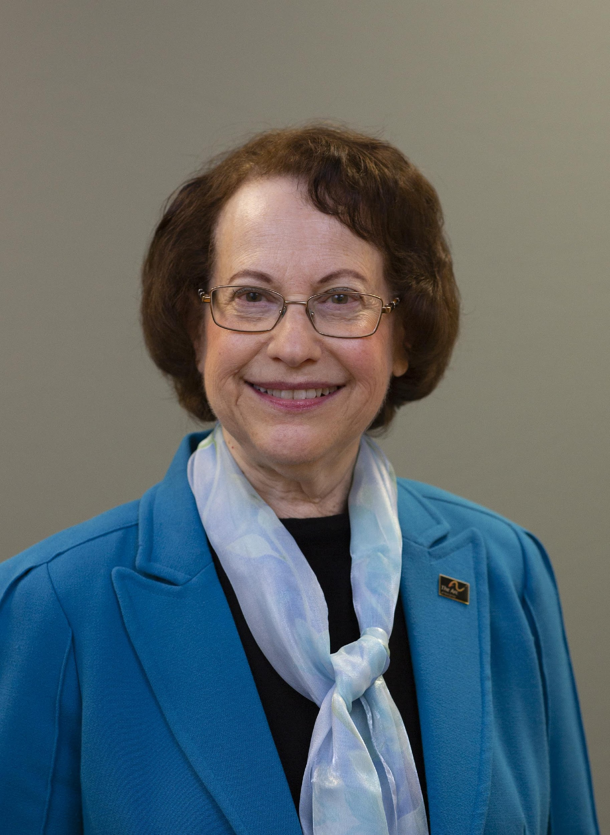
Beverly Roberts Memorial Healthcare Symposium
October 15, 2024
Thank you to our generous sponsor

Slide 2
Health Care and People with IDD: Better Care for a Better Future
Thank you to our generous sponsor

Slide 3
Navigating the Healthcare Landscape for Individuals with IDD: Challenges, Changes and Solutions
John J. Nevins DO, FAAFP
Medical Director Chatham Family Medicine
Atlantic Health System
Overlook Medical Center Family Medicine Residency Program

Slide 4
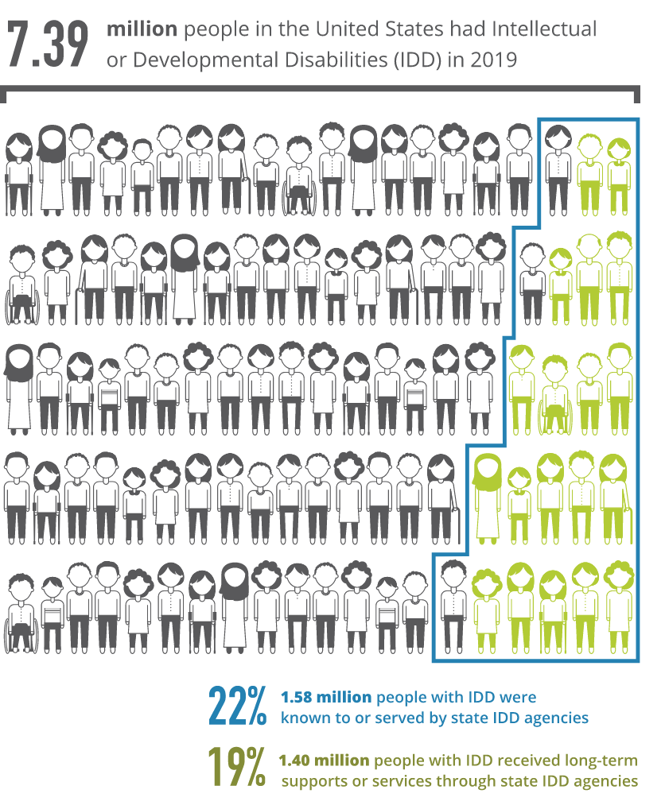
IDD Prevalence
Many say this is likely 10 to 16 million!!!

Slide 5
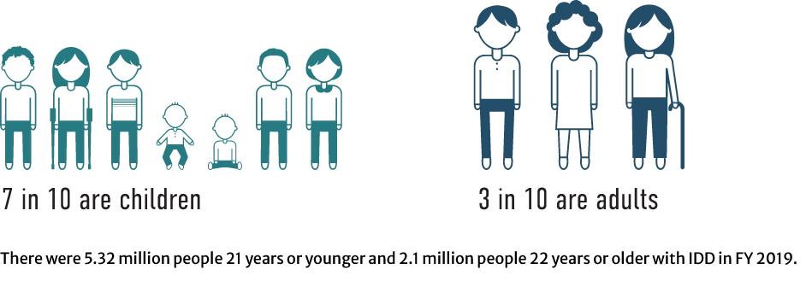
Age of People With IDD in the US Residential Information Systems Project (Minneapolis: University of Minnesota, RISP, Research and Training Center on Community Living, Institute on Community Integration. Retrieved from: https://risp.umn.edu.)
And if this is 10 to 16 million folks(and the ratios hold)……
Maybe 7-11
Maybe 3 -4.8

Slide 6
Chronic Condition Prevalence in IDD Community 201Ervin, D. E., Hennen, B., Merrick, J., & Morad, M. (4). Healthcare for Persons with Intellectual and Developmental Disability in the Community. Frontiers in Public Health, 2. https://doi.org/10.3389/fpubh.2014.00083

Slide 7
The Age-at-Death Gap Varies Widely by State Between Adults With and Without Intellectual and Developmental Disabilities
U.S. Adults With Intellectual and Developmental Disabilities Are Living Longer, But COVID Threatens to Erase Recent Gains. (n.d.). PRB. https://www.prb.org/articles/u-s-adults-with-intellectual-and-developmental-disabilities-are-living-longer-but-covid-threatens-to-erase-recent-gains/#:~:text=The%20age%2Dat%2Ddeath%20gap,in%20the%20Northeast%20or%20Midwest.

Slide 8
Health Inequity: Double Jeopardy for Non-White IDD Population
U.S. Adults With Intellectual and Developmental Disabilities Are Living Longer, But COVID Threatens to Erase Recent Gains. (n.d.). PRB. https://www.prb.org/articles/u-s-adults-with-intellectual-and-developmental-disabilities-are-living-longer-but-covid-threatens-to-erase-recent-gains/#:~:text=The%20age%2Dat%2Ddeath%20gap,in%20the%20Northeast%20or%20Midwest.

Slide 9
Healthcare needs of the IDD Community
• poorer health with higher rates of preventable mortality, co-morbidities, and chronic conditions; less access to preventative care and health promotion;
• inadequacies in mental and oral health services; preventive health screenings; and immunization updates;
• cognitive challenges in understanding, recognizing, and self-reporting/communicating health problems which affect adherence to treatment;
• financial barriers, even for the insured;
• insufficient healthcare provider incentives to ensure the health of people with IDD;
• mobility/access problems, social and attitudinal barriers, and societal misconceptions;
• lack of research about the healthcare needs of people with IDD; and,
• lack of formal training of healthcare providers, particularly around healthcare needs of adults with IDD, which results in lack of experienced providers in the community.

Slide 10
Impact of these of Healthcare Needs
In addition, in multiple surveys, over 90% of practitioners express discomfort and a lack of confidence in their ability to properly care for persons with IDD
One potential reason for this may be a paucity of research-based evidence within the medical literature that can serve as a basis for proper care
In a pre-ACA analysis of medical care cost expenditures, the primary driver of medical care costs (not including LTSS) in the population with IDD was prescription medication which was 28% higher in persons with IDD than in the general population, with the presence of secondary of chronic health conditions and poor mental health as being associated with high cost
A utilization analysis of South Carolina Medicaid recipients with IDD showed that almost 20% of their emergency visits, and 12% resultant hospitalizations, were due to issues that could have been managed in outpatient settings
Bonardi, A., Abend, S. L., & Ne’eman, A. (2024). Healthcare access and delivery for people with intellectual and developmental disability in the United States: Policy, payment, and practice considerations.
Journal of Policy and Practice in Intellectual Disabilities, 21(2). https://doi.org/10.1111/jppi.12487

Slide 12
Challenges to IDD Healthcare Funding I
The Congressional Budget Office projects that states will receive $58 billion less in federal Medicaid outlays in FY 2024 than they did in 2023. As a consequence, states report that their Medicaid spending will increase by 17.2% in FY 2024.
State revenue collections have started to slow down or decline, and some states may have to face budget gaps in the coming years. States have recently experienced an overall 2% decline in inflation adjusted revenues.
Altman, D. (2024, August 20). The shifting sands for state Medicaid programs lurking in our data | KFF. KFF. https://www.kff.org/from-drew-altman/the-shifting-sands-for-state-medicaid-programs-lurking-in-our-data/#:~:text=The%20Congressional%20Budget%20Office%20projects,decline%20in%20inflation%20adjusted%20revenues.

Slide 13
Challenges to IDD Healthcare Funding II
Role of private insurance in providing IDD care.
High costs and financial burden on families (out-of-pocket expenses, lack of comprehensive coverage).
Role of non-profits and community organizations in filling gaps (e.g., grants, local support).
Clinicians with IDD experience are uncommon, formal training is nascent-therefore ;cost -efficient care is a challenge
Pressure to include SDOH coverage through Medicaid ; further stretches clinician payment to make Medicaid participation virtually impossible for even the highest motivated clinician

Slide 15
Inconsistencies in insurance laws and regulations across public and private payers create barriers to predictable access to needed services for people with IDD, especially because their insurance coverage changes across the lifespan.
No national healthcare strategy for the IDD population
Variation in state coverage requirements for Medicaid and commercial plans disincentivize large or sustained investments by national health plans.
Policies that shift with political election cycles further disrupt long-term planning by payers and clinical organizations.

Slide 16
Innovations in Healthcare Payment
ACO
AICNY (recently acquired by Partnership Solutions(2024) was approved by CMS as a Medicare Shared Savings Program Accountable Care Organization (ACO) with approximately 350 physicians and other healthcare professionals providing care for about 6000 Medicare beneficiaries, the majority of whom were patients with IDD who are dually eligible for Medicaid and Medicare.
MSSP
Each provider led shared savings entity receives a global, monthly per-beneficiary capitation payment, adjusted for beneficiary age (child or adult), diagnostic eligibility category (BH, IDD, or dually diagnosed), Medicare eligibility (Medicaid-only or Medicare/Medicaid dual eligible), tier level, and region of the state (north or south) . True to the shared savings in the program name, the entities will retain any savings generated or absorb any losses sustained within a certain threshold, and will share in the savings or losses beyond that threshold
CMS Innovation Project PCF
Grants, State Initiatives ,Philanthropy

Slide 17
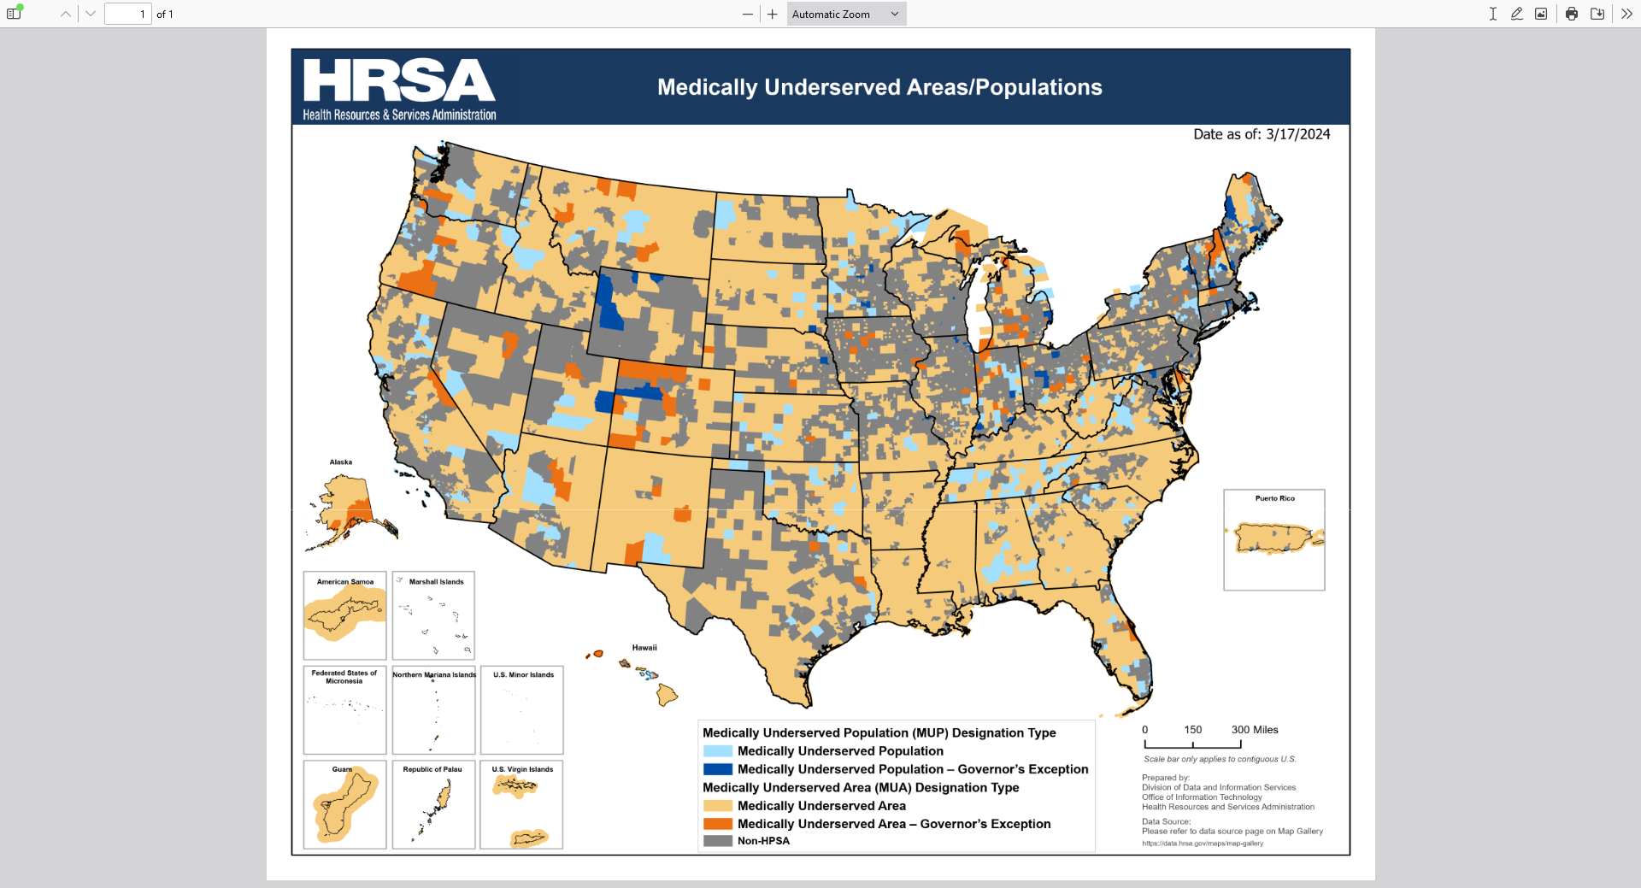
MUP-Medically Underserved Population
The IDD population meets many of the criteria found in other populations deemed “medically underserved
THERE IS NO SUCH DESIGNATION for this population
Such designation would allow the IDD population access to 34 federal programs which could address disparities in health care and access
Implications of Health Care Reform for Individuals With Disabilities ;Joe Caldwell DOI: 10.1352/1934-9556-48.3.216
Notes:
Those criteria define a medically underserved population and this is not just a descriptive-it is a legal designation that opens the door to a number of changes for a MUP

Slide 18
Evan Spivack, D.D.S.
Professor and Director
Special Care Treatment Center
Department of Pediatric Dentistry
Rutgers School of Dental Medicine
Newark, NJ
(973) 972-4242
spivacev@sdm.rutgers.edu

Slide 19
The Special Care Treatment Center
Started at UMDNJ/Rutgers SDM in 1994
Five dentists, one hygienist, support staff
Provide care to patients from all areas of NJ
Accept Medicaid/HMOs
Provide care in:
Outpatient setting
Hospital (O.R.) setting

Slide 20
Who are our patients?
Generally over age 12
Broad spectrum individuals with disabilities:
Intellectual/developmental disabilities
Psychiatric disabilities
Physical disabilities
Complex geriatrics

Slide 21
Philosophy of care
The mouth is an integral part of the body
A healthy mouth is the gateway to good overall health
Comprehensive oral care
Collaboration with other dental specialties
Collaboration with the patient’s care team
The patient
Caregivers
Medical professionals
Ancillary support professionals

Slide 22
Challenges to obtaining and maintaining dental care
PROFESSIONAL
AVAILABILITY
FINANCES
CAREGIVERS
MEDICAL AND
COGNITIVE STATUS
ANATOMY

Slide 23
Jennifer M. LeComte, DO, FAAP, FACP
Director RISN Center
Associate Professor Internal Medicine and Pediatrics
Wendy Aita, PhD
Co-Director RISN Center
Associate Professor Psychiatry and Psychology
Notes:
RECORDING
https://drive.google.com/file/d/1yQn5Kk0kMIKfVek0omarOfuC0bBR99Zm/view

Slide 24
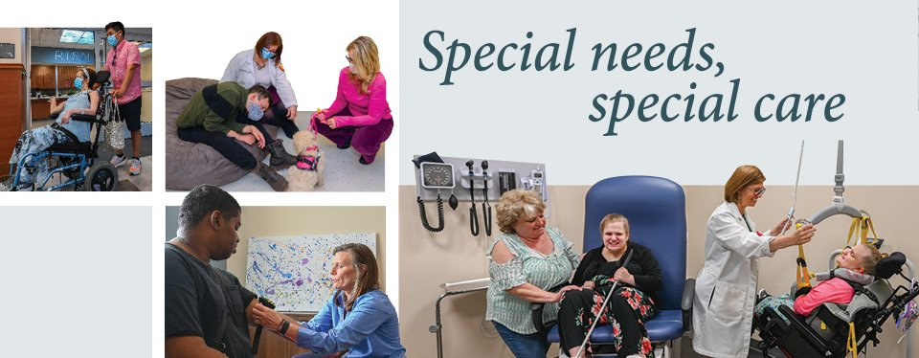
Provides South Jersey with its first special needs primary care facility with embedded behavioral health focused on care-coordination of integral services for the special needs population
Notes:
24

Slide 25
Our patients include
Patients with chronic conditions originating in childhood
Patients diagnosed with Autism
Patients that have an intellectual disability
Some may not use words to communicate
Some may have challenging behaviors
Some may have sensory challenges, fears, or trauma that make it hard to access routine medical procedures

Slide 26
The Good News…
Children with chronic health conditions are surviving into adulthood
Notes:
26
Celebrate the successes of Pediatrics
That means Young Adults with Special Health Care Needs (YASCHN) are going to be coming to your office...

Slide 27
The Bad News
People with ID experience dramatically higher rates of preventable health issues than peers without ID
4x higher preventable mortality rates
higher rates chronic conditions
3X higher rates of hospitalization
difficulty accessing care
Higher rates of preventable medical problems
MARGINALIZED
ID does NOT equal poor health!

Slide 28
FINALLY…
NIH designates people with disabilities as a population with health disparities on
Tuesday, September 26, 2023
A health disparity designation helps to encourage research specific to the health issues and unmet health needs of these populations.

Slide 29
So on a Court with TEN (10) athletes…
Four have untreated tooth decay and One - two are in need of urgent dental care
Two have never had an eye exam and four need a new prescription for glasses
Two would fail a hearing test
Two - three have low bone density even though they may look healthy
Six have problems with flexibility and Five will have problems with strength, placing them at risk for injury
Six are overweight or obese and at risk for chronic health conditions

Slide 30
Barriers to Health Care
Architectural
Medical equipment
Communication
Economic
Social policy
Attitudinal
Inadequate provider knowledge
Emotional
Behavioral

Slide 31
Recognizing Behavioral and Emotional Challenges
For individuals with Autism or IDD, fear response may look like:
Non-compliance
Aggression
Withdrawal/escape/shut down
Meltdown
Fight, flight, freeze, fawn
Behavior is communication and coping

Slide 32
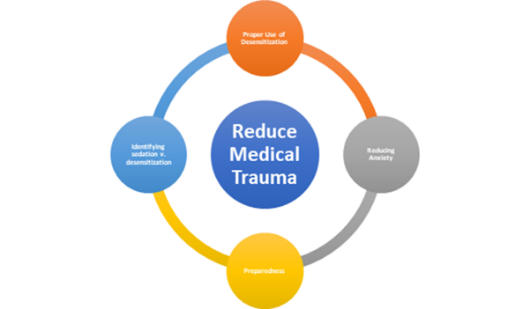
Improving Access
Patient education and preparation
Sense of control
Treat anxiety and previous trauma
Avoid medical trauma
Assess sensory issues
Provider patience
Alternate procedure

Slide 33
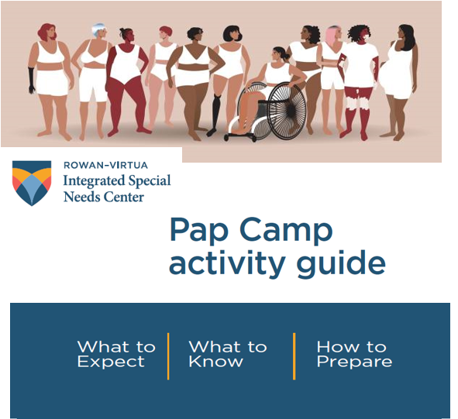
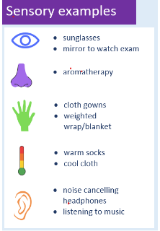
Accommodations
Timing
Choice
Reduce Fear
Distraction/comfort objects
Pain control
Start/stop signals
Sensory Accommodations

