Slide 1
Catching Up with Connor
Social Security Disability Insurance (SSDI)
Connor Griffin, MPH
Director, Health Care Advocacy Program
The Arc of New Jersey
healthcareadvocacy@arcnj.org
thearcnjhealthcareadvocacy.org

Slide 2
Social Security Disability Insurance (SSDI)
SSDI or “Disability” provides monthly payments to people who have a disability that stops or limits their ability to work
You may qualify if you have a disability or blindness and enough work history

Slide 3
Social Security Disability Insurance (SSDI)
If you have a disability or blindness and continue to work, you must remain under the earning income limit, or substantial gainful activity (SGA) threshold
In 2024, SGA is $1,550/month, or $2,590 if you’re considered blind
Generally need to have worked 5 of the past 10 years to qualify, but exceptions for individuals under the age of 24

Slide 4
Individuals with IDD
Some individuals with IDD become eligible to receive SSDI upon their own work record, while other individuals begin receiving SSDI based upon a parent's work record
When a parent retires or becomes disabled, and starts receiving Social Security benefits, the individual will need to re-apply to Social Security in order to receive SSDI
Usually amounts to 50% of the parent’s benefit
In cases where a parent passes away, the Social Security benefit is referred to as a Survivors benefit
Usually amounts to 75% of the deceased parent’s benefit

Slide 5
Disabled Adult Child (DAC)
When an individual begins receiving SSDI from a parent’s work record, the amount is often too high to receive SSI
This may result in termination of SSI and Medicaid
The person may qualify as a Section 1634 Disabled Adult Child (“DAC”)
Need to re-enroll with Medicaid as a DAC, and the monthly SSDI benefit is disregarded when considering income
Remember, Medicaid is needed for DDD!
Must remain under the Medicaid monthly resource limit of $2,000
DAC FAQs fact sheet

Slide 6
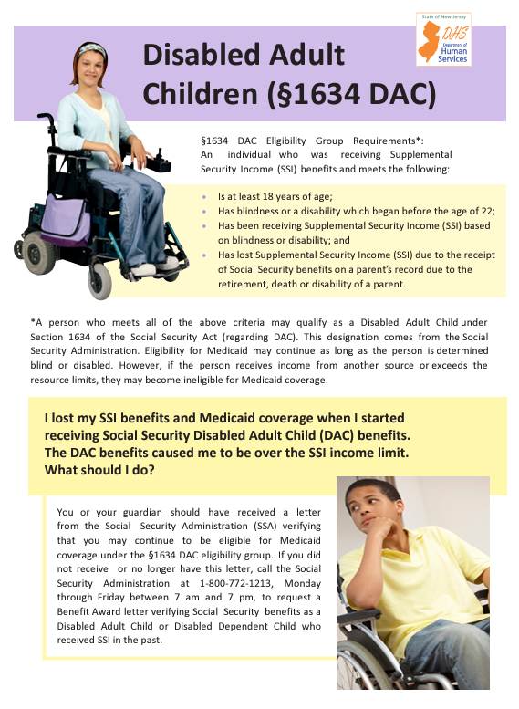
Disabled Adult Child (DAC)

Slide 7
Non-DAC
Some school-age individuals begin receiving SSDI, prior to turning 18 or being able to apply for SSI
These individuals have too much income for SSI and most Medicaid programs
But they do qualify for an exception to DDD’s Medicaid requirement, through approval via the DDD Waiver Unit
Provided the opportunity to apply for Medicaid upon turning 21 and being approved for DDD services
Non-DAC fact sheet

Slide 8
How to Apply
Online via the SSA website:
SSA.gov
Call or visit your local SSA office in person
ssa.gov/locator
Questions? You can call Social Security at 1-800-772-1213

Slide 9
More Information
The Arc of NJ Health Care Advocacy Social Security Resources
Social Security Resources
The Arc of NJ Fact sheets on DAC and Non-DAC
Fact Sheets & Flyers
The Arc of NJ Family Institute Social Security Go Bag
Social Security Go Bag
Social Security Administration Website
SSA.gov
Subscribe to our email list at arcnj.org
Scroll to to the bottom of the page and click “Health care issues” then the subscribe button.

