Slide 1
Potholes On The Road To Getting SSI
Tracey Cahn, Esq.
Risa Rohrberger, Esq.
ALL INFORMATION PROVIDED IN THIS PRESENTATION IS INTENDED FOR EDUCATIONAL PURPOSES ONLY
AND SHOULD NOT BE CONSTRUED AS LEGAL ADVICE.

Slide 2
What do I need to do before applying for SSI benefits for my young adult?
Is there any other Social Security program I should be applying for?
What forms will Social Security ask us to complete?
How should we complete them?
How should I address working/work experience?
Appealing denials
Questions

Slide 3
What do I need to do before applying for SSI benefits for my young adult?
Financial Considerations Medical/Educational/Vocational Information

Slide 4
Financial Considerations (age 18 or later) DO NOT APPLY BEFORE AGE 18

Slide 5
Resources/Assets

Slide 6
What is a countable resource?
Common resources for young adults include
savings accounts, checking accounts, stocks, bonds…
The SS website has “SSI Spotlights” giving more detailed information about Resources and many other topics.
https://www.ssa.gov/ssi/links-to-spotlights.htm
Beware: “secret” accounts, inheritances

Slide 7
Resources/Assets $2000 LIMIT for an unmarried SSI applicant

Slide 8
$2000 LIMIT
BEFORE starting application
WHILE Application is being processed
AFTER SSI Is awarded
ALWAYS-ALWAYS-ALWAYS-ALWAYS-ALWAYS
$2000
$2000
$2000

Slide 9
It is easy to lose track of the value of the resources.
Make this a priority!
Even having the total countable resources exceed $2000 for one month will have consequences.

Slide 10
What matters:
Whose NAME is on the resource.
What does not matter:
SS does not care what you intended to do with the resource.
Beware: “secret” accounts
Inheritances (after award)

Slide 11
Resource Spend-Down
DO NOT just transfer money out of the account or sell assets.
Spend-down must be for items acceptable to Social Security and purchases must be traceable.
(Keep receipts!)
“WHAT HAPPENS IF I GIVE AWAY OR SELL A RESOURCE?
If you, your spouse, or a co—owner give away a resource or sell it for less than it is worth, you may be ineligible for SSI benefits for up to 36 months. How long you are ineligible for SSI benefits depends on the value of the resource you transferred.” (From SS Website – SSI Homepage)

Slide 12
Consequences of exceeding $2000
Assessment of Overpayment and Demand to Repay
Termination of SSI benefits
Social Security could notify you YEARS later.

Slide 13
INCOME

Slide 14
ONLY the income of the Applicant (not parents)
should be considered once the Applicant turns 18.

Slide 15
After SSI is awarded,
income must be reported each month
(even if it will not cause an offset to the benefits)
Report wages
Report cash gifts
USE MYSS PORTAL – get receipt
(don’t rely on phone call)
CHECK NOTICES!
Social Security should send a notice when it changes the benefit
(reduction, increase, termination)
THERE ARE OFTEN ERRORS.
Address these quickly to avoid losing all benefits.

Slide 16
The SSI Application & the Disability Report

Slide 17
Risa has told you about the critical financial issues that you must understand before applying for Title XVI (SSI) benefits for your young adult.
I’m going to discuss the steps in filing an SSI Application.
This involves the Application & also a Disability Report.

Slide 18
Should I Do the Online Application and Disability Report Myself?
There is a new option of doing the SSI Application and Disability Report online.
However, I am not going to recommend it to you primarily because the questions are not well-written and can be easily misinterpreted. Thus, while not a perfect system, I recommend making an appointment to do the application with a Social Security representative.

Slide 19
There are various ways of getting started. You can call the national or local office to make an appointment to file the SSI application or you can now go online to make the appointment.
Whether you call for the appointment or make the appointment online, the date on which you make this request for the application appointment is critical because it establishes your child’s Protective Filing Date; if entitlement to benefits is established, SSA can go back to the date that you made the request for an application when figuring out your child’s retroactive benefits. The national number is below. I’ve also added a slide at the end of our presentation that lists more of the District Offices’ phone numbers.
The national number for an appointment at 800 772 1213.

Slide 20
Be Aware:
Social Security’s phone lines are being overwhelmed.
You may have to be on hold a long while or call multiple times before you get through.

Slide 21
New Online Tool to Make Your
SSI Appointment
Arc has added to its website a quick link to the SSA.gov website to make the appointment. If you have that handy, use that. If not, got to SSA.gov
(Please make sure that you have the correct website;
the information you will be providing is very sensitive.)

Slide 22
Once at SSA.gov, click on the word
 |  | .
That will take you to a new page
and you will click on the phrase
“Supplemental Security Income” (AKA Title XVI)

Slide 23
Next prompt - Click “Get Started”
Next prompt – Click “Next”
Next prompt, press the link for
“Privacy Act Statement” and then click “START”
From there, you will have 8 pages of short identification questions to answer.

Slide 24
To answer these questions, you will need to have
the following basic information:
The name, date of birth, and SSN of the applicant;
The applicant’s mailing address and phone number;
Your name and phone number, if assisting, and
If you check it often, I suggest giving the Agency your
email address.

Slide 25
Whatever way you use to make the appointment, it is
critical that you give the Agency a phone number that will not block their call.
Some of the mobile phones will block the Agency’s phone calls, as if it were spam. For that reason, if at all possible, have Social Security call you for the application on a landline. You could also ask for an in-person appointment, but with Covid restrictions still in place, the Agency continues prefer phone appointments.

Slide 26
In 7 to 14 business days, Social Security will send you notice of the appointment date and time by mail and email if provided.

Slide 27
What do I need at the time of the actual appointment?
If the applicant is for someone over 18, you will need the applicant there to identify themself and to give permission for you to speak on their behalf;
You will need the details of the applicant’s financial information (names of bank accounts, amounts in each account, type and amount/value of other resources like savings bonds and stocks);
and

Slide 28
3. You will also need at least the following:
Identifying information:
the applicant’s full name
date of birth
place of birth/citizenship status
Social Security number
Education Information:
The schools the applicant went to, especially important, the schools in which they received special education/accommodations.

Slide 29
Work Information:
the names and addresses of employers that your applicant worked for in 2022 and 2021
the employment period and hours worked per week
the amount they were/are paid per hour
their job title and their work duties
If there were earlier jobs, and/or self-employment, it would be good to have that information as well.

Slide 30
Medical Information:
The names of the chronic and/or recurring conditions/diagnoses that
have a negative impact on your applicant’s ability to work, and
TO THE BEST OF YOUR ABILITY,
the contact information for each doctor/healthcare provider your applicant has seen in the last few years;
the condition(s) each provider is treating and the treatment provided, including the names of medications; and
the names of and approximate dates of significant tests.

Slide 31
Vocational Services Information:
The contact information for any DVRS or DDD services your applicant has been receiving, if applicable.

Slide 32
WHAT IS THE DISABILITY ONSET DATE?
Social Security will ask for an onset date of disability.
If this is an SSI application only, please note that SSI benefits cannot be paid prior to the protected filing date.
From my perspective, I am not concerned with the date you choose, as long it is a date before the applicant turned 22 years of age, if that is accurate.

Slide 33
WHAT’S NEXT?
Once you have finished the Application and Disability report, Social Security will review the financial information you provided and make an assessment of whether your applicant meets financial eligibility for an SSI application.
If they do, the case will be moved over to DDS where a Claims Adjudicator will
be assigned. (That should take about 10 days, but it has been taking longer.)
If you do not receive any forms or other communications within a month after the application has been taken, I recommend calling the District Office and asking for status. (Again, many of the District Office phone numbers can be found on a slide attached to the end of this presentation.)

Slide 34
I’ll be back to talk about DDS forms.
Risa will now address the other programs that your applicant might qualify for.

Slide 35
Is there any other Social Security program I should be applying for? Title II (SSDI) Disabled Adult Child (DAC)

Slide 36
Title II (SSDI)
Based on applicant’s own work credits A person under 24 years of age needs only 6 credits to qualify. In 2022, earnings of $1510 equal one credit. A maximum of 4 credits can be earned every year.
$6040 annual earnings gives maximum annual credit
Amount of monthly Title II payment is based on past earnings.
Pays retroactive benefits up to 12 months prior to Application.
Can receive SSI and Title II, depending on the amount of the Title II benefit.
Assuming eligible for $604.98 in SSI
Receiving $200.00 in Title II (treated as countable income)
$404.98 from SSI
Medicare eligible (not Medicaid) -- unless also receiving SSI
No asset limit -- unless also receiving SSI or NJ Medicaid in the Aged, Blind, Disabled (ABD) category.
Need to report earnings monthly – Trial Work Period

Slide 37
DISABLED ADULT CHILD
DISABILITY ONSET DATE For SSI Application
SSI benefits are paid only as of the date of the Application/PFD.
The SS claims representatives like to use the date of the Application/PFD as the onset date because it is less work.
It is important to make sure that the SSI Application uses an onset date after age 18 and before age 22 – even if the application is made after age 22.
It is important to make sure that the Decision recognizes an onset date before age 22.
This will save time for a later DAC Application.
Available when Parent triggers an event:
Parent elects SS retirement benefits
Parent receives SS disability benefits
Parent dies
Disability must be found to have started prior to age 22
Amount of monthly benefit is 50%-75% of parent’s benefit
Retroactive benefits between 6 and 12 months, if applicable.
Considered to be a Title II benefit
(Medicare, No asset limit (unless also receiving SSI), etc.)

Slide 38
1. Information Gathering (The Application and Disability Report) 2. Development of the Claim (obtaining support: medical, educational, work) subcontracted to DDS 3. Initial Decision 4. Appeal unfavorable decisions (Initial Decision, Reconsideration Decision) 5. Hearing with Administrative Law Judge
The Application Process
FORMS
FORMS
FORMS

Slide 39
What forms will Social Security ask us to complete? How should we complete them?

Slide 40
The forms: We already discussed the Application and Disability Report – those are the major forms that start the process.
At the District Office Level (before the case is moved on to DDS and up for Medical Review), you will also be asked for an:
SSA-827 (authorization to disclose information)
this is necessary for SSA to request the applicant’s medical and educational records
possibly a couple of other authorizations for wage and employment information.
These are easy forms that require little more than a signature.

Slide 41
SSA-821 – Work Activity Report-Employee
You may also be asked to provide an SSA-821.
This is likely going to be requested if the applicant’s work has been or is significant in hours and/or pay.
An SSA-821 is generally not requested when the work
was part of an unpaid internship program.
The Work Activity Report is very important, but I will not be addressing it tonight because it does not apply to most of you. Tonight we are concentrating on what everyone needs to know. If a group would like us to come back and discuss this form in detail, that would be the better way of proceeding.

Slide 42
From District Office to DDS
Once the case is at DDS (Division of Disability Determination Services)
the case will be assigned to a CA (Claims Adjudicator).
The CA is the great gatherer of information. They will:
send requests for records to the applicant’s healthcare providers,
send requests for records to the applicant’s school, and
send the applicant and his/her “contact” forms to complete and return.

Slide 43
You will not have much control over the requests sent to third parties (doctors, schools, etc.).
You do have control over what you provide.
The forms that will certainly be sent to you and your child are:
Function Reports are 10 pages long and ask 25 questions about the applicant’s daily activities, and they are the most mystifying (annoying) of the forms Social Security sends.
The Function Report (SSA-3373) and
The Function Report Third Party (SSA-3380).

Slide 44
What makes them annoying?
Function Report questions are not tailored to any particular type of claim.
Your 18-year-old will be asked to fill out the same form given to a 50-year-old alleging problems that are vastly different from your child’s situation.
The questions are broad and repetitive.
The response time to answer is short, usually 10 days.
While the responses will likely not “win” the case,
they can easily cause the Application to fail.

Slide 45
Why are Function Report forms requested?
Isn’t the diagnosis enough?
A diagnosis alone does not mean there is a severe impairment
that entitles the applicant to SSDI or SSI benefits, and the burden of proof is on the applicant.
While the diagnosis may be very compelling, Social Security still needs to know what the actual impact of the condition is on this applicant’s ability to do work-related activities.

Slide 46
The Function Report Adult (SSA-3373)
Cardinal Rule #1
Don’t Do the Function Report for your child!
For many legitimate reasons, you will be tempted to do the Function Report for your son or daughter.
Don’t Do It!

Slide 47
WHY NOT?
For the same reason you do not do their school tests, you should not answer this questionnaire for them.
If you write out their responses, the Claims Adjudicator will have no choice but to credit your young adult with:
a vocabulary that they don’t have,
a processing speed that is not their own, and
handwriting or typing abilities that do not reflect their abilities.

Slide 48
If I should not do the form for my child,
how will the form get done?
If your child can read and write, explain to them that they need to do the form because of the SSA claim and ask them to do it to the best of their ability.
Some will take the form, answer the questions and hand it back to their parent. That applicant should sign the form. Once done, fax it or mail it to DDS. Remember to make a copy of the form for your files.

Slide 49
Many will find the form overwhelming and get through a couple of questions before getting upset.
If the form is left largely undone, explain what happened in the Remarks Section at the end of the document.
Where it asks for the name of the person completing the form, write your child’s name, and state that you wrote the Remarks, then fax it or mail it to DDS. Remember to make a copy of the form for your files.

Slide 50
If your child does ask you to sit down and assist, that’s okay.
Just make sure that the responses are theirs and
WRITE SOMETHING IN THE REMARKS SECTION EXPLAINING THE ASSISTANCE YOU GAVE AND WHY IT WAS NECESSARY.
For instance:
If you had to read the questions to the child
If the child had to do it over a course of days
If you had to write your child’s answers in the form
Where the forms asks for “Name of the person completing this form,”
write that you and your child completed the form together.

Slide 51
Please note, neatness does not count.
If your child’s handwriting is horrible,
do not make them rewrite it,
and do not write it out for them.
.

Slide 52
The Function Report Adult - Third Party Form (SSA-3380)
The Third Party Function Report is sent to an identified trusted contact of the applicant, most probably you or the child’s other parent.
In your child’s case, it will likely be the Third Party Function Report that will be the more informative report.
If you look at the two Function Report Forms side by side, you will quickly see that the forms are nearly identical. However, your answers may be vastly different from those of your child, and that is fine.

Slide 53
For instance,
while your child may have only a few words to say about their personal hygiene,
you may have a lot to say on this topic.

Slide 54
How to Answer Third Party Function Report Questions
How should you respond to the questions set out in this form?
Cardinal Rule #2
You should respond to the questions
HONESTLY,
AS IF UNDER OATH,
and
WITH KEEN INSIGHT!

Slide 55
What I find is that parents will:
Overlook problem behaviors, often because there has been some improvement over time, or
Write glowing statements about the accomplishments of their children, or
Actually, state the unvarnished truth about their child.
Please try for #3.
The goal is to accurately inform the SSA about your child’s ability to function.

Slide 56
Below are some of the Third Party Function Report questions that people often have difficulty with.
While your child’s situation is unique, I offer example answers here based on a hypothetical claimant, Danny Doe. Danny is a 20-year-old male who has a borderline FSIQ, is on the autism spectrum and has been diagnosed with generalized anxiety disorder.

Slide 57
Please note, NO MATTER WHAT I HAVE WRITTEN, your responses must be based on your child, not Danny Doe.

Slide 58
SSA-3380 page 3
Comment: This is actually a reasonably good question. There will be more specific questions later on, but your response to this one can set the tone for the reader.

Slide 59
EXAMPLE REPONSE:

Slide 60
By my answer, I am telling the Claims Adjudicator that if Danny were in a job, he would take other people off task to give him the attention he needs to accomplish his work.
That would not be tolerated in a competitive work environment.
If my responses are supported by educational or medical records, Danny’s disability case will be more likely to prevail.

Slide 61
SSA-3380 question 9
Comment: This is an unreasonable question.
If anyone were to truly answer this question in detail, they would need at least 6 pieces of paper. Social Security gives you 5 lines for your response. So, how do you answer?

Slide 62
I recommend you accept that you have only a few lines and give a general description of what your child does on a typical day, assuming they have typical days.

Slide 63
Comment: The answer I have given is as complete as you can get on this form, and it still does not fully answer the question.
Do not sweat it. The questions are repetitive; by the time you have completed the rest of the form, the Claims Adjudicator will have a good sense of your child’s daily activities.

Slide 64
SSA-3380 - QUESTION 13:
Comment: This question may seem difficult, but it isn’t.
Example response:

Slide 65
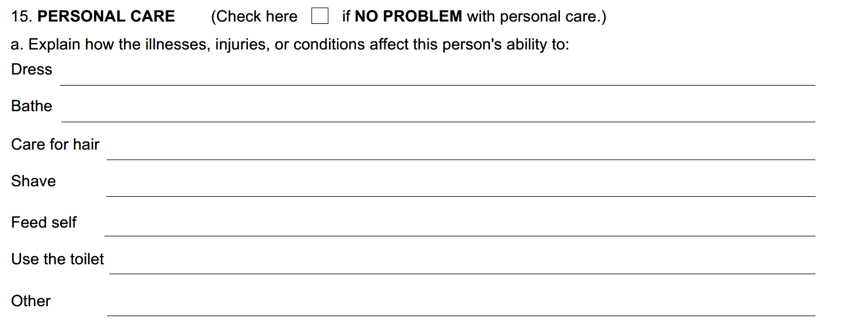

Slide 66
Observation: Instead of explaining their difficulties, a lot of people inappropriately check the “No Problem” box.
Why do they check No Problem?
For some, it just feels too personal.
I suggest you don’t take that approach.
There is a line for each type of personal care that Social Security wants you to address. Think about how your applicant does with each of the areas and write down what you know to be true.

Slide 67
Example Responses:
Dress: Danny likes to wear the same clothing several days in a row. He feels comfortable in them and he likes the smells. If the dirty clothing has been taken away, he will be confused and have a hard time figuring out what to wear.
Bathe: I get Danny to shower 3 days a week. On shower days, he needs me to stand by the bathroom door and remind him of what he needs to do. About ¹/₂ the time, I need to get him back into the shower to get the remnants of shampoo out of his hair.

Slide 68
Care for hair: It gets greasy and knotty because he doesn’t like to shampoo.
Shave: His dad shaves him because he is scared to use any kind of razor himself.
Feed Self: He can feed himself, but does not know how to handle a fork correctly.
Use the toilet: Danny is getting better about wiping himself, but at times he gets frustrated with that situation and makes a mess on himself. (Lately, that’s been happening 2-3 times a month.)
Other: He won’t brush his teeth unless someone watches him.

Slide 69
I wrote a lot here.
Your applicant may have far fewer issues than Danny Doe.
If the child has no issues with some or all of these personal hygiene issues, you need to leave those areas blank. We are not going to fabricate problems.

Slide 70
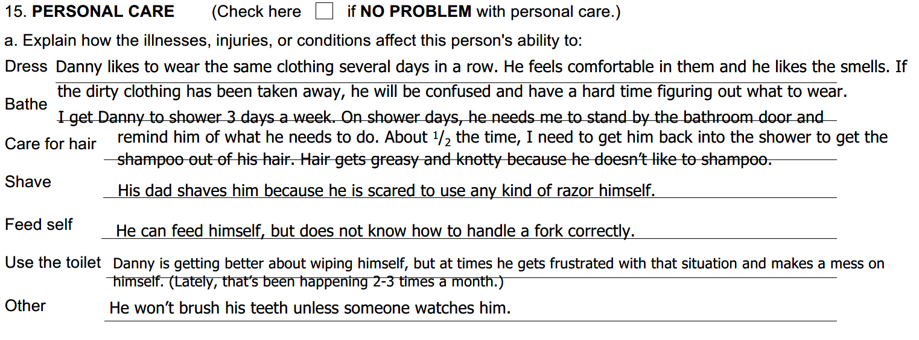
This is how my answers for the hypothetical claimant look typed out. Not neat, but readable, and it does give a lot of information about Danny’s functioning.

Slide 71
SSA-3380 - QUESTION 16: MEALS
Comment: I don’t like Yes or No questions and I don’t like the phrasing of this question.
Cardinal Rule #3
When the question does not ask for the information you want to give, answer the question as if it did.

Slide 72
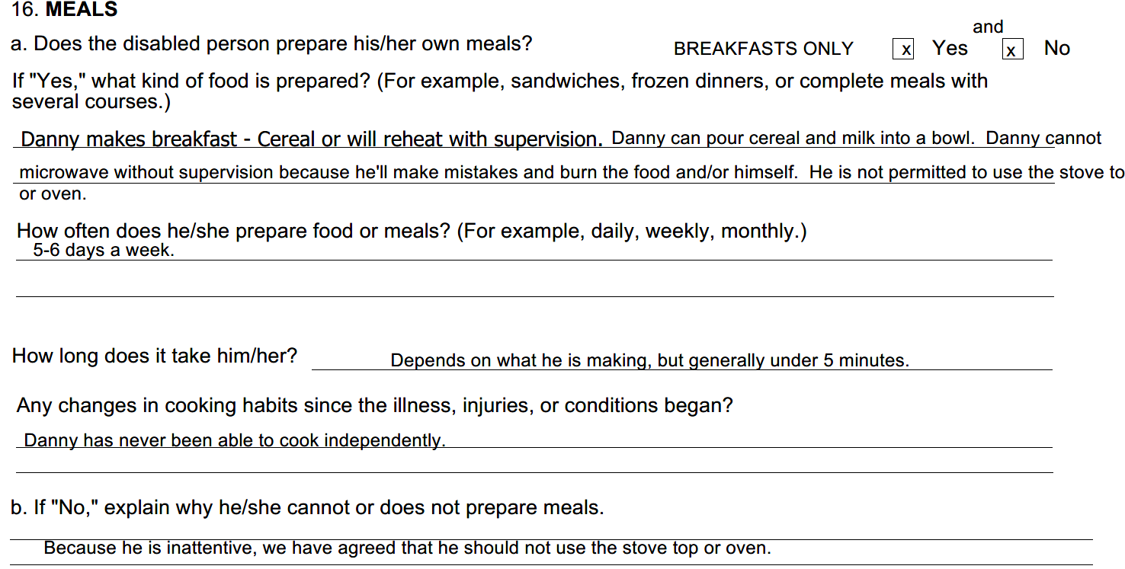

Slide 73
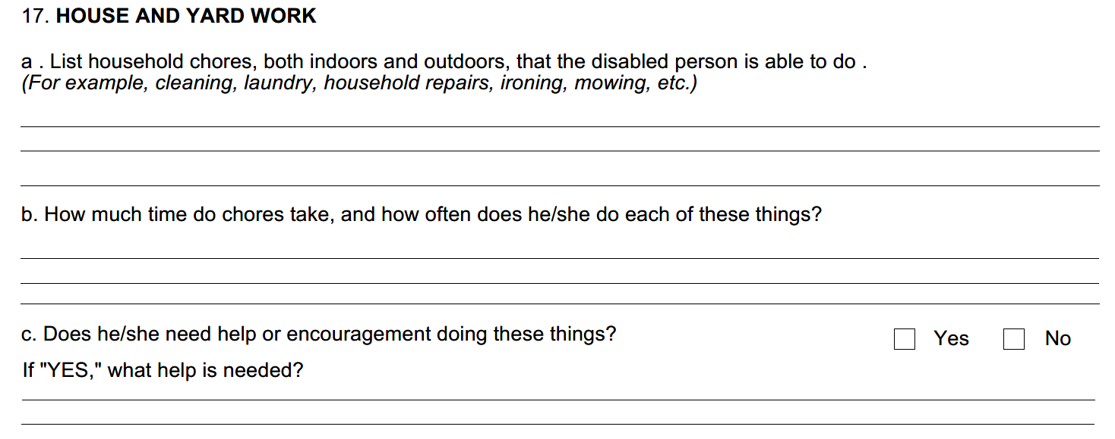
Remember Cardinal Rule #3:
When the question does not ask for the information you want to give, answer the question as if it did.

Slide 74
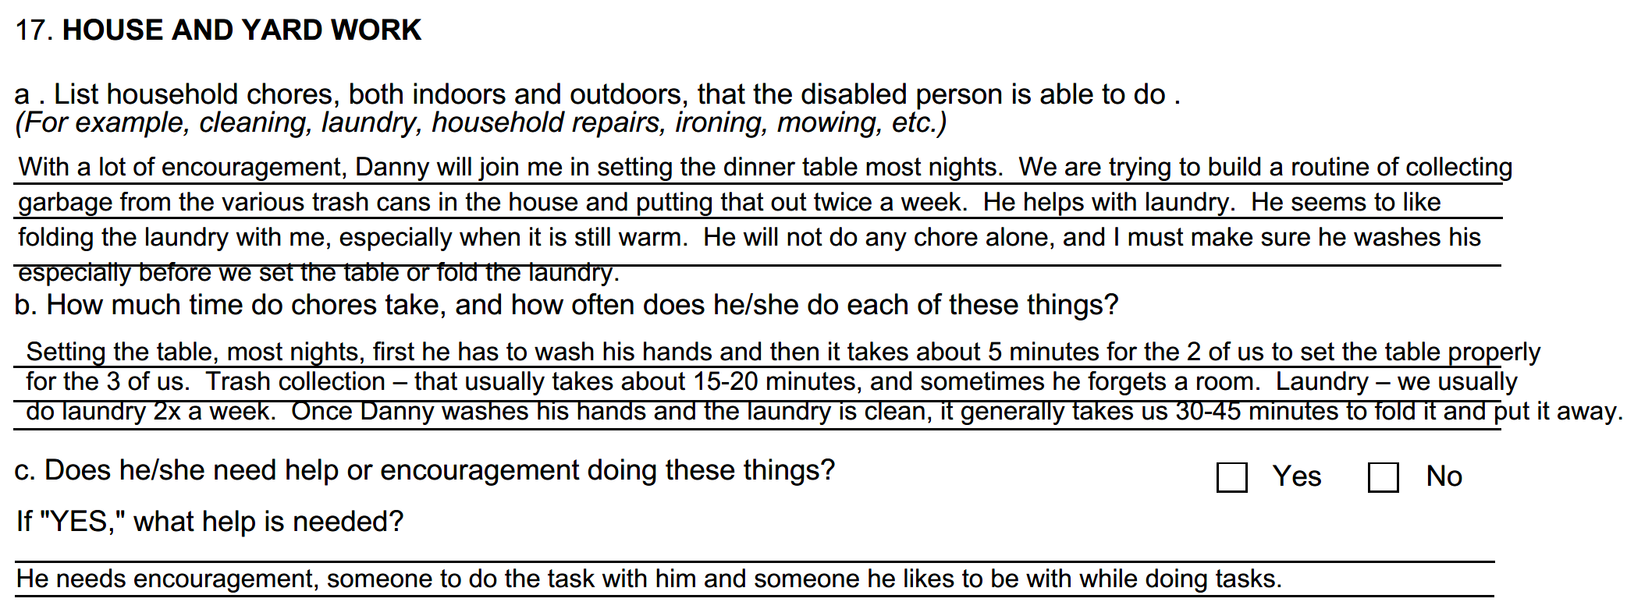
X

Slide 75
SSA-3380 - QUESTION 18:
Getting Around
a. How often does this person go outside?
Comment: The question is overly vague!
Example Response:

Slide 76
Remember Cardinal Rule #3:
When the question does not ask for the information you want to give, answer the question as if it did.

Slide 77
For Example:

Slide 78
Remember Cardinal Rule #3: When the question does not ask for the information you want to give, answer the question as if it did.
Example response:

Slide 79
Remember Cardinal Rule #3: When the question does not ask for the information you want to give, answer the question as if it did.

Slide 80
SSA-3380 - QUESTION 22d:
Question: Does this person have any problems getting along with family, friends, neighbors, or others?
Comment: Each situation is unique. If everyone is kind to your child and he gets along with everyone, that’s great. Our hypothetical Danny has issues that this question does not actually address, but we can use this space as an opportunity.
Example Response:

Slide 82
Cardinal Rule #4
While your child’s primary medical problems may be non-exertional, you need to inform SSA of all your child’s work-related limitations. So, of course you will check off and talk about the applicable non-exertational limitations, but you will also check off and talk about your child’s exertional limitations as well.
Social Security is tasked to look at the whole person, not just the primary medical impairments.
So, if your son or daughter has difficulty lifting more than 5-8 lbs., or has a problem standing for any reason, or any similar limitation, you need to tell Social Security about that as well as tell Social Security about their difficulty with following instructions.

Slide 83
The Remarks Section:
At the end of the form, you will have a page to add in your remarks.
This will give you the opportunity to further explain your applicant’s limitations.
You can also use this place to comment further on their response, or lack of response, to the First Party Function Report, or anything else you think the Claims Adjudicator should know.

Slide 84
Cardinal Rule #5
Once completed, re-read the entire report.
If it describes your child well, send it in.
If you are questioning it, try again or share it with your partner or someone else who can give you some honest feedback.
Only once you are satisfied, fax it or mail it to DDS. Remember to make a copy of the form for your files.

Slide 85
To Review – the Cardinal Rules are:

Slide 86
Cardinal Rule #1:
Don’t Do the Function Report for your child

Slide 87
Cardinal Rule #2:
Respond to the questions HONESTLY, AS IF UNDER OATH, and WITH KEEN INSIGHT.

Slide 88
Cardinal Rule #3: (The Big One!)
When the question does not ask for the information you want to give, answer the question as if it did.

Slide 89
Cardinal Rule #4:
While your child’s primary medical problems may be non-exertional, you need to inform SSA of all your child’s work-related limitations. So, of course you will check off and talk about the applicable non-exertational limitations, but you will also check off and talk about your child’s exertional limitations as well.

Slide 90
Cardinal Rule #5:
Once completed, re-read the entire report.
Only once you are satisfied that it describes your child accurately, will it be ready to send to DDS/SSA.
Remember to make a copy of the form for your files.

Slide 91
How should I address working/work experience?

Slide 92
Can working hurt the chances of an SSI award?
Income from working may affect eligibility.
Is the person’s income too high?
If an applicant is earning close to $1350 a month (2022 figure), SS considers them to be performing “substantial gainful activity” and will determine that they are not disabled unless there are exceptional circumstances.
Income can be reduced by
Impairment Related Work Expenses (Applicant, not parent, must be paying these expenses.)
Form 3033 from employer (For future discussion with Form 821)

Slide 93
Work/Work Experience can provide support for a disability claim Job exposure through school Read reports of job coach and teachers – do you think they are accurate? If yes, submit to DDS (even if school tells you that they have sent records).

Slide 94
Paid jobs
How did your child get the job? (family, friend?) Is there a job coach? Does the child need more supervision/reminders/redirection? Is/Was the child doing ALL the tasks required under the job title? Is/Was the quality of the work the same as others? Is/Was the productivity/pace the same as others? How many hours is/was the child working/ are they able to work more? (tired? angry? frustrated?) How long has the child had the job and do you have feedback from the employer? If no longer working at the job, how long did it last and why did it end?
Volunteer experience can also provide helpful information about abilities and limitations.
Working or Volunteering (if the person is capable of this) tells SS something about the person’s character.

Slide 95
Work performed after SSI award Report earnings each month Include details of Impairment Related Work Expenses (paid by your child) to reduce income deduction. To be ready for Continuing Disability Reviews, Keep written feedback from job coaches and employers Keep notes of incidents reported by your child or employer Continue with treatment or support

Slide 96
APPEAL APPEAL APPEAL

Slide 97
About 4 months after the case has gotten to DDS,
you will receive a decision.
What should you do if it is a medical denial?

Slide 98
If it is a medical denial, it will most likely include the following boilerplate statement:
“We have concluded that your physical condition is not considered
severe enough to be disabling. You have difficulty performing certain tasks
due to various mental issues.
However, you should be able to take care of your personal needs,
understand and follow simple instructions, and perform simple jobs.”

Slide 99
The kicker is the following language:
“If your condition gets worse and keeps you from working, please contact any Social Security office about filing another application.”
On another page of this 4-5 page denial, surrounded by more boilerplate language, the Notice will mention the applicant’s right to file an appeal.

Slide 100
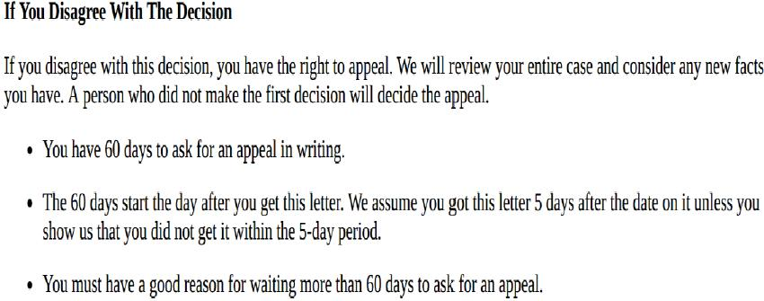

Slide 101
Risa and I have met many people who gave up when they received their first medical denial.
Why did they give up?

Slide 102
We think for many families, it just comes down to the fact that this is an ugly process.
Parents don’t like having to prove that their loved one is disabled, especially when they try so hard to be “normal” and live their best life.
Parents are tired and frustrated, and they are dealing with other pressing matters and don’t have the energy to pursue the appeal. They don’t need the benefits right now and think that they will apply again sometime in the future.
Parents feel that they have already presented a compelling claim and don’t expect that an appeal will result in a different decision.

Slide 103
If you have not retained an attorney before this point, you may want to when you need to appeal.
However, if you don’t want to involve lawyers or non-attorney advocates, you certainly can do the appeal on your own.
You can appeal on the website SSA.gov or by filling out a paper appeal and disability report. The forms will ask for your reason for appealing and there will be many questions about your child’s ongoing treatment, work and overall condition.

Slide 104
Why would you not want to hire an attorney?
I will leave that up to you, but you should know the following:
Attorneys in this field are restricted in how much they can charge;
Attorneys are only entitled to a fee if the application is successful.
The fee comes out of the applicant’s retroactive benefits, and should be sent directly to the attorney by the SSA.

Slide 105
A few other arguments for hiring an attorney early in the process:
Your attorney will be paid the same amount whether you hire them early or late in the process.
If you don’t win before you have to go before a judge, the likelihood is that the judge will push you to hire an attorney, and that can delay your case.

Slide 106
But Really,
If SSA Has Denied The Claim,
Why Appeal?

Slide 107
DDS claims adjudicators have little discretion to approve a case that is not crystal clear.
Additionally, they do not need to provide a
well-reasoned explanation for their denial.

Slide 108
After your child is denied twice,
once at the Initial level
and once at the Reconsideration Level,
your next move is to appeal and
request a Hearing before an Administrative Law Judge.

Slide 109
The ALJ will:
Look at all the evidence;
Read through any briefs and legal arguments;
Listen to testimony and the arguments at hearing;
and
Render a New Decision.

Slide 110
While the claim cannot be awarded without medical evidence, the ALJ has much more discretion in deciding a case.
Additionally, the ALJ must provide a multi-page Decision detailing the reasons for the favorable or unfavorable finding.

Slide 111
What happens if I don’t appeal
within the allotted time?

Slide 112
Can I apply again later?
Can I file a late appeal?

Slide 113
Can I apply again later?
You can file a new SSI application later BUT
Benefits will be paid only as of the date of the new application.
You cannot recover the months or years of benefits that would have been paid if the first application had been awarded.
Over time, documents that could have been helpful get lost or are not current enough.

Slide 114
Can I file a late appeal?
IT DEPENDS:
In the denial, it will state that
“you must have a good reason for waiting more than 60 days to ask for an appeal.”

Slide 115
Such reasons may be:
– I didn’t receive the denial until 4 months after it was supposedly sent;
– My house flooded;
or
– I was sick, we were overwhelmed, and I didn’t understand the process.

Slide 116
Social Security may allow you to file a little late in such cases, especially if you have proof of the extraordinary circumstances and/or provide a Certification of the facts, but there are limits, and you are asking for a favor that the SSA can deny.

Slide 117
Certainly, if you have let more than 2 years pass,
you will not be able to reopen an SSI application without first proving that SSA was at fault for the delay in appealing.
That is not a hurdle that can easily be overcome.

Slide 118
QUESTIONS
Cahn & Rohrberger, LLC
700 Godwin Avenue
Midland Park, NJ 07432
Phone: 201-932-1972
Fax: 201-932-1973
Tracey Cahn, Esq.
Tracey@CRdisabilitylaw.com
Risa Rohrberger, Esq.
Risa@CRdisabilitylaw.com
ALL INFORMATION PROVIDED IN THIS PRESENTATION IS INTENDED FOR EDUCATIONAL PURPOSES ONLY
AND SHOULD NOT BE CONSTRUED AS LEGAL ADVICE.

Slide 119
District Offices Phone and Fax Numbers
Brick District Office:
Phone: 877 405 5870, Fax: 833-950-3595
Bridgewater District Office:
Phone: 866 446 6198, Fax: 833 950 3264
Clifton District Office
Phone: 866-964-0170, Fax: 833-346-7157
East Orange District Office
Phone: 866 964 0030, Fax: 833 950 3311
Hackensack District Office
Phone: 866-964-4680, Fax: 833-950-3291
Hoboken District Office
Phone: 877 505 4547, Fax: 833-950-3268
Islin District Office
Phone: Fax: 833 950 2980
Jersey City District Office
Phone: 877-405-2884, Fax: 1-833-950-2982
Mount Laurel District Office
Phone: 866-837-5002, Fax: 833-950-3279
Neptune District Office
Phone: 877 405 0475, Fax: 833-950-3289

Slide 120
District Office Phone/Fax Continued
Newark District Office
Phone: 877 255 1507, Fax: 833-950-2690
New Brunswick District Office
Phone: 877 803 6313, Fax: 833-950-3315
Parsippany District Office
Phone: 866-331-7131, Fax: 833-950-3313
Paterson District Phone:
Phone: 888 – 397-9806, Fax: 833-950-2976
Springfield Avenue (in Newark) District Office
Phone: 877 455 7043, Fax: 833 950 3317
Toms River District Office
Phone: 877-255-1497, Fax: 833-950-2670
Union District Office
Phone: 877-803-6306, Fax: 833-950-2978

