Slide 1
What Parents Neet To Know
When Applying For
Their Adult Child’s SSA Benefits
Tracey Cahn, Esq.
Risa Rohrberger, Esq.
Cahn & Rohrberger, LLC
ALL INFORMATION PROVIDED IN THIS PRESENTATION IS INTENDED FOR EDUCATIONAL PURPOSES ONLY
AND SHOULD NOT BE CONSTRUED AS LEGAL ADVICE.

Slide 2
DO YOU REALLY WANT TO APPLY FOR SSI?
What Is Your Goal?
DDD benefits
funded through Medicaid
NJ State Medicaid is easier and faster to obtain
SSI benefits
provides federal Medicaid
provides monthly cash payment

Slide 3
SSI = Supplemental Security Income
Financial Qualifications (for an unmarried applicant)
1) countable resources $2000 or less
  *prior to application*, *during application process*,
  *after award is issued and individual is receiving SSI*
2) limited monthly income from work, investments, gifts

Slide 4
“Medical” Qualification for all SS disability programs
Unable to WORK
at a competitive job on a sustained basis
& earn the “substantial gainful activity” rate for that year
Competitive job: no unusual accommodations, no extra breaks, no extra help, acceptable level of productivity and quality …
Substantial Gainful Activity: a monthly/annual amount designated by the SSA each year.
(2024 non-blind applicant = $1550/month)

Slide 5
2 other Disability programs
DAC = Disabled Adult Child
Qualification: Disability started prior to age 22
When to Apply: when parent is receiving SS retirement, or SS disability, or is deceased
SSD = Social Security Disability
Qualification: sufficient credits under own work history
(must report on tax return)

Slide 6
TOPICS
Appealing denials
What do I need to do before applying for benefits for my Adult Child?
Applying for Benefits
What forms will Social Security ask us to complete?
How should we complete them?

Slide 7
APPEAL
APPEAL
APPEAL

Slide 8



Initial Application(s) AWARD
DENIAL
AWARD
Reconsideration Request
Hearing Request
Hearing with ALJ

Slide 9
Claims Adjudicators at the Initial and Reconsideration levels
have little discretion to approve a case that is not crystal clear.
Additionally, they do not need to provide a well-reasoned explanation
for their denial.
The Administrative Law Judge will:
Look at all the evidence;
Read through any briefs and legal arguments;
Listen to testimony and the arguments during the Hearing;
and
Render a New Decision.

Slide 10
The ALJ has much more discretion in deciding a case.
Additionally, the ALJ must provide a multi-page Decision detailing the reasons for the favorable or unfavorable finding.
So, while receiving denials from DDS may make you feel defeated, and the continued need to appeal may seem daunting, we encourage you not to give up. A Judge may come to a very different conclusion, and grant benefits.

Slide 11
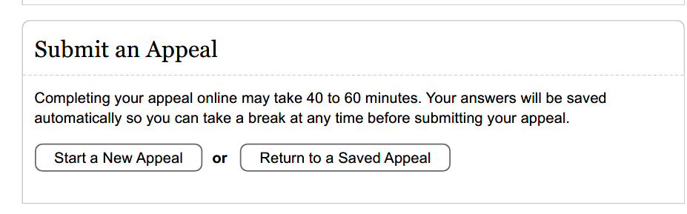
If you have not retained an attorney before this point, you may want to when you need to appeal. However, if you don’t want to involve attorneys or non-attorney advocates, you certainly can do the appeal on your own.
The easiest way to file an appeal is through the SSA website.
We prefer this option you can do it from your home computer and easily save a copy of the appeal and have proof of filing.

Slide 12
There are no tricks or special words that you need for the appeal.
Social Security will ask why you are appealing. You’ll tell them that the Claimant is disabled as a result of their Medical Determinable Impairments (MDIs). You may want to add more to your answer, but you only have two lines to respond to this question. Your answer doesn’t need to be fancy.
Most of their questions will ask for facts about healthcare providers, medications, new diagnoses, involvement with vocational program, educational programs and work attempts.
Just answer the questions to the best of your ability.

Slide 13
FILE THE APPEAL WITHIN THE ALLOTED TIME
SSI benefits are based on the date of the Application.
Payment for DAC and SSD benefits may also be affected by the date of the Application.
If you drop an appeal and later decide to apply again and are successful,
the award is going to be based on the date of that new Application.
So even if you are discouraged when you get a denial, power through the appeals so that you don’t lose out on what could be years of benefits.

Slide 14
What do I need to do before applying for SSI benefits for my Adult Child?
Financial Considerations
Medical/Educational/Vocational Information

Slide 15

Financial Considerations
DO NOT APPLY BEFORE AGE 18

Slide 16

COUNTABLE RESOURCES
$2000 LIMIT
        BEFORE starting application
        WHILE Application is being processed
        AFTER SSI Is awarded
ALWAYS-ALWAYS-ALWAYS-ALWAYS-ALWAYS
$2000
$2000
$2000

Slide 17
What is a countable resource?
Common resources include savings accounts, checking accounts, stocks, bonds…
(ABLE Accounts are not countable resources)
The SS website has “SSI Spotlights” giving more detailed information about Resources and many other topics.
https://www.ssa.gov/ssi/links-to-spotlights.htm

Slide 18
What matters:
Whose NAME is on the non-exempt resource.
What does not matter:
SS does not care what you intended to do with the resource.
Beware: “secret” accounts
Inheritances (after award)

Slide 19
Resource Spend-Down
DO NOT just transfer money out of the account or sell assets.
Spend-down must be for items acceptable to Social Security and purchases must be traceable.
(Keep receipts!) OR ABLE ACCOUNT
“WHAT HAPPENS IF I GIVE AWAY OR SELL A RESOURCE?
If you, your spouse, or a co—owner give away a resource or sell it for less than it is worth, you may be ineligible for SSI benefits for up to 36 months. How long you are ineligible for SSI benefits depends on the value of the resource you transferred.” (From SS Website – SSI Homepage)

Slide 20
It is easy to lose track of the value of the resources.
Make this a priority!
Even having the total countable resources exceed $2000 for one month will have consequences.
Overpayment and Demand to Repay
Termination of SSI benefits
Social Security could notify you YEARS later.

Slide 21
INCOME
For the Application,
ONLY the income of the Applicant (not parents)
should be considered once the Applicant turns 18.
After an Award, wages and cash gifts must be reported monthly.
Use the Social Security portal.

Slide 22
MEDICAL/EDUCATIONAL
/VOCATIONAL Considerations

Slide 23
DISABILITY
Unable to perform ANY competitive work
independently
& on a sustained basis
& earn SGA
due to a “medically determinable impairment”

Slide 24


Evidence of inability to perform SGA
School
Records
IEPs
Evaluations
PsychiatristTherapist notes
Independently obtained
Paid
Employment
Vocational
Experiences
School program
esp. job sampling
NJ DVRS
DDD
or private
Job Coach
Depending on
severity of impairments
Will need supplementing
Need detailed job description & discussion of problems
Depending on quality of counselor
Volunteer
Experiences
Vocational Assessment
Neurocognitive Assessment

Slide 25
When to Apply
Know what the school records say.
Know what the medical records say.
In most situations, it is important that the Adult Child
be under the care of medical professionals.
In many situations, it can be helpful to be participating in educational or vocational programs.

Slide 26
The Application Process
The SSI Application
& the Disability Report

Slide 27
Set up the interview:
Call the national line at 800 -772- 1213
or the local office to set up a phone appointment.

Slide 28
The interview: The Agent will call sometime,
likely within 2-4 hours of the appointment time.
Have the following prepared for the call:
1. Your Adult Child: If your Adult Child is capable, have them present to answer some of the questions.
  *Having them participate will give the Agent a sense of their abilities and limitations; also,
  *if you don’t have guardianship of your Adult Child, the Agent should ask them for permission to speak with you.

Slide 29
2. Have all the factual information quickly available for the Agent.
  Date of Birth
  SSN
  Diagnoses
  Healthcare Providers with contact information
  Schools with contact information
  Work History, if any
  Adult Child’s Bank Accounts and other Assets

Slide 30
  3. The Agent will ask for an ONSET DATE.
If this is an SSI application only, and your Adult Child has been disabled since before age 22, make sure to give the agent a date before age 22. This can make it easier if they need to apply for DDD benefits and/or Disabled Adult Child benefits later.

Slide 31
WHAT’S NEXT?
Once you have finished the Application and Disability report (medical/educational/work questions) interview with the Agent, your work is done for the time-being. Social Security will review the financial information you provided and make an assessment about whether the Applicant/your Adult Child meets the financial eligibility standards for an SSI application.
If the Adult Child is found financially eligible, the case will be moved over to DDS
(Division of Disability Determination Services) where a Claims Adjudicator will be assigned.
(That should take about 10 days.)
If you do not receive any forms or other communications within 6 weeks after the application has been taken, call the District Office for status. (Many of the NJ District Office phone numbers can be found on a slide attached to the end of this presentation.)

Slide 32
What forms will Social Security ask us to complete?
How should we complete them?

Slide 33
The Simple Forms:
SSA – 827: An authorization that allows Social Security to reach out for records from your Adult Child’s healthcare providers and teachers.
SSA-8240 – An authorization that allows Social Security to obtain wage and employment information; this would only be requested if your Adult Child has worked.
SSA will either send you the form(s) for a signature or will ask for permission while doing the phone interview.

Slide 34
From District Office to DDS
Once the case is at DDS the case will be assigned to a
Claims Adjudicator.
The CA is the great gatherer of information.
They will send requests to the healthcare providers and schools.
And, they will send you and your Adult Child Function Reports
SSA-3373 and SSA-3380

Slide 35
Function Reports are 10 pages long and ask 25 questions about the applicant’s daily activities.
They are annoying.
Why annoying?
Function Report questions are not tailored to any particular disability.
The questions are broad and repetitive.
The response time to answer is short, usually 10 days.

Slide 36
While your Function Report responses will likely not “win” the case, they can easily cause the Application to fail.
Having worked in this field for all these years, I have 5 rules that I ask you to follow when you receive these forms.

Slide 37
Function Report - Rules to follow:
Rule #1: Don’t Do the 1st Party Function Report for your Adult Child.
For the 3rd party function report: - The one you will fill out -
Rule #2:, remain patient, respond to the questions HONESTLY, AS IF UNDER OATH, and WITH KEEN INSIGHT.
Rule #3: When the question does not ask for the information you want to give, answer the question as if it did.
Rule #4: Make sure you inform the reader of all your Adult Child’s work-related limitations, the non-exertional and the exertional ones.
Rule #5: Once completed, re-read the entire report. Only once you are satisfied that it describes your Adult Child accurately, will it be ready to send to the CA. Remember to make copies of all forms you submit and keep them for your files.

Slide 38
The Function Report Adult (SSA-3373)
Rule #1
Don’t Do the Function Report for your Adult Child!
For many legitimate reasons, you will be tempted to do the Function Report for your son or daughter.
Don’t Do It!

Slide 39
If you do it for them, the Claims Adjudicator will have no choice but to credit your Adult Child with:
a vocabulary that they don’t have,
a processing speed that is not their own, and
handwriting or typing abilities that do not reflect their abilities.

Slide 40
If your Adult Child can read and write, explain to them that they need to do the form because of the SSA claim and ask them to do it to the best of their ability.
Some will have no trouble with that. They’ll take the form, answer the questions, sign it and be done with it.

Slide 41
More likely, your Adult Child will find the form overwhelming and get through a couple of questions before getting upset.
If the form is left largely undone, you should explain your child’s experience with the form in the Remarks Section at the end of the document, and return it to the Claims Adjudicator as is.

Slide 42
If your Adult Child does ask you to sit down and assist, that’s okay.
Just make sure that the responses are theirs and WRITE ABOUT THE ASSISTANCE YOU GAVE AND WHY IT WAS NECESSARY IN THE REMARKS SECTION.
For instance:
If you had to read the questions to the Adult Child
If the Adult Child had to do it over a course of days
If you had to write your Adult Child’s answers in the form
If you had to do any of this, or provide any other assistance, make sure you share the help you had to give your child with the Claims Adjudicator.
Where the forms asks for “Name of the person completing this form,” write that you and your Adult Child completed the form together, make a copy of the form and then return it to the CA.

Slide 43
Please remember, neatness does not count.
If your Adult Child’s handwriting is horrible,
do not make them rewrite the form,
and do not write it out for them.
That goes for bad spelling too. Just leave it alone.
.

Slide 44
The Function Report Adult - Third Party Form (SSA-3380)
The Third Party Function Report is sent to an identified trusted contact of the applicant.
In your Adult Child’s case, it will likely be the Third Party Function Report that will be the more detailed account.
The Function Report and Third Party Function Report are nearly identical. However, your answers may be vastly different from those of your Adult Child, and that is fine.

Slide 45
How to Answer Third Party Function Report Questions – Remember the previously mentioned rules.
Rule #2
Answer HONESTLY,
AS IF UNDER OATH,
and
WITH KEEN INSIGHT!
The goal is to accurately inform the SSA about your Adult Child’s ability to function.

Slide 46
Below are some of the Third Party Function Report questions that people often have difficulty with.
While your Adult Child’s situation is unique, I am offering some example answers based on a hypothetical claimant, Danny Doe. Danny is a 20-year-old male who has a borderline FSIQ, is on the autism spectrum and has been diagnosed with generalized anxiety disorder.
Please note, NO MATTER WHAT I HAVE WRITTEN, your responses must be based on your Adult Child, not Danny Doe.

Slide 47
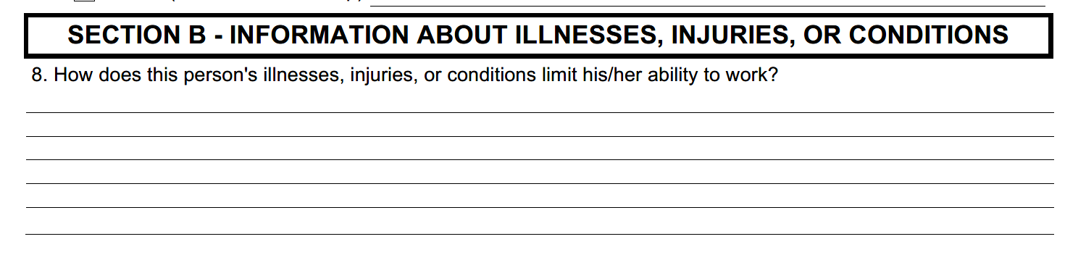
SSA-3380 page 3
Comment: This is actually a reasonably good question. There will be more specific questions later on, but your response to this one can set the tone for the reader.

Slide 48
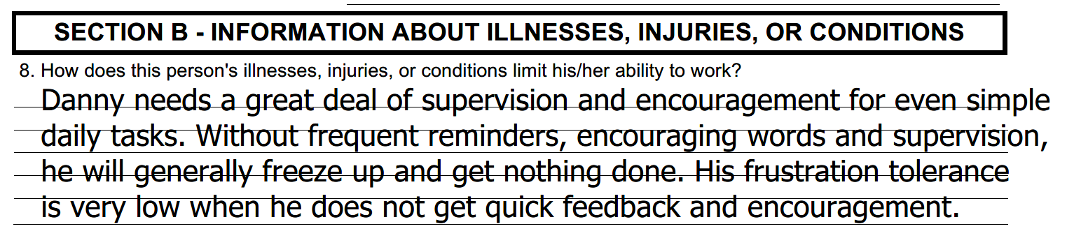
EXAMPLE REPONSE:

Slide 49
With this answer, I am telling the Claims Adjudicator that if Danny were in a job, he would take other workers off task to give him the attention he needs to accomplish his work.
That would not be tolerated in a competitive work environment.
If my responses are supported by educational and/or medical records, Danny’s disability case will be more likely to prevail.

Slide 50
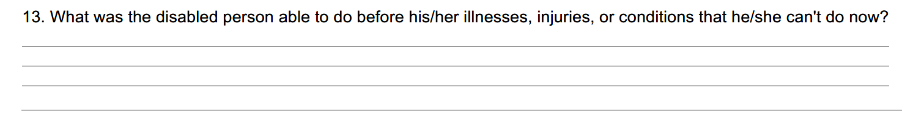
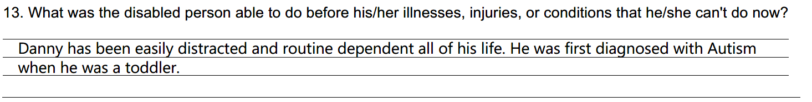
SSA-3380 - QUESTION 13:
Comment: This question may seem difficult, but it isn’t.
Example response:

Slide 51
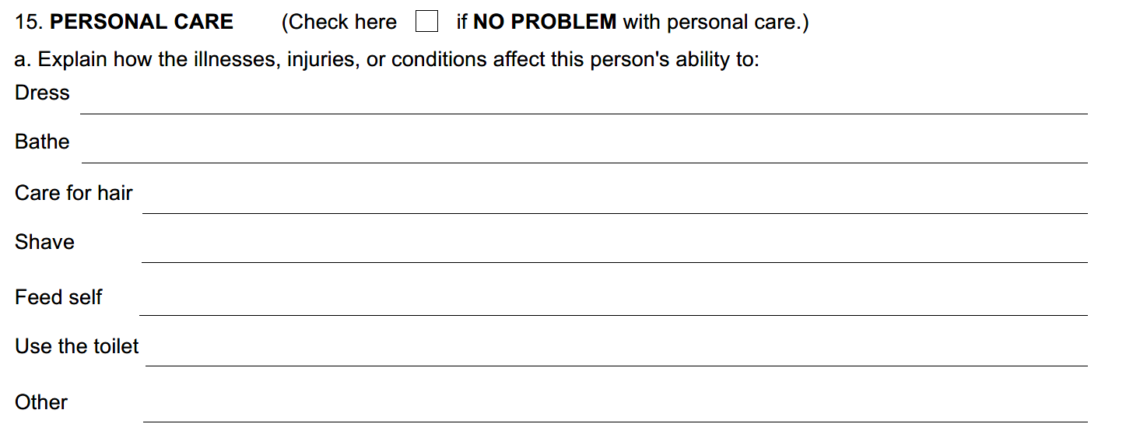

Slide 52
Example Responses:
Dress: Danny likes to wear the same clothing several days in a row. He feels comfortable in them and he likes the smells. If the dirty clothing has been taken away, he will be confused and have a hard time figuring out what to wear.
Bathe: I get Danny to shower 3 days a week. On shower days, he needs me to stand by the bathroom door and remind him of what he needs to do. About ¹/₂ the time, I need to get him back into the shower to get the remnants of shampoo out of his hair.

Slide 53
Care for hair: It gets greasy and knotty because he doesn’t like to shampoo.
Shave: His dad shaves him because he is scared to use any kind of razor himself.
Feed Self: He can feed himself, but does not know how to handle a fork correctly.
Use the toilet: Danny is getting better about wiping himself, but at times he gets frustrated with that situation and makes a mess on himself. (Lately, that’s been happening 2-3 times a month.)
Other: He won’t brush his teeth unless someone watches him.

Slide 54
I wrote a lot here.
Your Adult Child may have far fewer issues than Danny Doe.
If the Adult Child has no issues with some or all of these personal hygiene issues, you need to leave those areas blank.

Slide 55
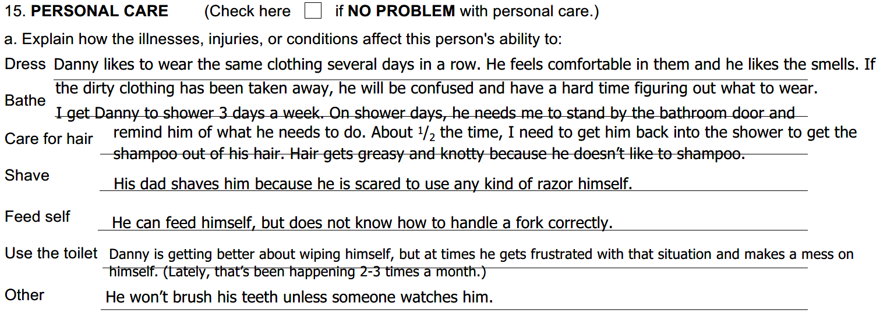
This is how my answers for the hypothetical claimant look typed out. Not neat, but readable, and it does give a lot of information about Danny’s functioning.

Slide 56
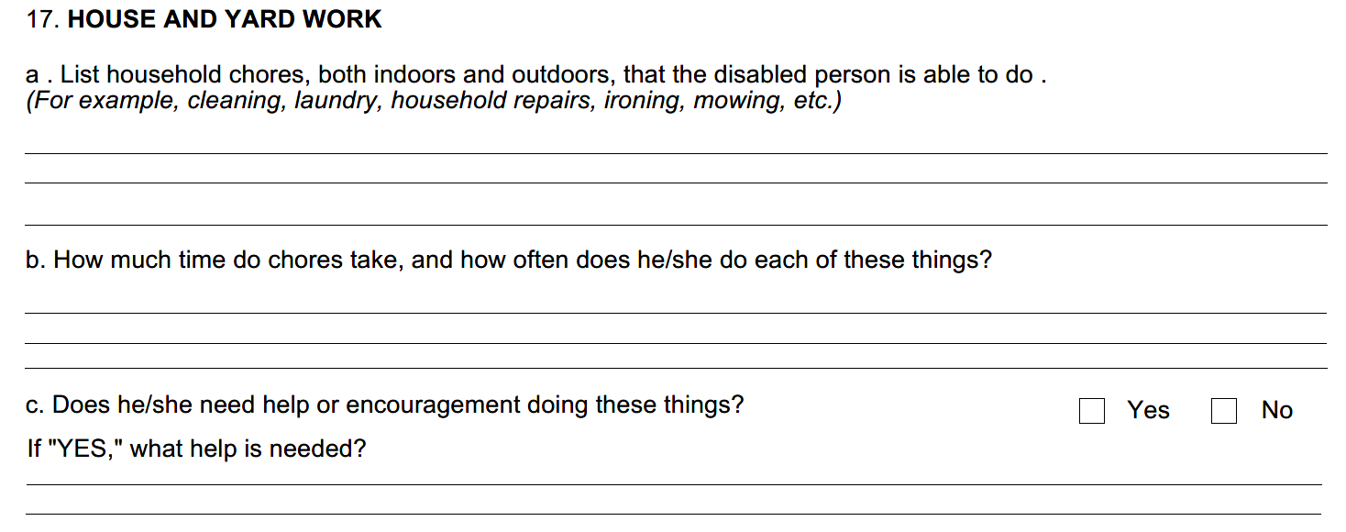
Remember Rule #3:
When the question does not ask for the information you want to give, answer the question as if it did.

Slide 57
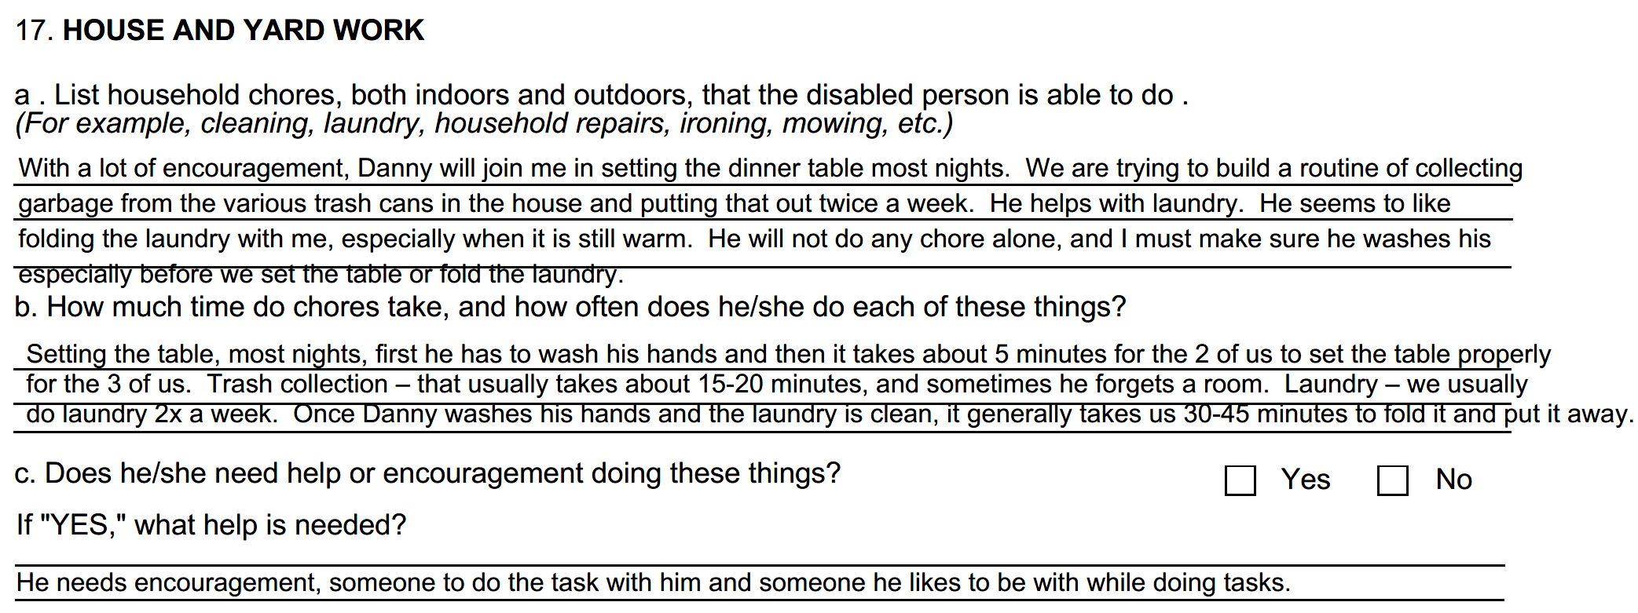
hands
X

Slide 58
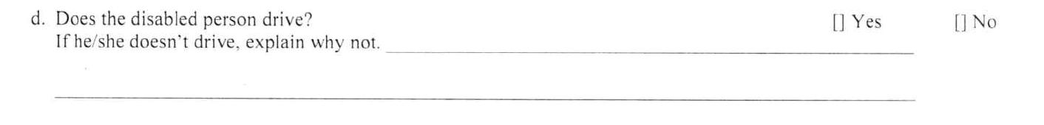
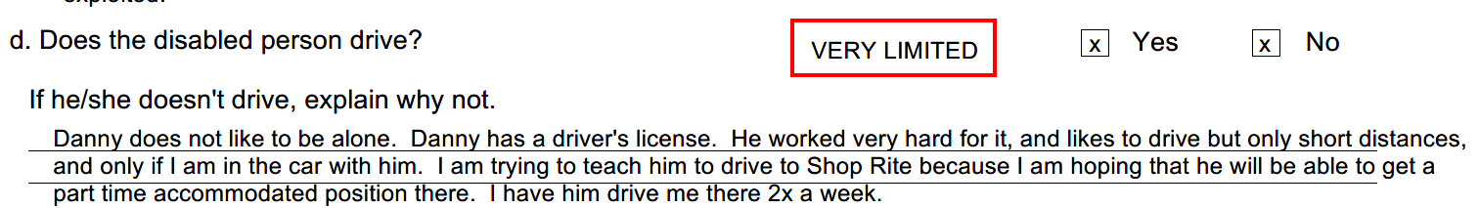
If I were to answer this question as it is written, my answer would be Yes, and that’s it. Little to no relevant information would have been conveyed. So, I ask that you use Rule #3: When the question does not ask for the information you want to give, answer the question as if it did.

Slide 59
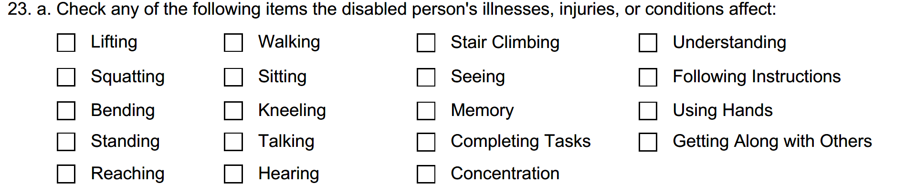

Slide 60
Rule #4
Rule #4: Make sure you inform the reader of all your Adult Child’s work-related limitations, the non-exertional and the exertional ones.
Social Security is tasked to look at the whole person, not just the primary medical impairments. So don’t hold back on any of it.

Slide 61
The Remarks Section:
At the end of the form, you will have a page to add in your remarks.
This will give you the opportunity to further explain your Adult Child’s limitations.
You can also use this page to comment further on your Adult Child’s response, or lack of response, to the First Party Function Report, and/or
provide any other relevant facts the Claims Adjudicator should know.

Slide 62
Rule #5
Once completed, re-read the entire report.
If it describes your Adult Child well, send it in.
If you are questioning it, try again or share it with someone who can give you some honest feedback.
Only once you are satisfied, fax it or mail it to the Claims Adjudicator (CA). Remember to make a copy of both the completed SSA-3373 and the completed SSA-3380 forms for your files.

Slide 63
Public Service Announcement
CAREGIVERS
Protect Your Own Disability Eligibility
“SSDI” “Regular” “Title II” Disability is available to people who have sufficient CURRENT work credits.
When you work (and pay taxes), you get SS retirement credits and SS disability credits.
Retirement credits do not expire.
Disability credits expire.
Generally, an applicant must have earned 20 quarters of credit in the last 40 quarters before becoming disabled to qualify for a SSDI application.
Stepping away from a paying job to take care of someone else (Adult Child, elderly parent,
spouse) puts YOU at risk for not being eligible to apply for Social Security Disability and may
Even impact retirement benefits later. It isn’t easy, but try to protect yourself too.

Slide 64
Credits are earned by working & paying taxes on your gross wage income.
You can earn up to 4 credits in 1 year.
In 2024, 1 credit = $1730 gross
4 credits = $6920 gross
Even if you can’t earn all 4 credits, every credit that you do earn could make a difference.
Sufficient credits ensure your eligibility.
How much you earn determines the amount of your cash benefits.

Slide 65
Cahn & Rohrberger, LLC
700 Godwin Avenue
Midland Park, NJ 07432
Phone: 201-932-1972
Fax: 201-932-1973
Tracey Cahn, Esq.
Tracey@CRdisabilitylaw.com
Risa Rohrberger, Esq.
Risa@CRdisabilitylaw.com
ALL INFORMATION PROVIDED IN THIS PRESENTATION IS INTENDED FOR EDUCATIONAL PURPOSES ONLY
AND SHOULD NOT BE CONSTRUED AS LEGAL ADVICE.

Slide 66
District Offices Phone and Fax Numbers
Brick District Office:
Phone: 877 405 5870, Fax: 833-950-3595
Bridgeton District Office
Phone: 866 837 1235, Fax: 833 950 2990
Bridgewater District Office:
Phone: 866 446 6198, Fax: 833 950 3264
Clifton District Office
Phone: 866-964-0170, Fax: 833-346-7157
East Orange District Office
Phone: 866 964 0030, Fax: 833 950 3311
Egg Harbor District Office
Phone: 877 714 0394, Fax 833 950 2986
Hackensack District Office
Phone: 866-964-4680, Fax: 833-950-3291
Hoboken District Office
Phone: 877 505 4547, Fax: 833-950-3268
Jersey City District Office
Phone: 877-405-2884, Fax: 1-833-950-2982
Mount Laurel District Office
Phone: 866-837-5002, Fax: 833-950-3279
Newton District Office
Phone: 877 575 5189, Fax: 833 950 3283
Neptune District Office
Phone: 877 405 0475, Fax: 833-950-3289

Slide 67
District Office Phone/Fax Continued
Newark District Office
Phone: 877 255 1507, Fax: 833-950-2690
Newton District Office
Phone: 877-575-5189, Fax:833-950-3283
New Brunswick District Office
Phone: 877 803 6313, Fax: 833-950-3315
Parsippany District Office
Phone: 866-331-7131, Fax: 833-950-3313
Paterson District Phone:
Phone: 888 – 397-9806, Fax: 833-950-2976
Springfield Avenue (in Newark) District Office
Phone: 877 455 7043, Fax: 833 950 3317
Toms River District Office
Phone: 877-255-1497, Fax: 833-950-2670
Woodbridge (formerly Iselin) District Office
Phone: 877 600 2852 Fax: 833 950 2980
Union District Office
Phone: 877-803-6306, Fax: 833-950-2978

