Slide 1
SSI and Medicaid for Individuals with Intellectual and Developmental Disabilities
Connor Griffin, Director, Health Care Advocacy
Céline Fortin, Associate Executive Director
The Arc of New Jersey

Slide 2
The Arc of NJ is the State’s leading advocacy and service organization for children and adults with intellectual and developmental disabilities (IDD) and their families.
The Arc consists of a State office, 20 Local County Chapters and a National office in Washington, DC.
The Arc of NJ is primarily an advocacy organization, conducting public policy work, community outreach and information and referral.
The Arc of NJ also runs several programs including:
  Project HIRE
  Planning for Adult Life
  The NJ Self-Advocacy Project
  The Criminal Justice Advocacy Program
  The Arc of NJ Family Institute
  Health Care Advocacy
  Training & Consultation Services
  NJ Camp Jaycee
  Children’s Advocacy
Sign up for our email list at www.arcnj.org

Slide 3
DDD – NJ Division of Developmental Disabilities
DHS – NJ Department of Human Services
IDD – intellectual and developmental disabilities
SSA – Social Security Administration
SSDI – Social Security Disability Income (based on work history)
SSI – Supplemental Security Income (not based on work history)

Slide 4
IMPORTANT: Continuation of Parent’s
Private Health Insurance AFTER age 26
All young adults can stay on parent’s health insurance until age 26.
BEFORE child’s 26th birthday – parent requests a form from employer’s Human Resources Dept.
Special process for young adults with disabilities who are not capable of self-sustaining employment to stay on parent’s employer’s health insurance – for as long as parent has the health insurance.
Can have private health insurance and Medicaid. Medicaid is always payer of last resort.
The Arc of NJ’s fact sheet on private insurance.

Slide 5
Why do we focus on applying for Medicaid?
Because Medicaid is a critical benefit for individuals with disabilities to access services and supports.

Slide 6
To Receive Division of Developmental Disabilities (DDD) Services at Age 21
Must be functionally eligible for DDD services and
must have Medicaid.
Best way to have Medicaid: Apply for
Supplemental Security Income (SSI) at age 18.
Everyone who receives SSI will also get Medicaid.
  SSI is the cash benefit. Medicaid is the health insurance benefit and the gateway to DDD services.

Slide 7
Rule #1 – Age Matters!
When the individual with a disability is under
18 years old, determination for
Supplemental Security Income (SSI)
is based on the family income.
When the individual is over 18, the determination is based
on the individual’s income.
Apply as soon as possible after the individual’s 18th birthday.

Slide 8
Rule #2 – Money Matters!
If the individual has “too much” they won’t be eligible.
Person with a disability can’t have more than $2,000 in his/her name (assets). This includes anything with that person’s Social Security number.
Spend-down” if amount over $2,000 is small. Can document for spend-down: summer camp; class trip; therapies not covered by insurance.
  No spend-down on food, clothing, shelter – these are considered the parent’s responsibilities.
Income can be earned or unearned – there are also some issues if someone has too much income (we’ll talk about this later!)

Slide 9
If applicable, consider a Special Needs Trust (SNT). Hire a professional who specializes in SNT!
Set up an ABLE Account (Achieving a Better Life Experience)
  Persons with disabilities can deposit up to $18,000/year in an ABLE tax-exempt savings account.
  Age of onset of disability must be before age 26
  Must be receiving SSI or SSDI; or with medical documentation, someone can deposit money into ABLE as spend-down before applying for SSI.
  ABLE accounts won't affect continuing financial eligibility for SSI, Medicaid and other public benefits, until the account reaches $100,000.
  If the individual works, they may be able to deposit more than $18,000 a year.

Slide 10
  ABLE accounts are available in NJ.
  The individual can open an ABLE account in this state or another state. https://savewithable.com/nj/home.html
  Visit the ABLE National Resource Center website www.ablenrc.org, for state-specific information. Great website with educational webinars and state-by-state comparisons.

Slide 11
Applying for SSI or Medicaid
if parents are divorced
When parents are divorced, child support is viewed as the child’s “unearned income”.
Depending upon the amount of child support, adolescent may not be eligible for SSI or Medicaid, but there is a 1/3 exclusion of child support income.
  Example: if child receives $1,000/month in child support, only $666 would be counted by Medicaid as “unearned income.”

Slide 12
Rule #3 – Be prepared!
As you are getting ready to complete the application, start collecting:
Evaluations and assessments
Schools: Name, address, IEPs and Progress Reports
Disabilities: names of conditions/diagnoses; onset date
Doctors and therapists: Name, address, phone, dates first and last seen, specialty, diagnosis
Medications: Name, prescribing physician, date and dosage when started as well as most recent date and dosage
Employment: Name, address, phone, supervisor name, position held, date and pay when started, last date of work and pay
Division of Vocational Rehabilitation Services information
Put together a file or binder as well as creating electronic files, if possible.

Slide 13
Start thinking about the questions.
What is the individual’s disability?
How does it affect the individual?
What is keeping them from working?
Can they complete tasks and activities independently?
What does a typical day look like?
What steps have been tried previously to work? What happened?

Slide 14
Be prepared to talk about the individual’s disability.
Decide who is the best person to be “in charge”.
Consider how you will answer questions about the individual’s disability, including when you are discussing their disability with them present.
Prepare the individual to talk about their disability.
Let them know they will be asked questions, when appropriate.
Help them to describe how they feel or how their disability affects their daily life.
Help them to feel as comfortable as possible.
A diagnosis alone does not mean there is a severe impairment that entitles the applicant to SSDI or SSI benefits, and the burden of proof is on the applicant.
While the diagnosis may be very compelling, Social Security still needs to know what the actual impact of the condition is on this applicant’s ability to do work-related activities.

Slide 15
Ready to apply?
Information on applying for SSI: www.ssa.gov/ssi/text-apply-ussi.htm
Can start the disability application process online, as long as this is a first time SSI application.
Call Social Security at 1-800-772-1213 to make appointment to apply for SSI benefits for son/daughter with IDD. With appointment, can apply for SSI on the phone or in person at local Social Security office.
Notes:
Have everything ready – employment information, doctors information, dates, prescriptions, etc.

Slide 16
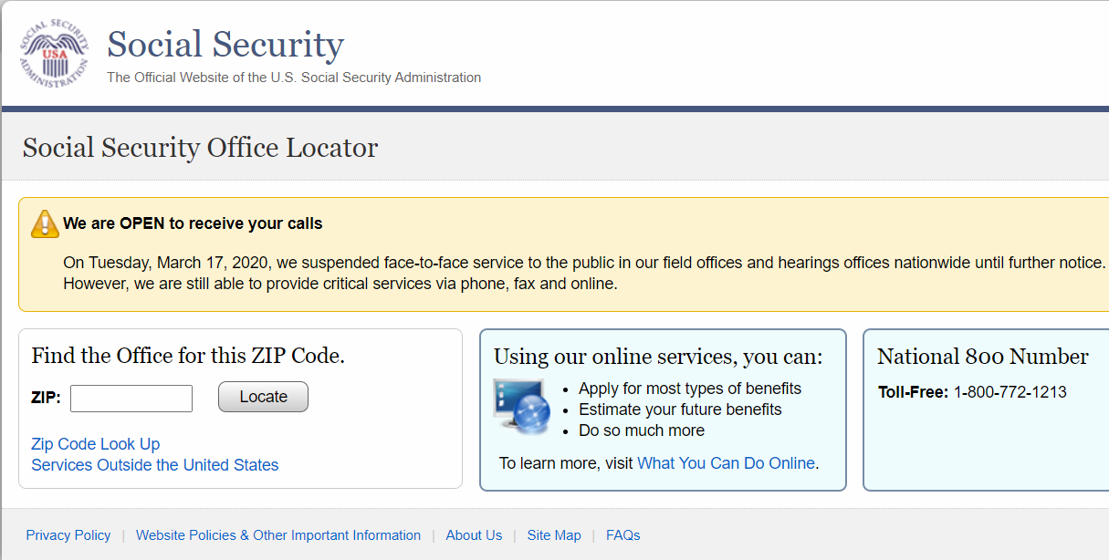
http://Secure.ssa.gov/ICON/main.jsp

Slide 17
Keep in mind that if you do the application online, you can always stop, save it and go back to it later. This is very helpful if you find yourself getting distracted or tired.
Remember – if you begin to answer questions just to “get them over with”, it’s time to stop and take a break.

Slide 18
Once you have finished the Application and Disability report, Social Security will review the financial information you provided and make an assessment of whether your applicant meets financial eligibility for an SSI application.
If they do, the case will be moved over to DDS where a Claims Adjudicator will be assigned for the medical review. (That should take about 10 days, but it has been taking longer.)
If you do not receive any forms or other communications within a month after the application has been taken, call the District Office and ask for a status report.

Slide 19
Functional Reports
Don’t do the Function Report Adult for your child (SSA-3373)
  Let your child do whatever they can. If you help in any way, be sure to note that in the comments section.
Complete the Third Party Function Report (SSA-3380)
  Answer honestly and with insight
  When the question does not ask for the information you want to give, answer it as if it does
  Once completed, re-read the entire report
  If you think it is lacking anything, ask someone who knows your child well to read it
  Make a copy, paper and scanned, before mailing
  Mail receipt requested

Slide 20
How does the person’s illnesses, injuries or conditions limit his/her ability to work?
Joe needs a great deal of supervision and encouragement for even simple daily tasks. Without frequent reminders, constant prompting and supervision, he can not complete tasks. His frustration tolerance is very low and is easily overwhelmed and upset. This leads to him to refuse to continue to try to complete tasks.

Slide 21
Describe what the disabled person does from the time he/she wakes up until going to bed.
Marie wakes up around 7 am but needs prompting to get up. If clothing from the day before are in her room, she will just put those clothes back on. She can make a bowl of cereal with supervision but needs prompting to eat in time to be ready for the van. She goes to a day program and returns at 4. She will have a snack and watch TV. Marie can set the table with prompts. After dinner she may listen to the radio or watch TV until bedtime at 10. She will not change into pajamas unless told to do so.

Slide 22
What was the disabled person able to do before his/her illness, injuries or conditions that he/she can’t do now?
Michael was diagnosed with autism as a toddler. He has been routine dependent and easily distracted and upset all of his life. He has always needed supervision and prompting to complete even the basic everyday tasks.

Slide 23
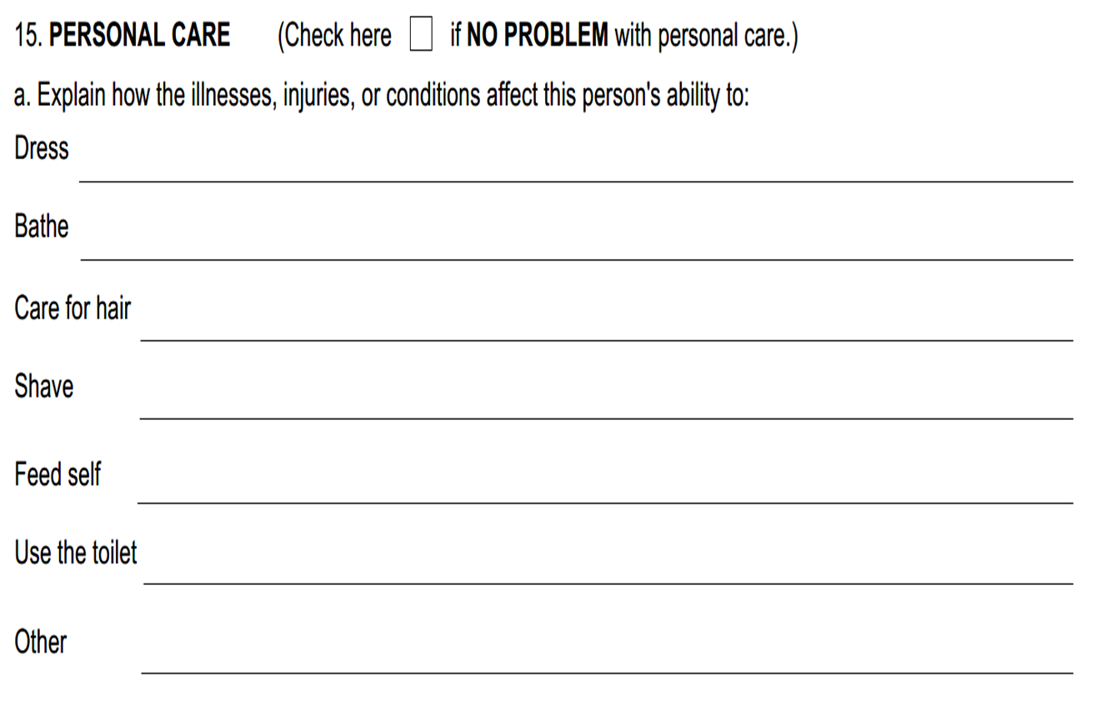

Slide 24
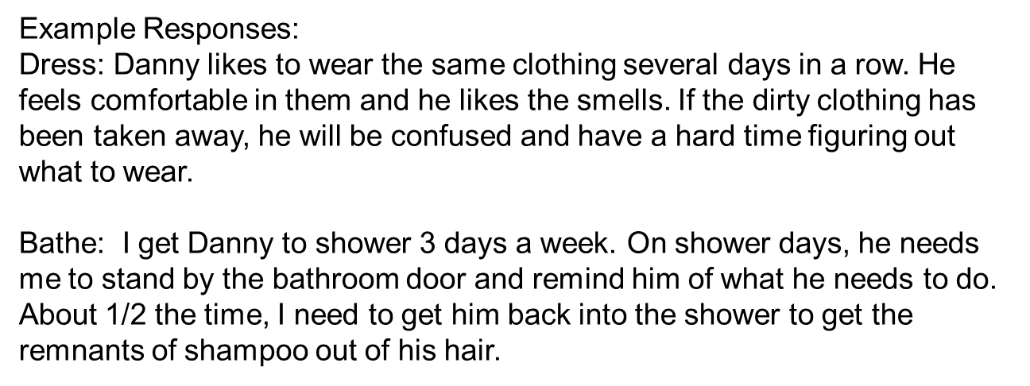

Slide 25
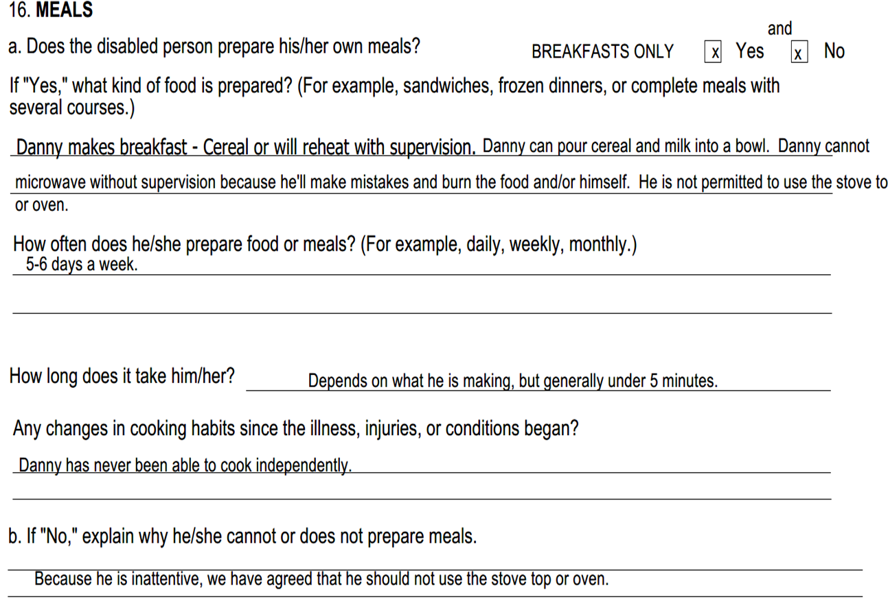

Slide 26
d. Does the disabled person drive? Very limited X Yes X No
If he/she doesn’t drive, explain why not.
Linda has a driver’s license. She worked very hard to get her license but if very fearful of driving alone. She will only go short distances as long as someone is with her. She only drives short distances maybe once every few weeks.

Slide 27
After approval for SSI
Always respond in timely way to official requests for information. SSI and Medicaid can be terminated for failure to respond.
If moving, be sure Social Security and Medicaid have the new mailing address.
If person receiving SSI is working, you must report wages monthly to Social Security.
Social Security: Substantial Gainful Activity (SGA) - $1,550/mo., gross income (2024).

Slide 28
When SSI begins…
Parents should open new bank account, jointly with individual with IDD, with child’s Social Security number first.
Consider a representative payeeship for the funds.
SSI checks to be deposited electronically into this new joint bank account.
Can’t have more than $2,000 in assets!
If receiving lump sum back payments, you have 9 months to spend down. After 9 months, assets cannot exceed $2,000 in the individual’s name. Open ABLE account or start a SNT, if needed.
Select a Medicaid HMO or be auto-assigned.

Slide 29
Continuing Disability Reviews and Redeterminations
After being approved for SSI (or SSDI) parents should expect their child will have continuing disability reviews.
Continuing Eligibility Review: Is the individual still disabled? Frequency is determined by specific disability and symptoms.
  Can be required every 3 years; can be more or less often.
Redetermination: Does individual continue to meet the technical eligibility requirements for SSI/SSDI, including documentation of finances, resources and income.
  Can be required every 6 years; can be more or less often.
If there is a rep payee, they need to fill out an annual financial report.

Slide 30
SSI and travel outside the U.S.
Important note: If a person receives SSI and travels out of the U.S. for 30 consecutive days or more, he/she is not eligible for SSI (or Medicaid) during any month when he/she is outside the U.S.
An individual who was receiving SSI, and has traveled out of the U.S. for 30 days or longer is not considered by Social Security to be in the U.S. until he/she is in the U.S. for 30 consecutive days upon returning.

Slide 31
What happens if the SSI application is turned down?
Appeal in timely manner! Easiest way to appeal: www.socialsecurity.gov/disability/appeal
Possible reasons for denial of SSI:
  Assets above $2,000
  Special Needs Trust not done correctly
  Medical documentation not sufficient to justify a severe disability, per SSA requirements.
  Parents may want to contact attorney to represent the son/daughter at a hearing with a judge.

Slide 32
Community Health Law Project
Main Admin - South Orange, 973-275-1175
Essex County - Bloomfield, 973-680-5599
DCF & DDD - Bergen, Essex, Passaic, Sussex, Warren
Union County - Elizabeth, 908-355-8282
DCF & DDD - Hudson, Morris, Union, Somerset
*Hudson County - Jersey City, 201-630-6201
Monmouth County - Eatontown, 732-380-1012
DCF & DDD - Monmouth, Ocean
*Ocean - Toms River, 732-349-6714
Mercer County - Trenton, 609-392-5553
DCF - Burlington, Hunterdon, Mercer, Middlesex
DDD - Hunterdon, Mercer, Middlesex
*Burlington - Mt. Holly, 609-261-3453
Camden County- Collingswood, 856-858-9500
DCF - Atlantic, Camden, Cape May, Cumberland, Gloucester, Salem
DDD - Atlantic, Burlington, Camden, Cape May, Cumberland, Gloucester, Salem
*Atlantic - Galloway, 856-858-9500

Slide 33
New Jersey State Bar Association
Lawyer Referral Service
The link below is a list of county bar associations that offer lawyer referral services
http://bit.ly/LegalReferralService

Slide 34
Other avenues to accessing Medicaid
There are instances where the individual may not receive SSI (the cash benefit) but they can still receive Medicaid.
The applicant is receiving a Social Security benefit because their parent, died, is retired or is collecting Social Security Disability themselves.
The applicant has high unearned income such as child support.
The applicant has a job.

Slide 35
Why is it helpful to have SSI?
When parent of person with IDD retires, becomes disabled, or dies: If the son/daughter has SSI, they are able to receive Social Security Disability Insurance (SSDI) income on parent’s work record, instead of SSI.
Monthly SSDI based on a parent’s work record is often too high to get Medicaid.
But, when persons with IDD previously had SSI, they are “Disabled Adult Children: Section 1634 DACs”, as defined by the Social Security Admin. They are eligible to get Medicaid again, after they start receiving SSDI on a parent’s work record. The amount of the SSDI benefit is ignored.

Slide 36
Official Definition: Section 1634 DAC
DAC = Disabled Adult Child. See Section 1634 DAC flyer developed by NJ DHS. Flyer was revised, Sept. 2021
Social Security Administration (SSA) definition of a DAC:
  A person who was receiving Supplemental Security Income (SSI) benefits (and Medicaid) and who meets the following:
  Is at least 18 years of age;
  Has blindness or a disability which began before the age of 22;
  Has been receiving SSI based on blindness or disability; and
  Has lost SSI due to the receipt of Social Security benefits on a parent’s record due to the retirement, death, or disability of a parent.
Also, the person cannot have more than $2,000 in resources in his/her name (not including a Special Needs Trust or ABLE account).
See the DAC FAQs fact sheet.

Slide 37
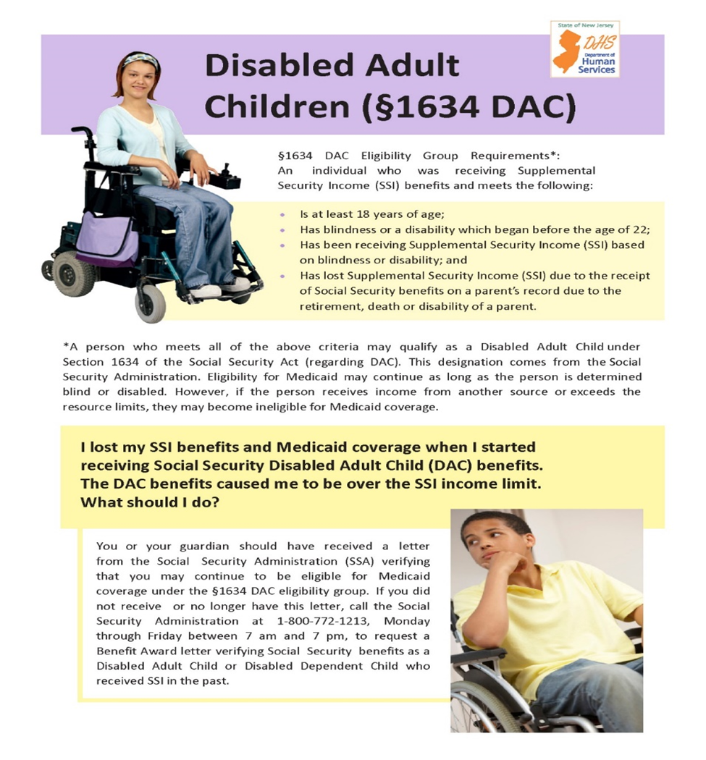

Slide 38
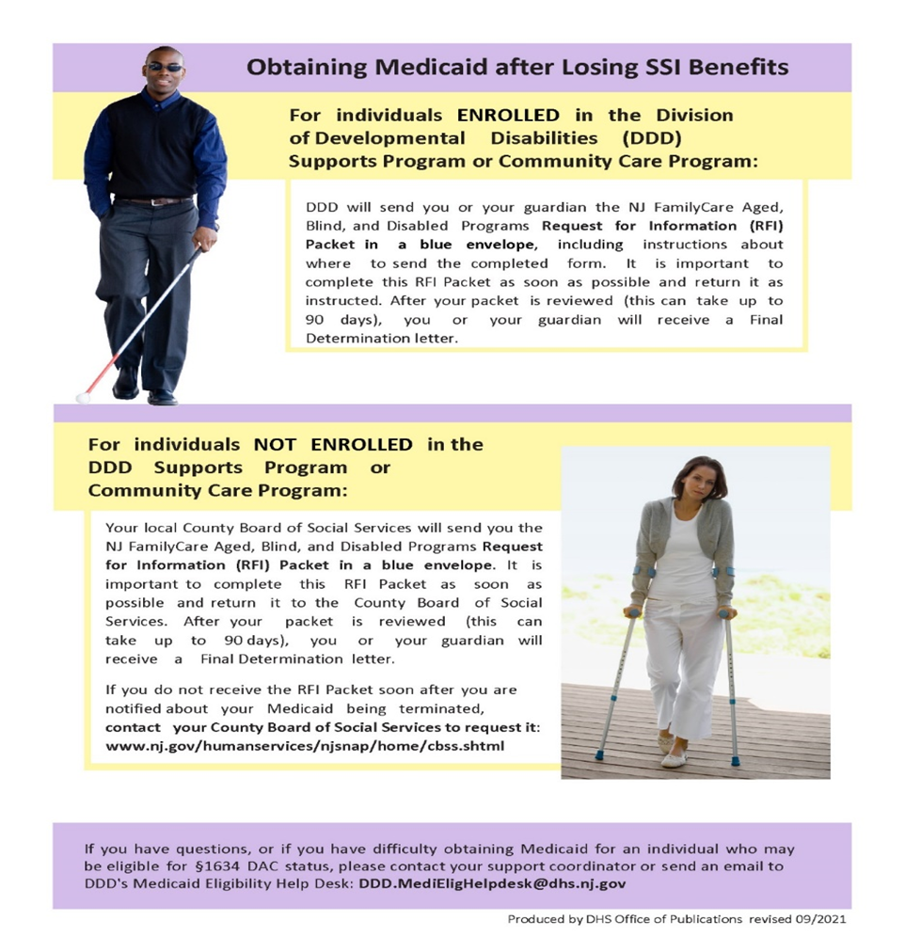

Slide 39
How to obtain Medicaid after becoming a Section 1634 DAC, and SSI benefits end
For individuals ENROLLED in the DDD Supports Program or Community Care Program:
  DDD will send the NJ FamilyCare Aged, Blind, and Disabled Programs Request for Information (RFI) Packet, which includes instructions about where to send the completed form. It is important to complete this RFI Packet as soon as possible and return it as instructed. After your packet is reviewed (this can take up to 90 days), you will receive a Final Determination letter.
For individuals NOT ENROLLED in the DDD Supports Program or Community Care Program:
  Your local County Board of Social Services should send you the NJ FamilyCare Aged, Blind, and Disabled Programs Request for Information (RFI) Packet in a blue envelope. It is important to complete this RFI Packet as soon as possible and return it to the County Board of Social Services. After your packet is reviewed (this can take up to 90 days), you will receive a Final Determination letter.
  If you do not receive the RFI Packet from the County BOSS, contact that office to request it: www.nj.gov/humanservices/njsnap/home/cbss.shtml

Slide 40
NJ Care Special Medicaid
If the individual with a disability is not on SSI and receiving a benefit from the parent’s work record that is less than $1,255/month (2024).
Can apply through the local County Board Board of Social Services.

Slide 41
“Non DAC” Medicaid through DDD
If the individual with a disability is not on SSI and receiving a benefit from the parent’s work record that is more than $1,732/month (2024).
Unique Non DAC status, only provided through the DDD waiver unit.
Following DDD intake and, upon approval for services, later provided a Medicaid application.

Slide 42
Can I Work While on SSI/Medicaid?
If an individual with IDD is working and they earn too much to be eligible for Medicaid through other means:
NJ WorkAbility provides Medicaid for people with disabilities who are employed and at least age 16.
Persons with disabilities, working PT or FT, are eligible.
Can earn as much as $73,932/yr. (2023), if an individual has no unearned income.
There are no asset limits or spousal deeming requirements!
However, if unearned income exceeds $1,215/mo. (2023) due to parent’s work record, they are not eligible for NJ WorkAbility. SSDI income from parent is considered “unearned income.”
Caution: If the person becomes unemployed, NJ WorkAbility ends.

Slide 43
Employment, Social Security, and Medicaid
NJ WINS: Free help for persons with disabilities who are planning to work, or are already employed, and want to know if they can maintain SSI, SSDI and Medicaid while working.
  www.njwins.org
  The “contact us” page lists the staff contact info by county, including company phone number and e-mail address.
DDS: speak with a highly trained Community Resource Specialist at 1-888-285-3036.
  They can review potential for eligibility, answer any questions, and provide guidance on whether or not NJ WorkAbility can work.
Disability Benefits 101 (DB101) - online benefits tool and estimator to see how work can affect eligibility for different forms of health insurance and/or public benefits.
  nj.db101.org

Slide 44
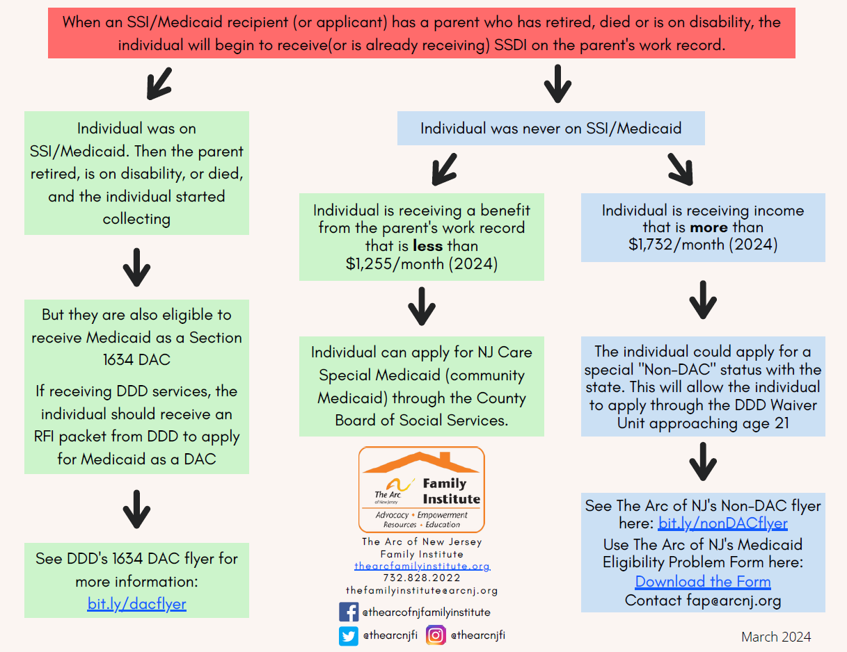

Slide 45
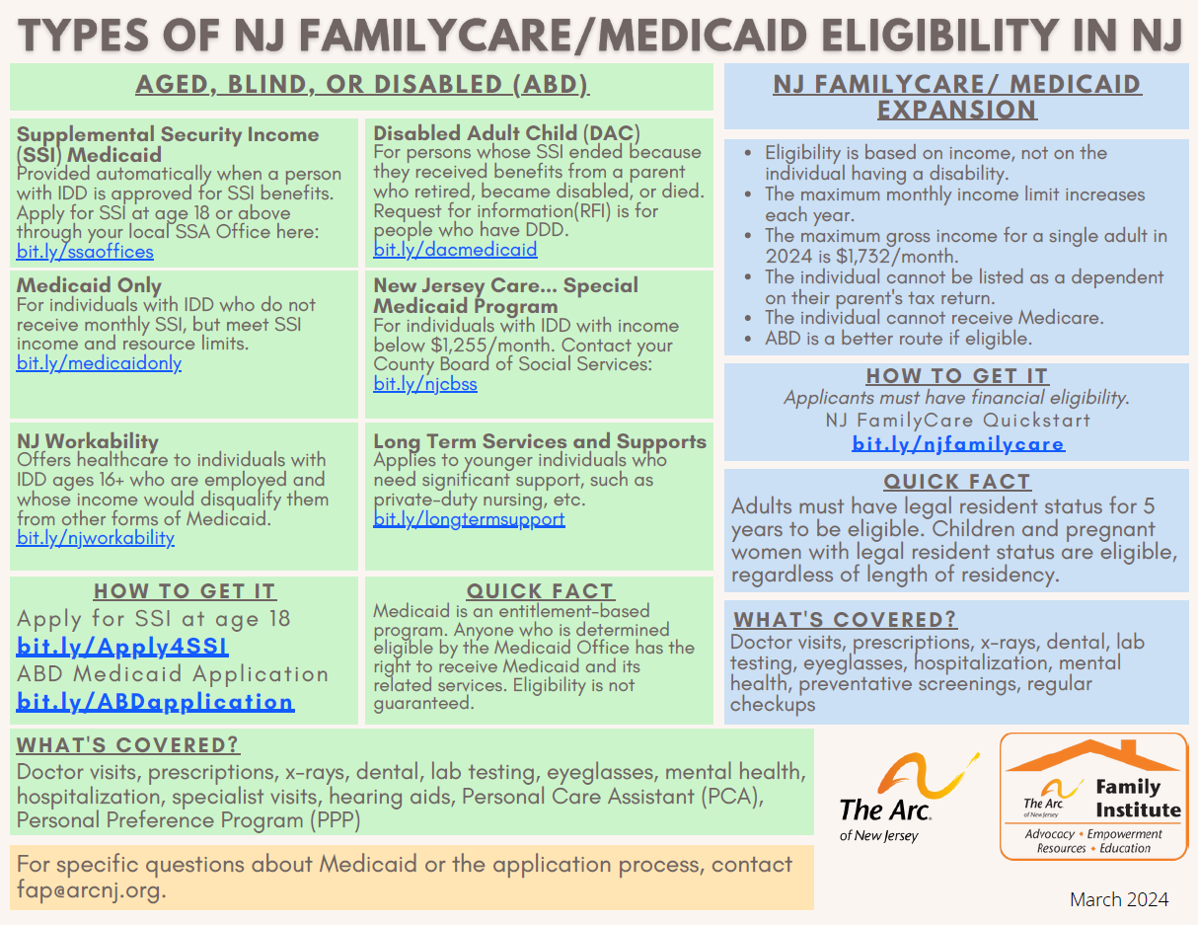

Slide 46
Medicaid “Unwinding”
COVID-19 pandemic started in March 2020, and the federal government declared a Public Health Emergency (PHE) and “continuous Medicaid enrollment”. No one was terminated from Medicaid since March 2020.
This continuous Medicaid enrollment ended and 1/12th of NJ FamilyCare/Medicaid enrollees have been receiving renewal packets each month since April 2023.
Unwinding will continue through the end of this month.
Individuals with IDD must continue to have Medicaid to keep their DDD services.

Slide 47
Medicaid “Unwinding”
Medicaid unwinding does not apply to people who receive SSI and Medicaid.
But sometimes Social Security does redeterminations for disability beneficiaries. Respond promptly to any requests for information from Social Security or Medicaid!

Slide 48
Medicaid Managed Care
Everyone enrolled in Medicaid must be enrolled in Medicaid managed care. Can select the managed care org. (MCO), and switch at any time for “good cause.”
Health Benefits Coord. for Medicaid questions: 1-800-701-0710.
Care management available, upon request, from the MCO.
If son/daughter has private insurance, it is the primary payer and Medicaid is the “payer of last resort;” may only be needed to access DDD services.
Five Medicaid MCOs in NJ:
1. Horizon NJ Health
2. United Health Care Community Plan
3. Wellpoint (formerly Amerigroup)
4. Fidelis Care
5. Aetna Better Health

Slide 49

Questions? info@arcnj.org
healthcareadvocacy@arcnj.org
More information can be found at www.arcnj.org, under the page for the Health Care Advocacy Program, or at www.TheArcFamilyInstitute.org

