Slide 1
Catching Up with Connor
NJ WorkAbility
Connor Griffin, MPH
Director, Health Care Advocacy Program
The Arc of New Jersey
healthcareadvocacy@arcnj.org
thearcnjhealthcareadvocacy.org

Slide 2

NJ FamilyCare/Medicaid
NJ FamilyCare = NJ Medicaid
2 main types of Medicaid:
  “Regular” NJ FamilyCare: covering children under 19, adults, and pregnant women. ACA Medicaid or MAGI Medicaid. Based on income.
  Aged, Blind, or Disabled (ABD): covering people 65 and older, and people determined blind or disabled by Social Security or the state. Based on age or disability.
Most individuals with IDD have ABD Medicaid.
Medicaid is required to receive Division of Developmental Disabilities (DDD) services at age 21.

Slide 3

NJ WorkAbility
One of the ABD Medicaid programs.
Provides full Medicaid coverage to working individuals with disabilities whose income or assets would make them ineligible for other Medicaid programs.
A person must be at least 16 years old, be a NJ resident, have a disability, and be employed to qualify.
Loss of employment would result in termination from the program.

Slide 4
Phase 2 of NJ WorkAbility
As of February 1, 2024, WorkAbility:
  Is open to anyone 16 years of age or older with a disability determination
  Does not count spousal income when determining eligibility or a premium
  Does not count resources/assets for eligibility purposes
  Does not count income for eligibility purposes.
    People with countable income in excess of 250% of the Federal Poverty Level (FPL) must pay a premium.

Slide 5
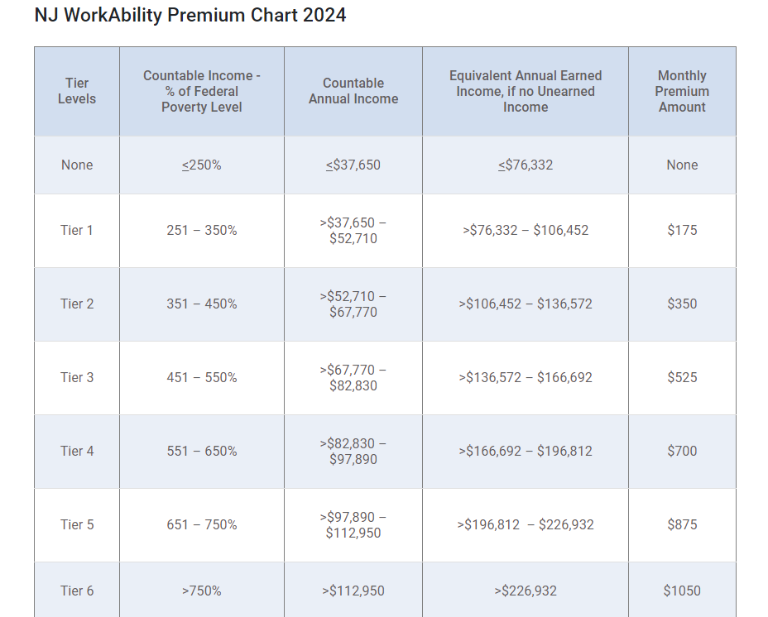
NJ WorkAbility Premium Chart 2024

Slide 6
NJ WorkAbility Premiums
If a person’s countable annual income is below 250% of FPL, or $37,750, you should not have to pay a premium
  If a person has no unearned income, may only have to pay a premium if gross earned income exceeds $76,332/year (2024).
Higher monthly premiums for increasingly higher tiers above 250% of the FPL.
Portions of both earned and unearned income are not counted for the NJ WorkAbility program.
Only way to be certain if you would have to pay a premium or not is by submitting an application.

Slide 7
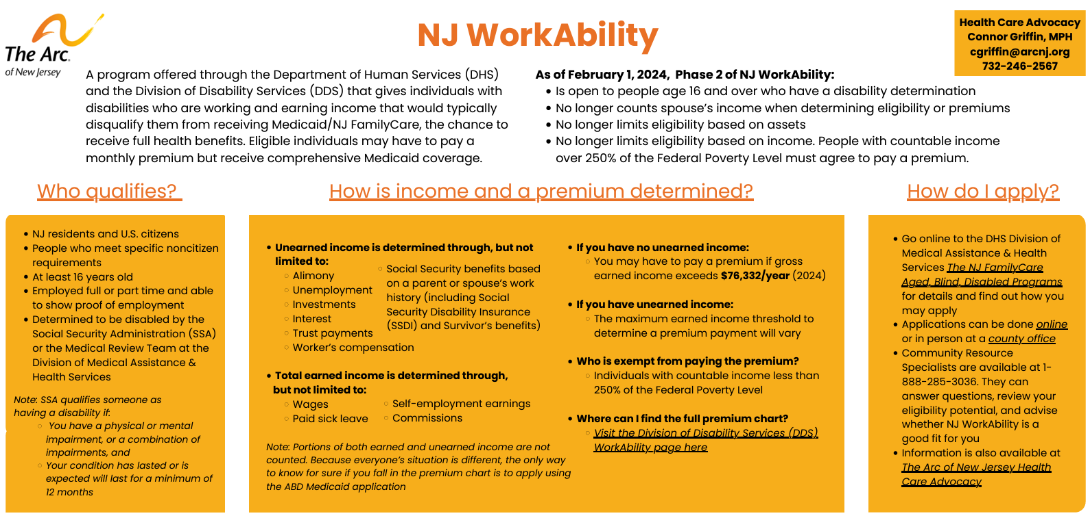
The Arc of New Jersey WorkAbility Fact Sheet
The Arc of New Jersey Health Care Advocacy - Fact Sheets & Flyers
https://www.arcnj.org/programs/health-care-advocacy/resources.html

Slide 8
How to Apply
Online via the NJ FamilyCare website (preferred)
  Apply here
In person at your local County Board of Social Services office
  Find your local office
Print the application, fill in out, and mail it in
  A pdf of the application
Call NJ FamilyCare at 1-800-701-0710 (TTY: 711) for assistance

Slide 9
More Information
The Arc of New Jersey Health Care Advocacy Program
  thearcnjhealthcareadvocacy.org
Subscribe to our email list at arcnj.org
  Scroll to the bottom of the page and click “Health care issues” then the subscribe button.
NJ FamilyCare/Medicaid
DMAHS NJ FamilyCare/Medicaid ABD
DDS NJ WorkAbility
  Speak with a highly trained Community Resource Specialist at 1-888-285-3036
Disability Benefits 101 (DB101)
  https://nj.db101.org/

