Slide 1
Catching Up with Connor
An Overview of NJ FamilyCare/Medicaid Part 1
Connor Griffin, MPH
Director, Health Care Advocacy Program
The Arc of New Jersey
healthcareadvocacy@arcnj.org
thearcnjhealthcareadvocacy.org

Slide 2
NJ FamilyCare/Medicaid
NJ FamilyCare = NJ Medicaid
2 primary programs:
NJ FamilyCare, covering children under 19, adults, and pregnant women
Aged, Blind, or Disabled (ABD), covering people 65 and older, and people determined blind or disabled by Social Security or the state
Most individuals with IDD have ABD Medicaid
Medicaid is required to receive Division of Developmental Disabilities (DDD) services at age 21

Slide 3
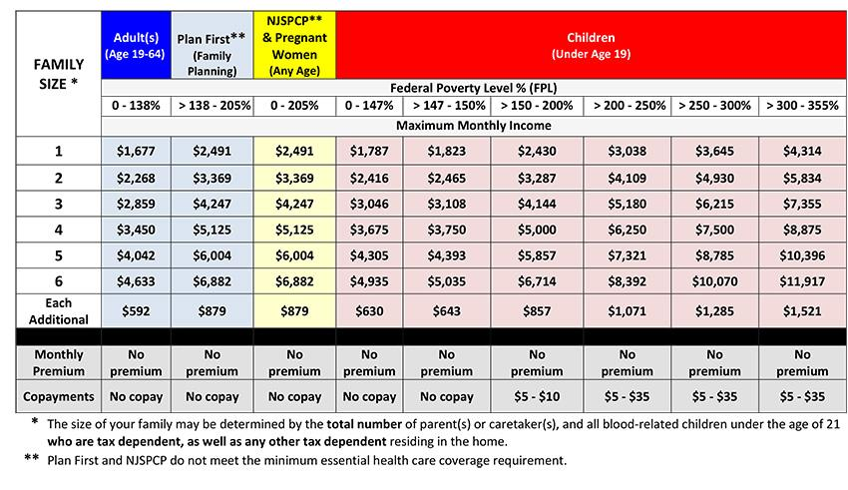
NJ FamilyCare
NJ FamilyCare or Affordable Care Act (ACA) expansion Medicaid
Eligibility is based on income, not on an individual having a disability
Maximum gross income of $1,677/month
ABD Medicaid is a better option if an individual has a disability and is eligible

Slide 4
ABD Medicaid
ABD Medicaid Programs:
Supplemental Security Income (SSI) Medicaid
Medicaid Only
New Jersey Care … Special Medicaid Programs
NJ WorkAbility
Managed Long Term Services and Supports (MLTSS)
Multiple ABD programs, but only one application
See the online brochure

Slide 5
SSI Medicaid
Eligible individuals who receive Supplemental Security Income (SSI) through the Social Security Administration
No separate application required
NJ individuals determined eligible for SSI automatically receive full ABD Medicaid benefits
Eligibility is tied to the Social Security monthly resource limit:
$2,000/month for individuals
Can apply for SSI on the Social Security website
https://www.ssa.gov/apply/ssi

Slide 6
Medicaid Only
Individuals who do not receive SSI but have income and resources under SSI limits:
Gross monthly income below $974.25 for an individual
Resources below $2,000

Slide 7
How to Apply
Online via the NJ FamilyCare website (preferred)
Apply here
In person at your local County Board of Social Services office
Find your local office
Print the application, fill in out, and mail it in
A pdf of the application
Call 1-800-701-0710 (TTY: 711) for assistance

Slide 8
More Information
The Arc of New Jersey Health Care Advocacy Program
thearcnjhealthcareadvocacy.org
Subscribe to our email list at arcnj.org
Scroll to the bottom of the page and click “Health care issues” then the subscribe button.
NJ FamilyCare/Medicaid
DMAHS NJ FamilyCare/Medicaid ABD

