Slide 1
Catching Up with Connor
Moving States and Medicaid Coverage
Connor Griffin, MPH
Director, Health Care Advocacy Program
The Arc of New Jersey
healthcareadvocacy@arcnj.org
thearcnjhealthcareadvocacy.org

Slide 2
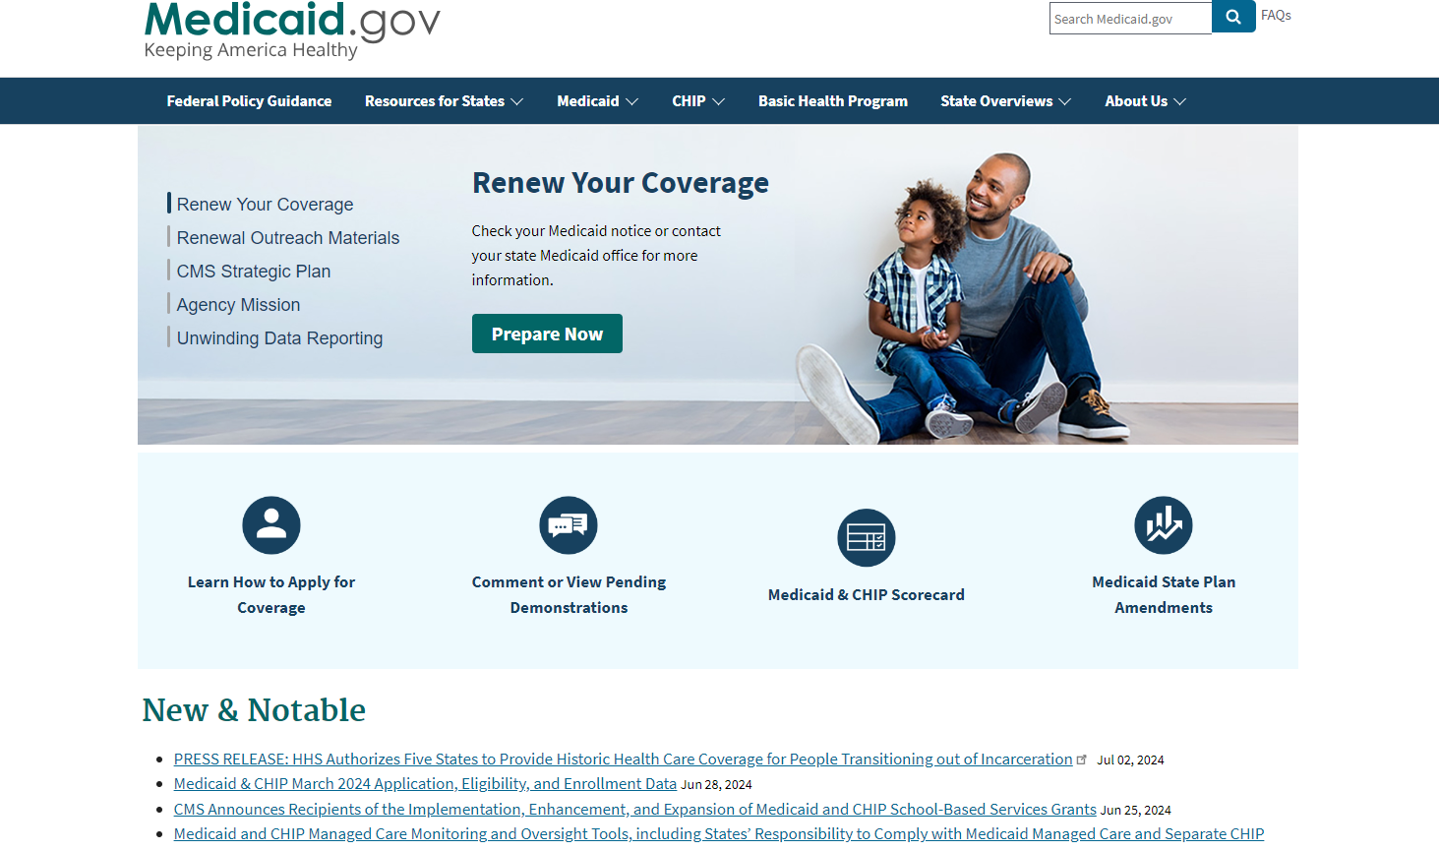
State Medicaid Programs
Each state has its own unique Medicaid program, jointly funded by the state and federal government.
Federal guidelines for Medicaid are broad.
This allows greater flexibility in the design and implementation of individual state programs.
Eligibility and benefits often vary widely state-by-state.

Slide 3
State Medicaid Programs
No two state Medicaid programs are the same!
  Hence, the reason that Medicaid coverage is not transferable across different states.
Cannot simultaneously have Medicaid in two different states.
You must discontinue current Medicaid before acquiring new Medicaid coverage.

Slide 4
Prepare for the Move
Inform your current Medicaid program that you will be moving.
  Notify Medicaid at least a few weeks in advance.
Plan ahead! Apply for new Medicaid as soon as possible and research eligibility requirements before you move.
If done quickly, a person can switch their state Medicaid coverage without a lapse in benefits.

Slide 5

Moving out of New Jersey
If a person has NJ FamilyCare (NJ Medicaid), a new Medicaid application in the new state of residence will be needed.
You cannot transfer NJ FamilyCare to another state.
Do not delay! Apply for new Medicaid with your new address.
If one acts quickly, there should be no gap in coverage.

Slide 6
Moving to New Jersey
You will need to complete an NJ FamilyCare application, no matter your former state of residence.
Do not delay! Apply as soon as you have a NJ address.
If one acts quickly, there should be no gap in coverage.
Even if the person is an SSI recipient, you must complete a NJ FamilyCare application
  Typically, a person in NJ automatically qualifies for Medicaid when approved for SSI, but moving states affects this process.

Slide 7
Moving (back) to New Jersey
You will still need to complete an NJ FamilyCare application, even if you were formerly an NJ resident and/or on NJ FamilyCare in the past.
If you moved out of the state and then back to NJ, a person is treated as if moving to NJ for the first time.

Slide 8
How to Apply for Medicaid
Online via the NJ FamilyCare website (usually preferred)
  https://dmahs-nj.my.site.com/abd/abdstart
Complete the application in person at your local County Board of Social Services office
  https://www.nj.gov/humanservices/njsnap/home/cbss.shtml
Questions about the application? Please call 1-800-356-1561
If you are moving out of NJ, please search online for your relevant state Medicaid program, or visit Medicaid.gov

Slide 9
More Information
The Arc of New Jersey Health Care Advocacy Program
  thearcnjhealthcareadvocacy.org
NJ FamilyCare/Medicaid
  https://www.nj.gov/humanservices/dmahs/clients/medicaid/
Subscribe to our email list at arcnj.org
  Scroll to to the bottom of the page and click “Health care issues” then the subscribe button.

