Slide 1
Catching Up with Connor
Medicare Enrollment:
Looking Towards 2025
Connor Griffin, MPH
Director, Health Care Advocacy Program
The Arc of New Jersey
healthcareadvocacy@arcnj.org
thearcnjhealthcareadvocacy.org

Slide 2
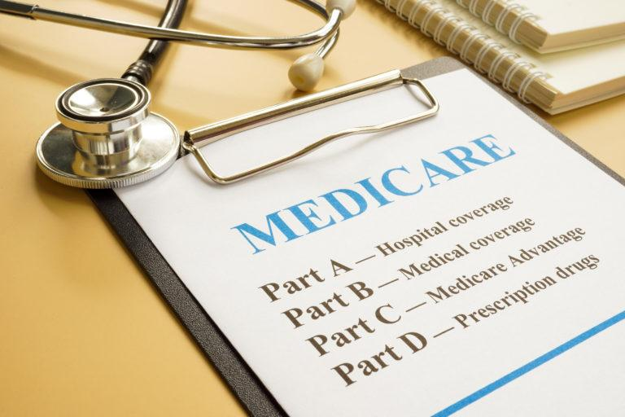
Medicare
The federal health insurance program for individuals 65 years of age and older, certain younger individuals with disabilities, and those with End Stage Renal Disease (ESRD)
Different parts of Medicare cover different health services:
  Medicare Part A - Hospital
  Medicare Part B - Medical
  Medicare Part C - Medicare Advantage Plans
  Medicare Part D - Prescription Drugs

Slide 3
How do Individuals with IDD qualify before Age 65?
Individuals eligible for Social Security Disability Insurance (SSDI) automatically become eligible for Medicare after 24 months
SSDI can be based on the individual’s own work record, or may receive SSDI if a parent retires, becomes disabled, or passes away
Many people with IDD start receiving Medicare (automatically, no application needed) after 2 years because a parent retired and started collecting Social Security
Able to receive Medicaid and Medicare
  A “dual eligible” enrollee

Slide 4
Annual Open Enrollment
Every year October 15th - December 7th
A person has the ability to:
  Join, drop, or switch to another Medicare Advantage/Part C Plan (or add or drop drug coverage).
  Switch from “Original Medicare” (Parts A & B) to a Medicare Advantage Plan or from a Medicare Advantage Plan to Original Medicare.
  Join, drop, or switch to another Medicare drug plan if you’re in Original Medicare.
New coverage takes effect January 1st

Slide 5
Other Enrollment Periods
Initial Enrollment Period
  Begins 3 months before you get Medicare and lasts 3 months after you get Medicare
Medicare Advantage Open Enrollment (if you are already enrolled in a Part C plan)
  January 1st - March 31st
  First 3 months you get Medicare
Special Enrollment Period (SEP)
  Varies! Only for certain situations that happen in your life, like moving to a new address, losing or changing your current coverage, or getting Medicaid, can result in an eligible SEP.

Slide 6

Medicare Part D
Administered through private companies, but the federal government approves each plan
Costs and coverage vary by plan
Helps cover prescription drug costs
“Benchmark” plans established by Medicare each year with a $0 monthly premium for dual eligible persons with Medicaid
Other low cost plans for duals who qualify for extra help/low income subsidy (LIS) with Medicaid
The Arc of NJ is planning a webinar in early November that covers Part D and other Medicare updates for 2025!

Slide 7
Part D in 2025…
Major Update in 2025:
  $2,000 spending cap on out-of-pocket costs for prescription drugs
  Applies to Part D and Part C plans
The $2,000 cap includes deductibles, copayments and coinsurance for covered drugs
Does not apply to premiums or drugs a plan does not cover
Also does not apply to Part B drugs
The Arc of NJ is planning a webinar in early November that covers Part D and other Medicare updates for 2025!

Slide 8
More Information
The Arc of New Jersey Health Care Advocacy Program
  thearcnjhealthcareadvocacy.org
  Dual-Eligibles Resource Page
Subscribe to our email list at arcnj.org
  Scroll to to the bottom of the page and click “Health care issues” then the subscribe button.
NJ State Health Insurance Assistance Program (SHIP)
  Free help to NJ Medicare beneficiaries who have problems or questions about their health insurance. SHIP is a statewide program administered by the NJ Department of Human Services
  https://www.nj.gov/humanservices/doas/services/q-z/ship/
Medicare.gov
  Joining a plan: https://www.medicare.gov/basics/get-started-with-medicare/get-more-coverage/joining-a-plan

