Slide 1

Update for 2025 on the
Medicare Drug Benefit for People
Who Have Both Medicare and
Medicaid (the Dual Eligibles)
Mary McGeary
Director, SHIP
NJ Division of Aging Services
November 7, 2024

Slide 2
What is a “Dual Eligible”?
A dual eligible is a person who has both Medicaid and Medicare benefits.
The federal term for a dual eligible is “Qualified Medicare Beneficiary Plus” or QMB+.
Most dual eligibles receive their prescription drugs from Medicare Part D – not from Medicaid.
        The exception is dual eligibles who also have private health insurance, usually through a parent’s employer.

Slide 3
Dual Eligibles – FAQs
"Understanding what happens when a person with IDD who receives Medicaid becomes eligible for Medicare.“
The Arc of NJ has distributed Frequently Asked Questions (FAQs) to respond to the questions that families often ask.
The questions and answers are divided into three sections:
FAQ- Dual Eligibles General Information
FAQ- Dual Eligibles and Prescription Medication
FAQ- Dual Eligibles and Special Needs Plans (D-SNPs)
Available at https://www.arcnj.org/programs/health-care-advocacy/resources.html

Slide 4
If individual with Medicare and Medicaid also has private health insurance…
Usually not permitted to have drug coverage from both private health insurance and Medicare Part D.
If private health insurance drug coverage is as good as (or better than) Medicare Part D, employer should provide a letter of “creditable coverage.” Opt out/Disenroll from Medicare Part D.
When a dual eligible also has private health insurance (and is not enrolled in Medicare Part D), NJ Medicaid should continue to cover the drug co-pay costs.
If your pharmacy needs help billing both your private drug plan and Medicaid, call NJ Medicaid Pharmacy Unit for help at 609-588-2732.

Slide 5
Important Terms
Low Income Subsidy (LIS), also called Part D “Extra Help”: Medicare beneficiaries with limited income and resources may qualify for extra help, in the form of a Low Income Subsidy (LIS), to pay for prescription drug costs.
Dual eligibles are automatically eligible for the LIS.

Slide 6
What is a “Benchmark”
Drug Plan?
The Medicare drug plans do require a monthly fee. However, for the dual eligibles, that fee is subsidized by Medicare up to a specific amount (which is known as the benchmark).
  Benchmark premium for 2025 in NJ is $56.86
When a dual eligible enrolls in a benchmark drug plan, there is no monthly premium fee.
There are two types of drug plans: Basic and Enhanced, but only the Basic plans can qualify as benchmark plans.

Slide 7
Overview of
Medicare Benchmark Drug
Plans for NJ’s Dual Eligibles
Benchmark Plans in 2025 | Notes
Humana Basic Rx Plan | New benchmark for 2025
Horizon Medicare Blue Rx Standard | New benchmark for 2025
Aetna’s Silverscript Choice | New benchmark for 2025
Wellcare Classic | Was benchmark in 2024
Clear Spring Health Value Rx- Benchmark in 2024
Terminating all members 12/31/2024. Members will be auto-enolled into a different benchmark for 1/1/25

Slide 8
Blue Reassignment Letter
Some dual eligibles are enrolled in a drug plan that CMS enrolled them in. It was $0 premium in 2024 but will not a benchmark plan in 2025.
CMS sends a BLUE colored letter to these dual eligibles, to let them know they will be moved to another plan for 1/1/2025.

Slide 9
Tan “Choosers” Letter
Some dual eligibles are currently enrolled in a drug plan that is not a benchmark plan, or that the consumer enrolled themselves into the current plan.
They may be paying a monthly premium fee for this plan.
CMS sends a tan colored letter to these dual eligibles, to let them know they can switch to a $0 benchmark plan or stay in the same drug plan and pay a monthly fee in 2025.
  Changing to a benchmark drug plan is not required.

Slide 10
Why Would Dual Eligibles Select a Non-Benchmark Drug Plan?
If a dual eligible needs a medication not available on the formulary of benchmark drug plans, but it is available in non-benchmark plan – it may be more cost-effective to pay a relatively low monthly premium to get the needed medications.
This decision must be made on an individual basis.
NJ Division of Aging Services has chart of all Part D drug plans on its website.
  The chart shows the monthly premium fees for NJ’s non-benchmark drug plans in 2025 in the column with the heading “Premium with Medicaid.”

Slide 11
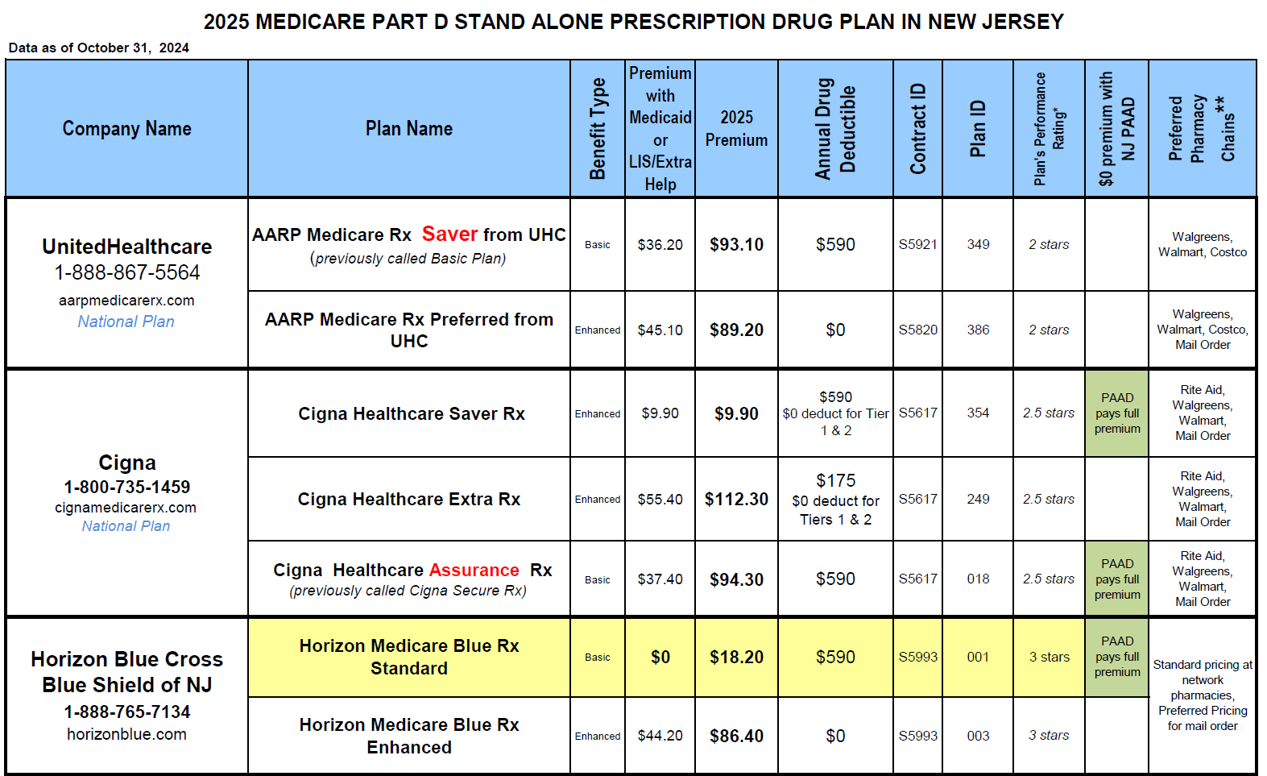

Slide 12
2025 Part D Changes that do NOT impact Dual Eligibles
Inflation Reduction Act (IRA) simplified the Part D structure by eliminating the Coverage Gap/Donut Hole .
2025 Part D Benefit will have 3 phases:
  Deductible ($590 max )
  Initial Coverage Phase (up to $2,000 maximum out of pocket)
  Catastrophic Phase ($0 cost sharing)
Members with high drug copays will have option to enroll in plan’s Prescription Payment Plan
Dual Eligibles or members with NJPAAD should NOT enroll in their plans Payment Plan.
Notes:
An Inflation Reduction Act (IRA) provision simplified the Part D structure by eliminating the coverage gap phase. That is, once people with Medicare meet the out-of-pocket drug spending limit ($2k in 2025), they will move directly from the initial coverage phase to the catastrophic phase.
The Plan Details and Enrollment Confirmation pages will be updated to remove references to the gap phase for CY25.

Slide 13
Medicare Part D Co-Pays for Dual Eligibles
Dual eligibles receiving DDD services have either Supports or the Community Care Program (CCP). They have a $0 co-pay for Medicare Part D drugs.
A dual eligible receiving Managed Long-Term Services and Supports (MLTSS) will have $0 copay for Part drugs.
If a dual eligible does not receive DDD services: Drug co-pays for 2025 will be $1.60 for each generic and $4.80 for each brand name drug.

Slide 14
Low Income Subsidy Level | 2025 Copays for Drugs on Part D Plan Formulary
LIS Level 3 Duals (people with Medicare and full Medicaid) who also live in nursing home or Assisted Living, or have MLTSS, or on other Medicaid Waiver (CCP) or Supports Program Enrolled in a DSNP plan | $0
LIS Level 2 Duals with full Medicaid Benefits | $1.60 generics $4.80 brand names
LIS Level 1 Help paying Part B premium (SLMB, QI or QMB); Duals on Workability NJ Family Care Those who approved for LIS via SSA | $4.90 generics $12.15 brand names ($7 brand names if also have PAAD)

Slide 15
Transition Policy
For the first 90 days of 2024, CMS expects all Part D plans to cover one 30-day fill for drugs which the member is currently taking that are either:
a) not on the formulary, or
b) are on the formulary but require prior authorization or step therapy
Pharmacist should print out a message from drug plan at the point of sale, saying this is a one-time transition fill.
CMS requires the Part D plans to send written notice to each enrollee who receives a transition fill, within 3 business days.

Slide 16
Formulary Changes that May
Affect All Dual Eligibles
Every year, in January, Medicare drug plans are permitted to change their formulary (the list of drugs they pay for)
Many plans are dropping coverage for brand name drugs that treat mental health problems. Consumers who must take brand name drugs (such as Carbatrol, Keppra XR, Clozaril & Depakote) should check to see if their plan will continue to cover it. If not, and if they can’t take a generic, they will need to submit an exception request.
Caregivers should find out if the enrollee’s current prescription drugs will still be covered in 2025.

Slide 17
No “lock-in” For Dual Eligibles!
Dual eligibles are not “locked in” to a Medicare drug plan.
If dual eligibles want to switch drug plans and they don’t do it before 1/1/ 2025, they can switch next year.
New for 2025: Drug plans or DSNP plans can be switched every month, but enrollment into Medicare Advantage Plan is limited to Fall Open Enrollment.
Drug plan changes are always effective the first day of the next month.

Slide 18
Aspects of Medicare Part D That
Do Not Apply to the Dual Eligibles
Monthly premium fees
    As long as consumer is enrolled in a benchmark plan, there is no premium fee
    Non-bench mark plans will have the premium subsidized
No deductibles.
Drug tiers
    As long as a drug is on the formulary, it does not matter which tier it is on
Preferred Pharmacies –
  You do not need to use the drug plan’s “preferred pharmacy” but must use a pharmacy in the plan’s network.

Slide 19
How To Get Medications if
No Medicare Drug Plan Enrollment
Ask the pharmacist to enroll the dual eligible in LINET: Limited Income Newly Eligible Transition Program, with Humana.
This process allows pharmacist to enroll dual eligible (or other Low Income Subsidy person) into a temporary Part D plan (LINET Humana) in order to get medications immediately.
This process is also for dual eligibles NEW to Medicare Part D who are not yet auto-enrolled.
If pharmacists need help with LINET enrollment, they can call 800-783-1307, ext. 1.

Slide 20

Dual Eligible’ s Enrollment Choices
Original Medicare
Medicare Advantage Plan
(Medicare HMO or PPO )
Special Needs Plan for Duals (DSNP)
Part A
Hospital
Insurance
and
Part B
Medical
Insurance
Part D Prescription Drug Plan or other creditable drug plan
Medicare Part C
Plan combines
Part A, Part B and
Part D
Combines
Part A, Part B,
Part D and Medicaid benefits. Replaces Medicaid MCO enrollment.
Supplement Insurance (optional)
employer group health plan
Medicaid MCO
Medicaid MCO
MLTSS can be added to any of the enrollment choices

Slide 21
New Jersey
Dual Eligible Special Needs Plans:
D-SNPs
Also called FIDE-SNPs:
Fully Integrated Dual Eligible
Special Needs Plans
ENROLLMENT IS VOLUNTARY

Slide 22
Voluntary enrollment in
Medicare HMO D-SNP
Dual eligibles may enroll voluntarily in a Medicare managed care D-SNP at any time. Enrollees do not receive any bills when using in-network providers.
If thinking about joining a D-SNP:
  Network of doctors, hospitals & prescription drugs are through the D-SNP. Must use that provider network.
    If enrolled in D-SNP and go to out-of-network provider – dual eligible will be charged the full cost of the medical care provided.
  Cannot be in a stand-alone drug plan if enrolled in a
  D-SNP. Check the D-SNP formulary before enrolling to be sure needed drugs are on the formulary.
  Enrollees in D-SNP have a $0 co-pay for prescription drugs.
  Plans offer Extra benefits such as spending card for over-the –counter health items, or groceries.

Slide 23
If enrolled in a Medicare D-SNP and want to disenroll…
    Can disenroll from D-SNP by calling 1-800-Medicare to disenroll. Will then be in “Original” Medicare, and a Medicaid HMO. Will also need to select a Part D drug plan.

Slide 24
Why enroll in Medicare Advantage Plan instead of stay with Original Medicare?
Maybe you cannot find providers/specialists willing to treat the Medicare consumer because they also have Medicaid AND
  You are not satisfied with the Medicaid provider options.
Maybe you want some of the “extra” benefits offered by some of the plans such as debit card for buying things like aspirin or cold medicine.
Maybe you cannot afford the drug copays of $1.60/$4.80 and need to lower it to $0 that the D-SNP plans offer.

Slide 25
Caution Regarding Copays in Medicare Advantage Plans
Although dual eligibles enrolled in Medicare Advantage plans are not required to pay in-network doctor or other medical service co-pays, in practice, co-pays are often charged.
It is difficult to convince some medical providers that co-pays should be waived for dual eligibles,
Call the plan or Medicare to complain about any providers charging copays to a dual eligible who has QMB status (Qualified Medicare Beneficiary).

Slide 26
Which is better- Medicare Advantage Plan or Special Needs Plan?
Depends on the NETWORK of providers you want to use
For a dual, start by looking at the D-SNP plans.
  Easier to use the providers because all agree to treat duals
  ONE network to navigate
  ID card shows $0 copays for medical services
  All covered drugs have $0 copay
  CAUTION- if have MLTSS with your Medicaid MCO, will be assigned a different care manager if switch to the MCO’s DSNP plan.
If not happy with DSNP network of providers or formulary of drugs, then look at Medicare Advantage Plan options.
  Some MA plans have bigger network of providers than DSNP plans.

Slide 27


How to use
the medicare plan finder
for Dual Eligibles
Mary McGeary
NJ SHIP Director
Division of Aging Services
NJ Department of Human Services
The ARC of NJ November 2024

Slide 28
Getting to the Drug Plan Finder
Go to www.Medicare.gov
Or call 1-800-Medicare
    Customer Service Assistance for choosing a plan & enrolling
    Available 24 hrs a day
    Language Line Interpreters for 150 languages

Slide 29
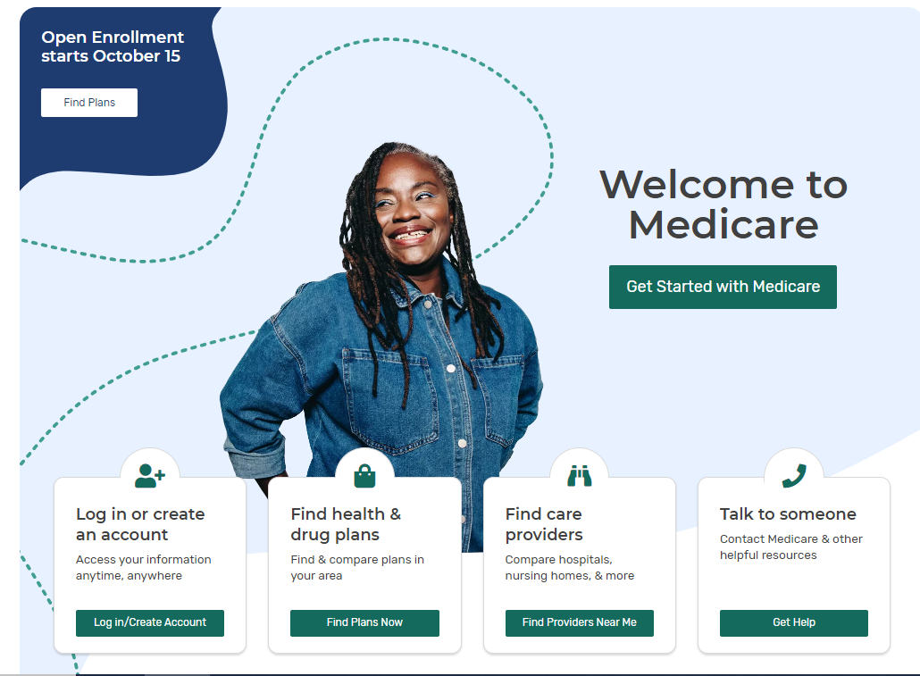
Medicare.gov Homepage
Notes:
Note: This homepage will display starting on Oct 1.

Slide 30
Getting Started: What You Will Need
Consumer’s zip code
List of Consumer’s prescription drugs with dose
Pharmacy they use
Does Consumer have a Medicare account?
Other Helpful Information
  Medicare card with Medicare number
  Other Health Insurance cards
  Subsidy eligibility (Medicaid, LIS, PAAD)

Slide 31
Seven Step Process for Dual Eligibles
Plan Finder Steps for Dual Eligibles
Enter Consumer Information
Enter drugs by name, dose and quantity
Select pharmacies
Review search results and compare plans
Review Plan Details
Save or print plan details
Enroll

Slide 32
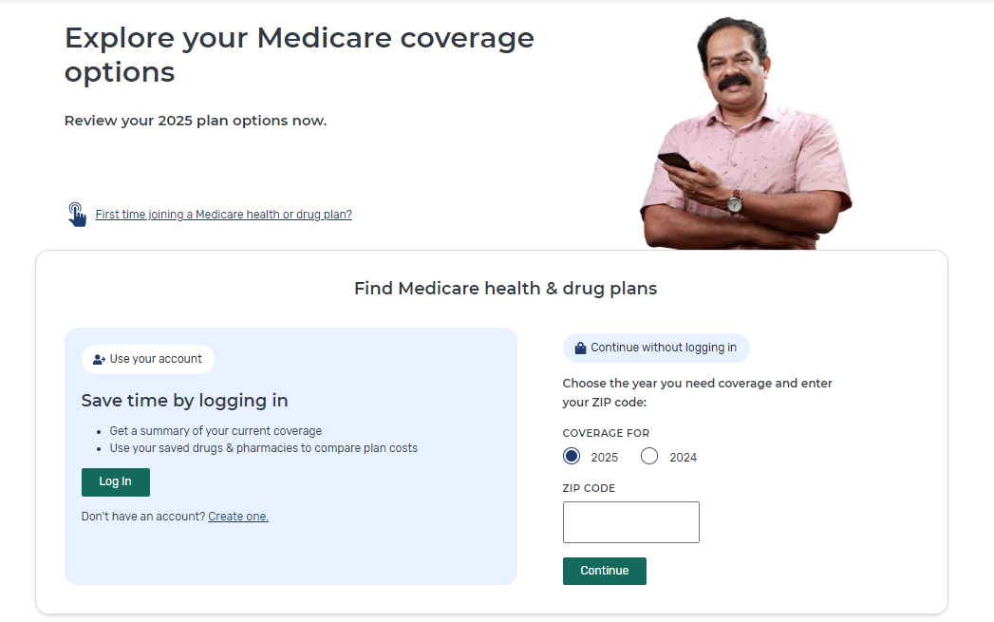
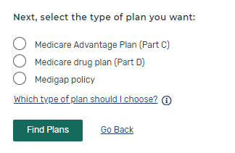
Medicare Plan Finder Home Page
Choose type of plan to review
Log into Medicare account
or create an account
3
Or continue without logging in and enter zip code
1
2
Notes:
Here’s the Plan Finder landing page. Note that you’re still on Medicare.gov—this is part of that website, not a different one. You can choose to login, or browse plans by ZIP code and plan type. For step “Choose type of plan to review”, you will have several options, including Medigap Policy. For comparing drug prices, you need to start with either Medicare Advantage or Part D Plan.

Slide 33
Things to Consider
Can’t save drug list if you “continue without logging in”
  Will be able to see plan and coverage information to make an enrollment choice
In order to save the drug list, you must login or create a Medicare Account
  Doing this will show your drug list from prior year’s claims
  Doing this step will confirm consumer’s level of “extra help”
  You need to update it with any new drugs/dosages
Notes:
You won’t be able to save or access your drug list unless you login. If you create and use your Medicare account, you can save your drug lists and will be able to view and compare your current coverage to your enrollment choices.
If you have insulin products or vaccines in a previously-saved drug list, remove them before continuing.

Slide 34
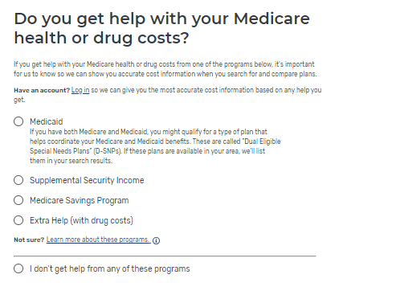
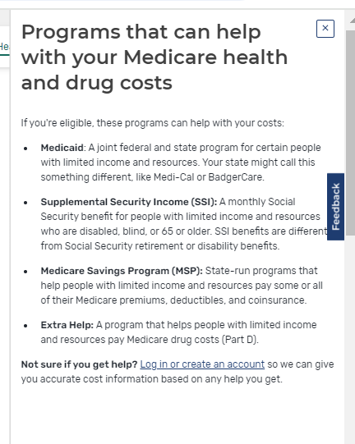
Question on “Extra Help”- new look
Question on “Extra Help”
Notes:
Identify any help you get paying your Medicare costs.

Slide 35
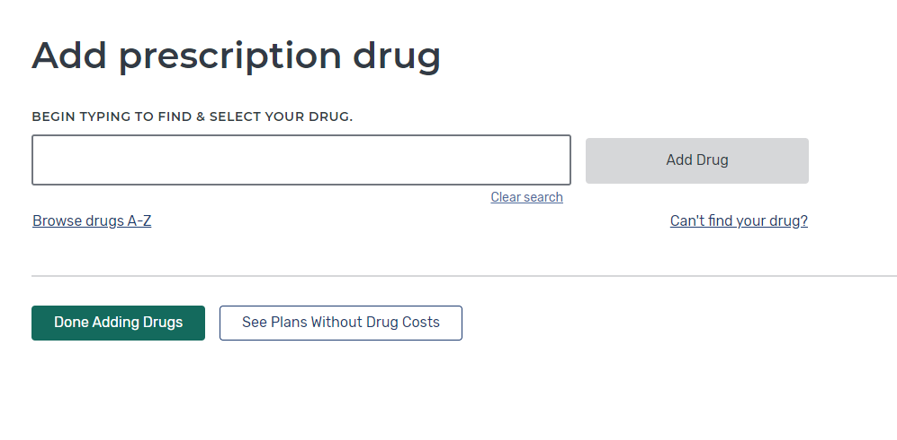

Step Two- Entering Drugs by name
Type in the drug name in the box
Or you can search for the name of drug by first letter
A
B
Don’t enter over-the-counter
drugs or drugs covered under Medicare Part B (Medical Insurance)
Notes:
To enter new drugs, you can type or use the browse function. Only include drugs covered by Medicare Part D. Don’t add any over-the-counter medications or drugs paid for by Medicare Part B (Medical Insurance).

Slide 36
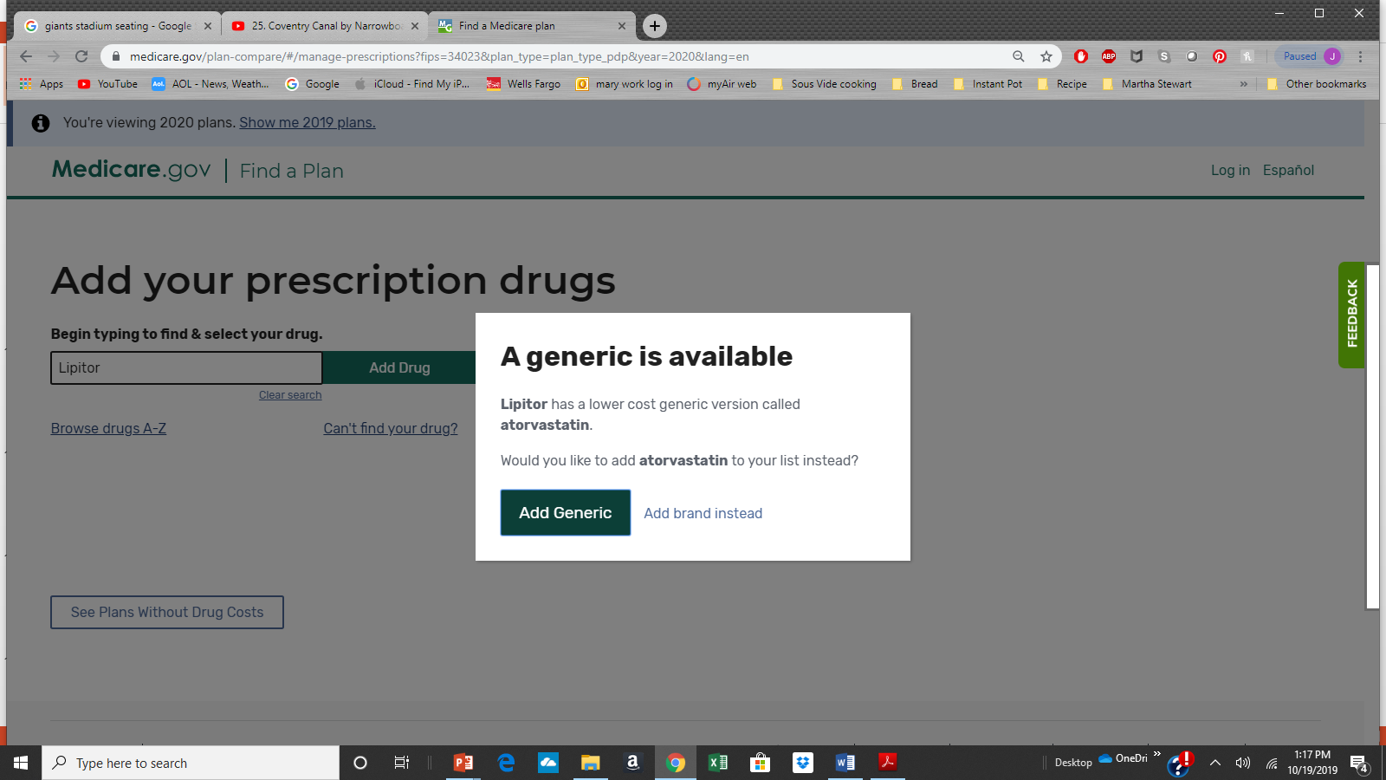
Pop Up Reminder: Generic or Brand Name Drug Used?

Slide 37
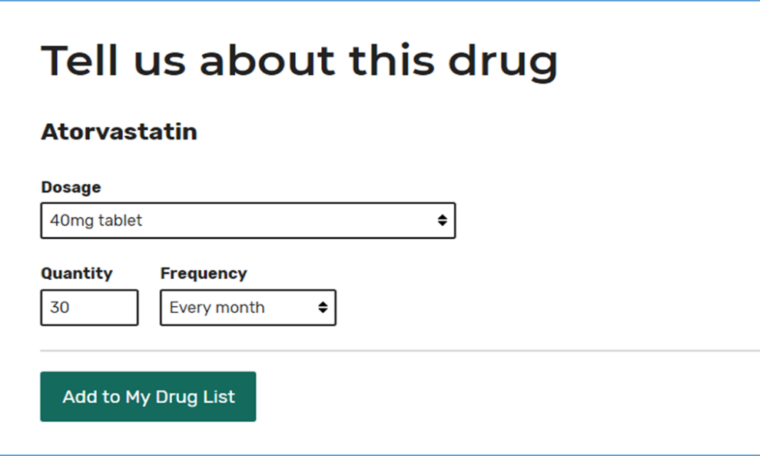
Enter the Drug Dosage
Adjust Dosage
Then select “Add to My Drug List”
1
2
Notes:
Select the appropriate dosage, desired quantity, and frequency to complete your drug list addition.

Slide 38
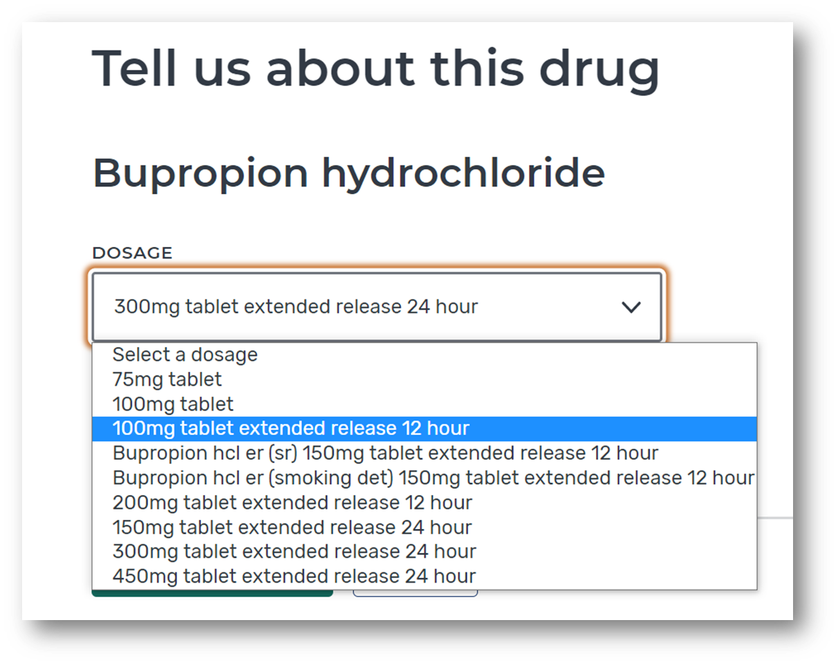
Tip: Letters Included with Drug Dose are Important
Shown on medicine bottle as 100mg ER
Notes:
If you’re uncertain about the dosage, check the prescription bottle for specifics.

Slide 39
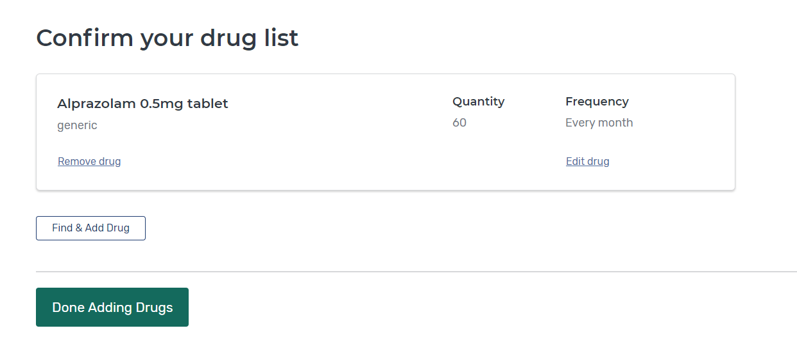
Add Additional Medications
Select “Find and Add Drug” to add any additional medications
Select “Done Adding Drugs” after all medications have been entered.
A
B
Enter all drugs with same refill frequency (monthly or every 3 months) for best results
Notes:
Continue adding medicines to your drug list until it’s complete.

Slide 40
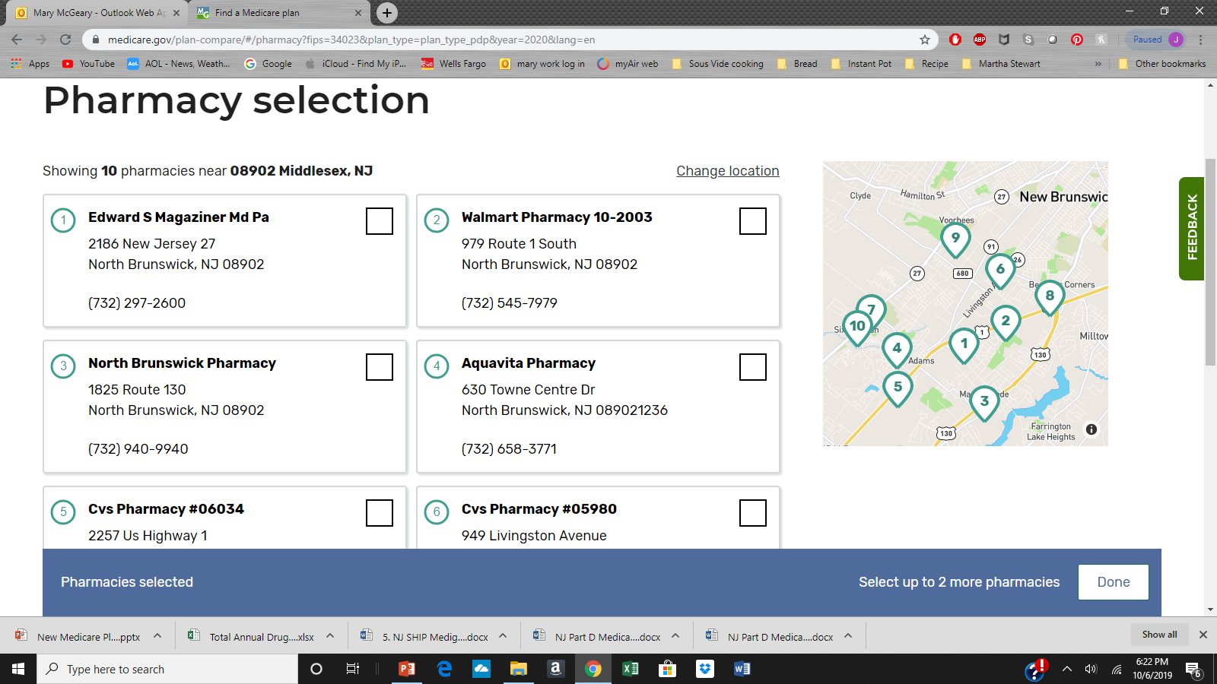
Step Three- Choose up to 5 local Pharmacies

Slide 41
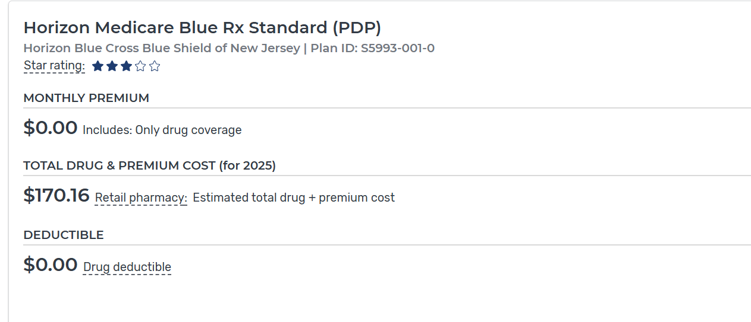
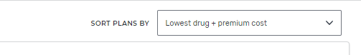
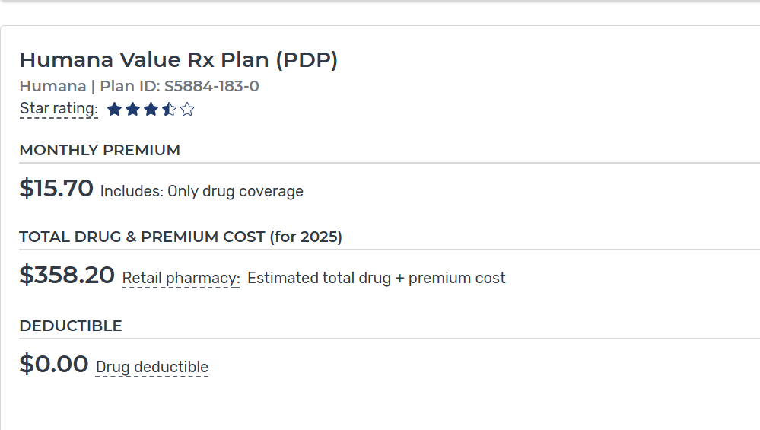
Step Four: View Results
“Benchmark” plans will show $0 premium
“Non-Benchmark” plans will show a subsidized premium

Slide 42
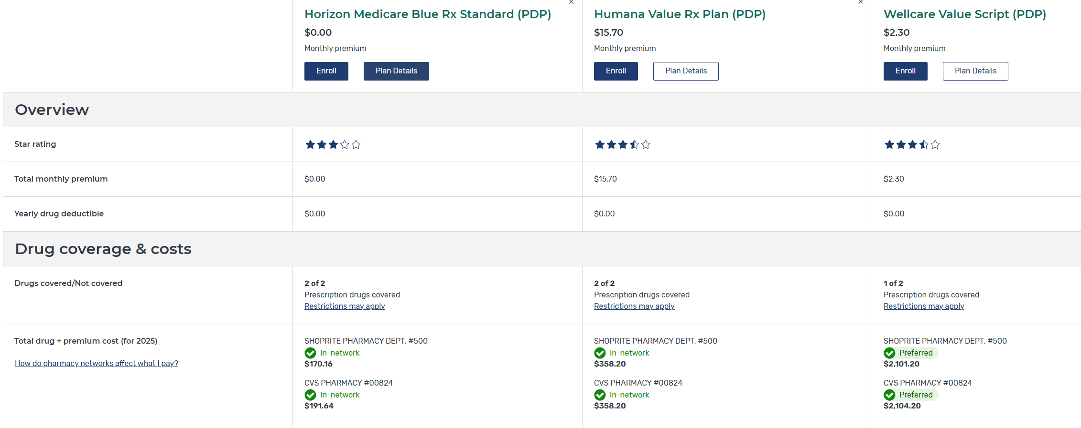
Compare up to three plans side by side
Make sure all drugs entered are covered by the plan.
Review total cost at different pharmacies

Slide 43
IMPORTANT: When doing plan comparison with
“general” search…
If not creating or logging into a consumer‘s Medicare account:
The drug copays listed will not be correct level of Extra Help
  Copays listed will be $4.90 for generics and $12.15 for brand names
A full dual eligible will actually be charged
    $1.60 or less for generic drug
    $4.80 or less for brand name drug
    $0 if on CCP, Supports Program, or MLTSS

Slide 44
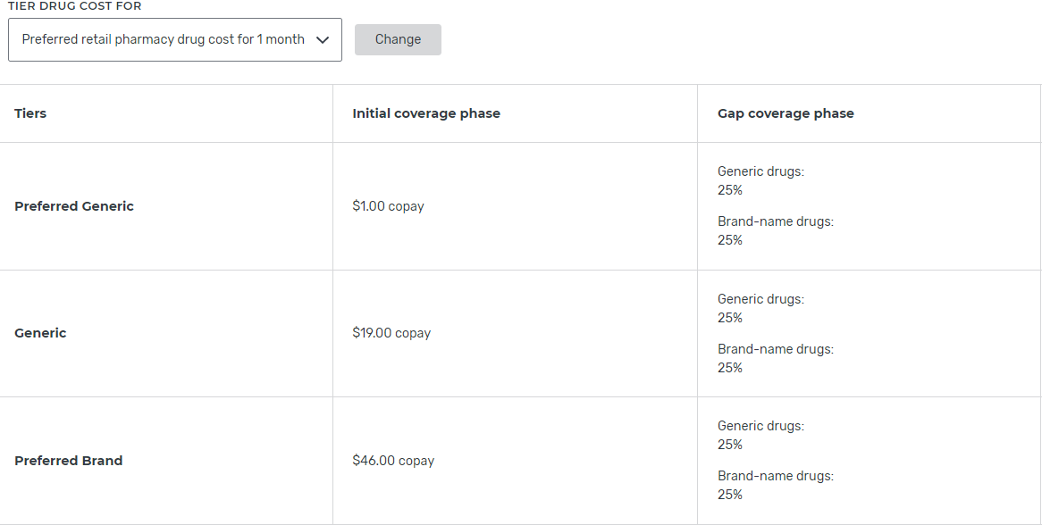
Step 5: Plan Details- Cost by Drug Tier
These plan copays do NOT apply to dual eligibles if cost is more than $4.90

Slide 45
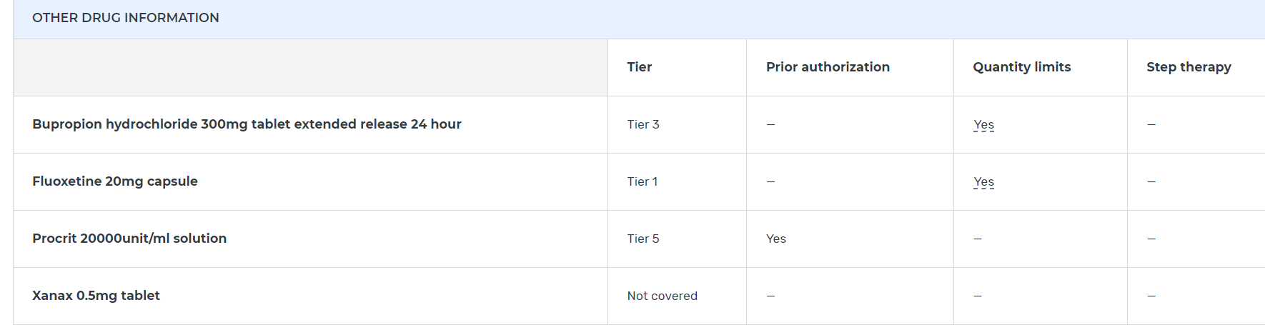
Plan Details- View Other Drug Information
“Quantity Limits” are OK, but “Yes” in PA or ST means doctor must submit medical documents to the plan to get approval.
Drug Tier does not matter. But “Not Covered” means plan will not pay,
and Medicaid will not pay.

Slide 46
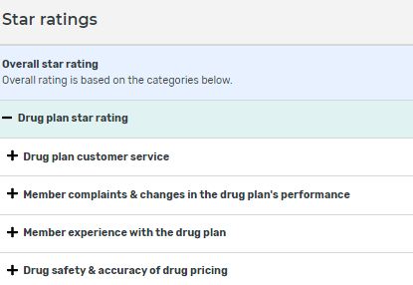
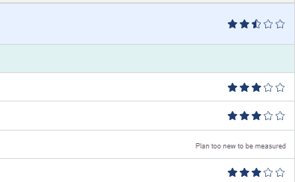
Plan Details- Star Ratings

Slide 47
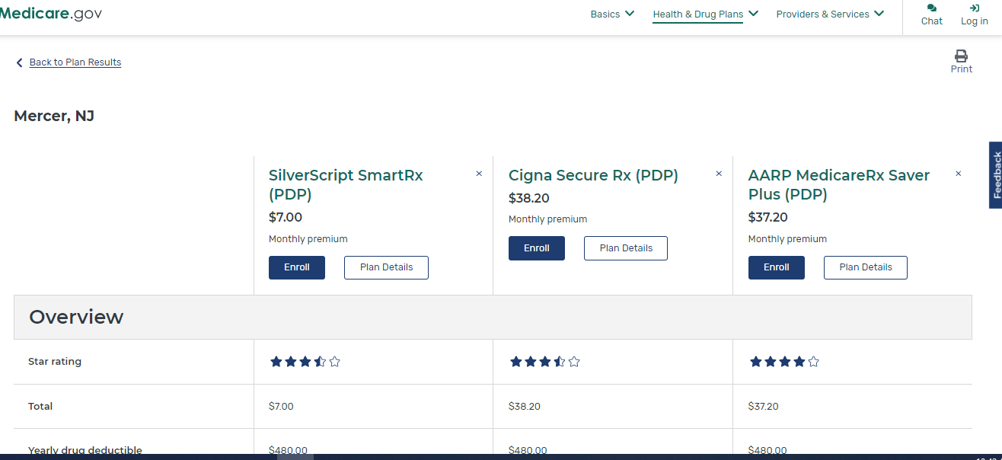
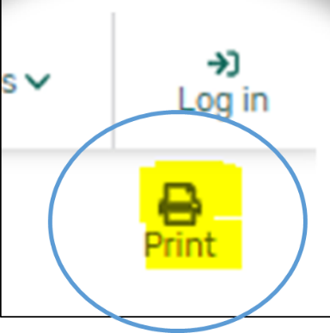
Step 6: Printing Plan Finder Results
Reduce size to about 67%
Notes:
If you’re not ready to select a plan yet and would like to save and print your results, you can do so by using the “Print” icon from the plan comparison screen.

Slide 48
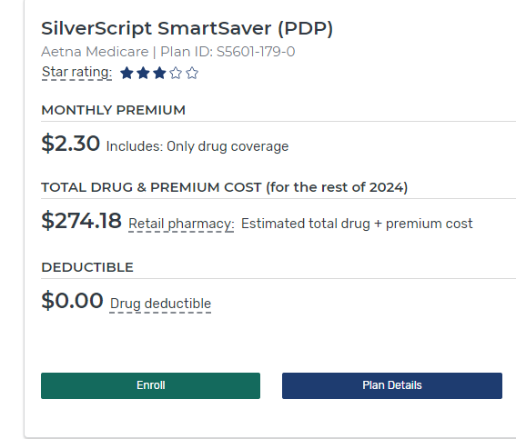
Step Seven: Enroll
ENROLL buttons found on multiple pages
  Plan Results Page
  Top of Plan Details Page
  Top of Plan Compare Page

Slide 49
Step 7: Enrolling
Complete enrollment form
When completed will get confirmation number-
  print the page or copy the number for proof of enrollment.
New Plan will start January 1st if enrolling during the OEP.
No need to take action to disenroll from prior Part D or Medicare Advantage Plan

Slide 50
How to Obtain Answers for
Medicare Questions
NJ Division of Aging Services SHIP website
  https://nj.gov/humanservices/doas/services/q-z/ship/
Check the www.Medicare.gov website.
Call 1-800-MEDICARE
Create a www.Medicare.gov account to see Medicare enrollment status and claims.
Call the current drug or health plan and speak with a customer service representative.
Contact a SHIP counselor

Slide 52

Thank you for joining us today.
Mary McGeary
Mary.mcgeary@dhs.nj.gov

