Slide 1
Back to Basics: Healthcare 101 for Individuals with IDD
John J. Nevins , DO FAAFP
Medical Director Chatham Family Medicine
Faculty at AHS/Overlook Family Medicine
Notes:
Background information
Training involved IDD & Chronically mentally ill patients for longitudinal care
Medical Director at the ARC of Monmouth’s groundbreaking Adult Primary Care Center – 1991-2012- PCMH ahead of its time
Incorporating primary care for IDD throughout career in private practice and now in the AHS Overlook Family Medicine residency program
The culture and challenges of health care delivery for our population are not becoming easier
I hope to be able to provide an overview of IDD care delivery from a PCP point of view and am interested in hearing of challenges faced by clinicians, families and direct care staff

Slide 2
It took over 20 years for the legal definition of a developmental disability to evolve
(a) is attributable to a mental or physical impairment or combination of mental and physical impairments,
(b) is manifested before the person attains age twenty-two;
(c) is likely to continue indefinitely;
(d) results in substantial functional limitations in three or more of the following areas of major life activities:
(1) self-care,
(2) receptive and expressive language,
(3) learning,
(4) mobility,
(5) self-direction,
(6) capacity for independent living, and
(7) economic sufficiency; and
(e) reflects the person's need for a combination and sequence of special, interdisciplinary, or generic care, treatment, or other services which are of lifelong or extended duration and are individually planned and coordinated; except that such term when applied to infants and young children means individuals from birth to age 5, inclusive, who have substantial developmental delay or specific congenital or acquired conditions with a high probability of resulting in developmental disabilities if services are not provided.“\
The Developmental Disabilities Assistance and Bill of Rights Act of 2000; S.1809 — 106th Congress (1999-2000)
Notes:
At least a definition of our population exists
Identifies the need for interdisciplinary care and services which are lifelong….individually planned and coordinated – health care delivery and Primary Care are subsumed in these services-More on this definition of IDD and how it impacts our population’s health care

Slide 3
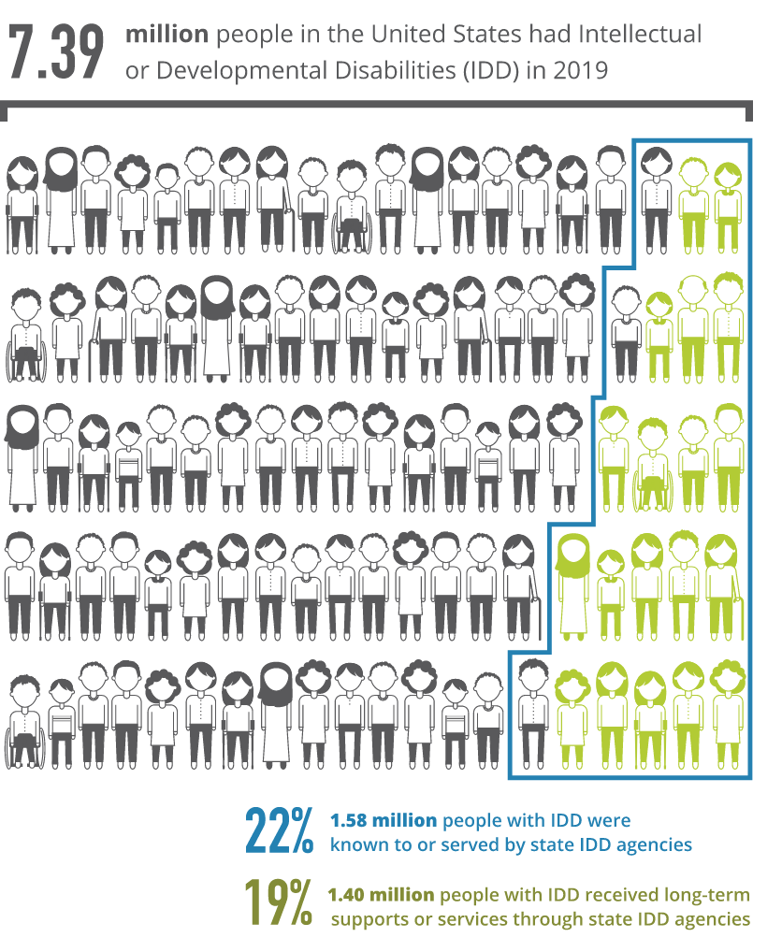
IDD Prevalence
Many say this is likely 10 to 16 million!!!
https://www.ie-care.org/about-the-population
‹#›
Notes:
The lack of definitive data is alarming especially in respect to in planning for services
The outreach to the non-engaged is imperative
These are vulnerable people and families – an appreciated Health Equity crisis

Slide 4
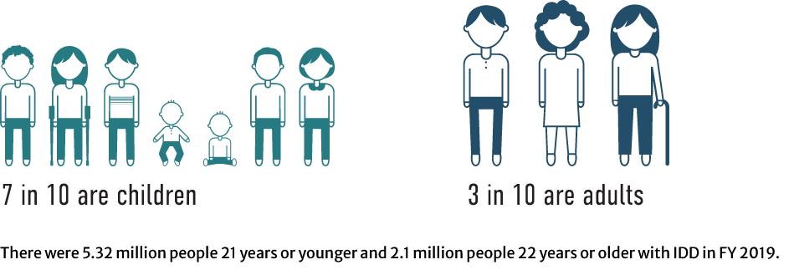
Age of People With IDD in the US Residential Information Systems Project (Minneapolis: University of Minnesota, RISP, Research and Training Center on Community Living, Institute on Community Integration. Retrieved from: https://risp.umn.edu.)
And if this is 10 to 16 million folks(and the ratios hold)…….
Maybe 7-11
Maybe 3 -4.8
‹#›
Notes:
Again –lack of hard data blocks appropriate care and planning. Young people get older – and if these projections/trends hold –there is a wave of IDD folks coming-and there are problems to prevent, conditions to treat to maintain optimum health

Slide 5
Primary Care
Primary care is the provision of integrated, accessible health care services by physicians and their health care teams who are accountable for addressing a large majority of personal health care needs, developing a sustained partnership with patients, and practicing in the context of family and community. The care is person-centered, team-based, community-aligned, and designed to achieve better health, better care, and lower costs.
Primary Care | AAFP
Notes:
Primary care- it’s not only the “first stop,”
It may be the most important stop - it is the hub of care
We family docs like to say that we can handle 85% of all complaints coming through our door and know where to send when we can’s handle it.
We are right care at the right time in the right setting.

Slide 6
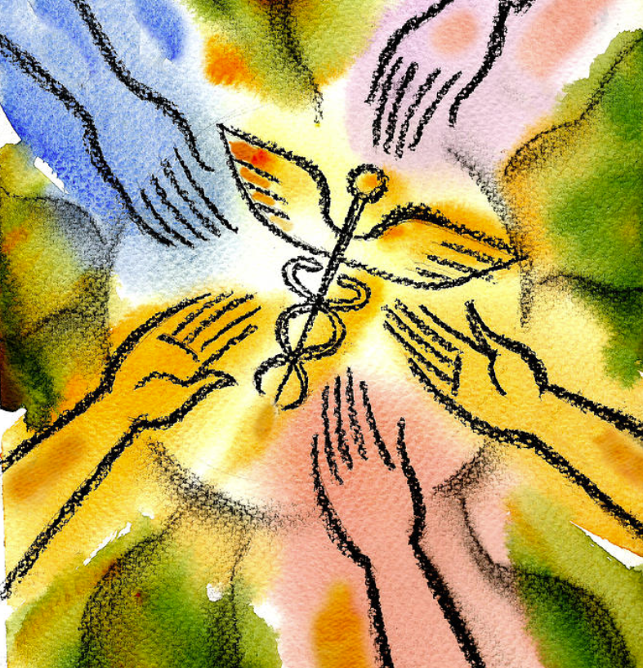
Primary Care
Primary care physicians specifically are trained for and skilled in comprehensive, first contact, and continuing care for persons with any undiagnosed sign, symptom, or health concern (the “undifferentiated” patient) not limited by problem origin (biological, behavioral, or social), organ system, or diagnosis.
Primary Care | AAFP
Leon Zernitsky
Notes:
Just driving home my point about the broad capabilities of a primary care physician
Just noting that this further description is from AAFP so “not limited by problem origin”

Slide 7
Primary Care
Additionally, primary care includes:
health promotion
disease prevention
health maintenance
counseling, patient education
diagnosis and treatment of acute and chronic illnesses in a variety of health care settings (e.g., office, inpatient, critical care, long-term care, home care, schools, telehealth, etc.).
Primary care is performed and managed by a personal physician who often collaborates with other health professionals and utilizes consultation or referral as appropriate. Primary care provides patient advocacy in the health care system to accomplish cost-effective and equitable care by coordination of health care services. Primary care promotes effective communication with patients and families to encourage them to be a partner in health care.
Primary Care | AAFP

Slide 8
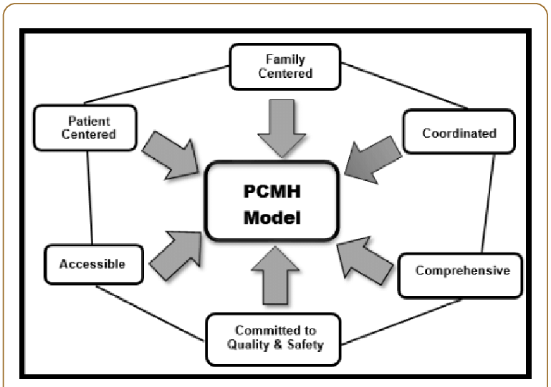
Patient Centered Medical Home: What is a Patient Centered Medical Home?
The medical home is best described as a model or philosophy of primary care that is patient-centered, comprehensive, team-based, coordinated, accessible, and focused on quality and safety.
Notes:
This is an important concept in primary care- the PCMH- it is based upon team integration to identify patient care gaps and execute appropriate engagement to achieve guidelines. It is a model that must meet certain “infrastructure “capabilities in terms of access to care, communication, comprehensiveness and coordination of care to be certified by a national certifying organization like the Joint Commission or NCQA.

Slide 9
PCMH: Patient Centered Medical Home
Five Key Functions of a Medical Home
Access and Continuity - Provide the care your patients need—anytime, anywhere.
Planned Care and Population Health - Use technology to help you be proactive about managing patients’ chronic conditions.
Care Management - Identify which patients need additional support from your care team, and provide those services.
Patient and Caregiver Engagement - Encourage patient participation and shared decision making.
Comprehensiveness and Coordination - Build relationships and coordinate care across the medical neighborhood.
The Patient-Centered Medical Home | AAFP

Slide 10
Health Status in People with IDD
A study which is representative of the complexities of care for IDD was published in 2015
A group of adults with autism(N1507) was compared to an age and gender control group of normal adults at a 10:1 ratio(control/ASD pop.)
Medical and psychiatric conditions were compared in the 2 groups
The health status of adults on the autism spectrum.
Croen LA¹, Zerbo O², Qian Y², Massolo ML², Rich S³, Sidney S², Kripke C⁴Autism. 2015 Oct;19(7):814-23. doi: 10.1177/1362361315577517. Epub 2015 Apr 24.
Notes:
Getting data is even tougher about health status – some of the findings in this may generalize across the population
This is a study from Kaiser Permanente in California demonstrating the prevalence of various conditions in an ASD population.

Slide 11
Health Status in People with IDD
Adults with autism had significantly increased rates of all major psychiatric disorders including:
Depression
Anxiety
Bipolar disorder
Obsessive-compulsive disorder
Schizophrenia
Suicide attempts.
Notes:
Certainly, we notice a high incidence of behavioral health issues in the IDD population. Since we are dealing with conditions that are impacted by the very structure and physiology of the brain we are bound to have not only behavioral health problems but cognitive issues and not least-seizure activity

Slide 12
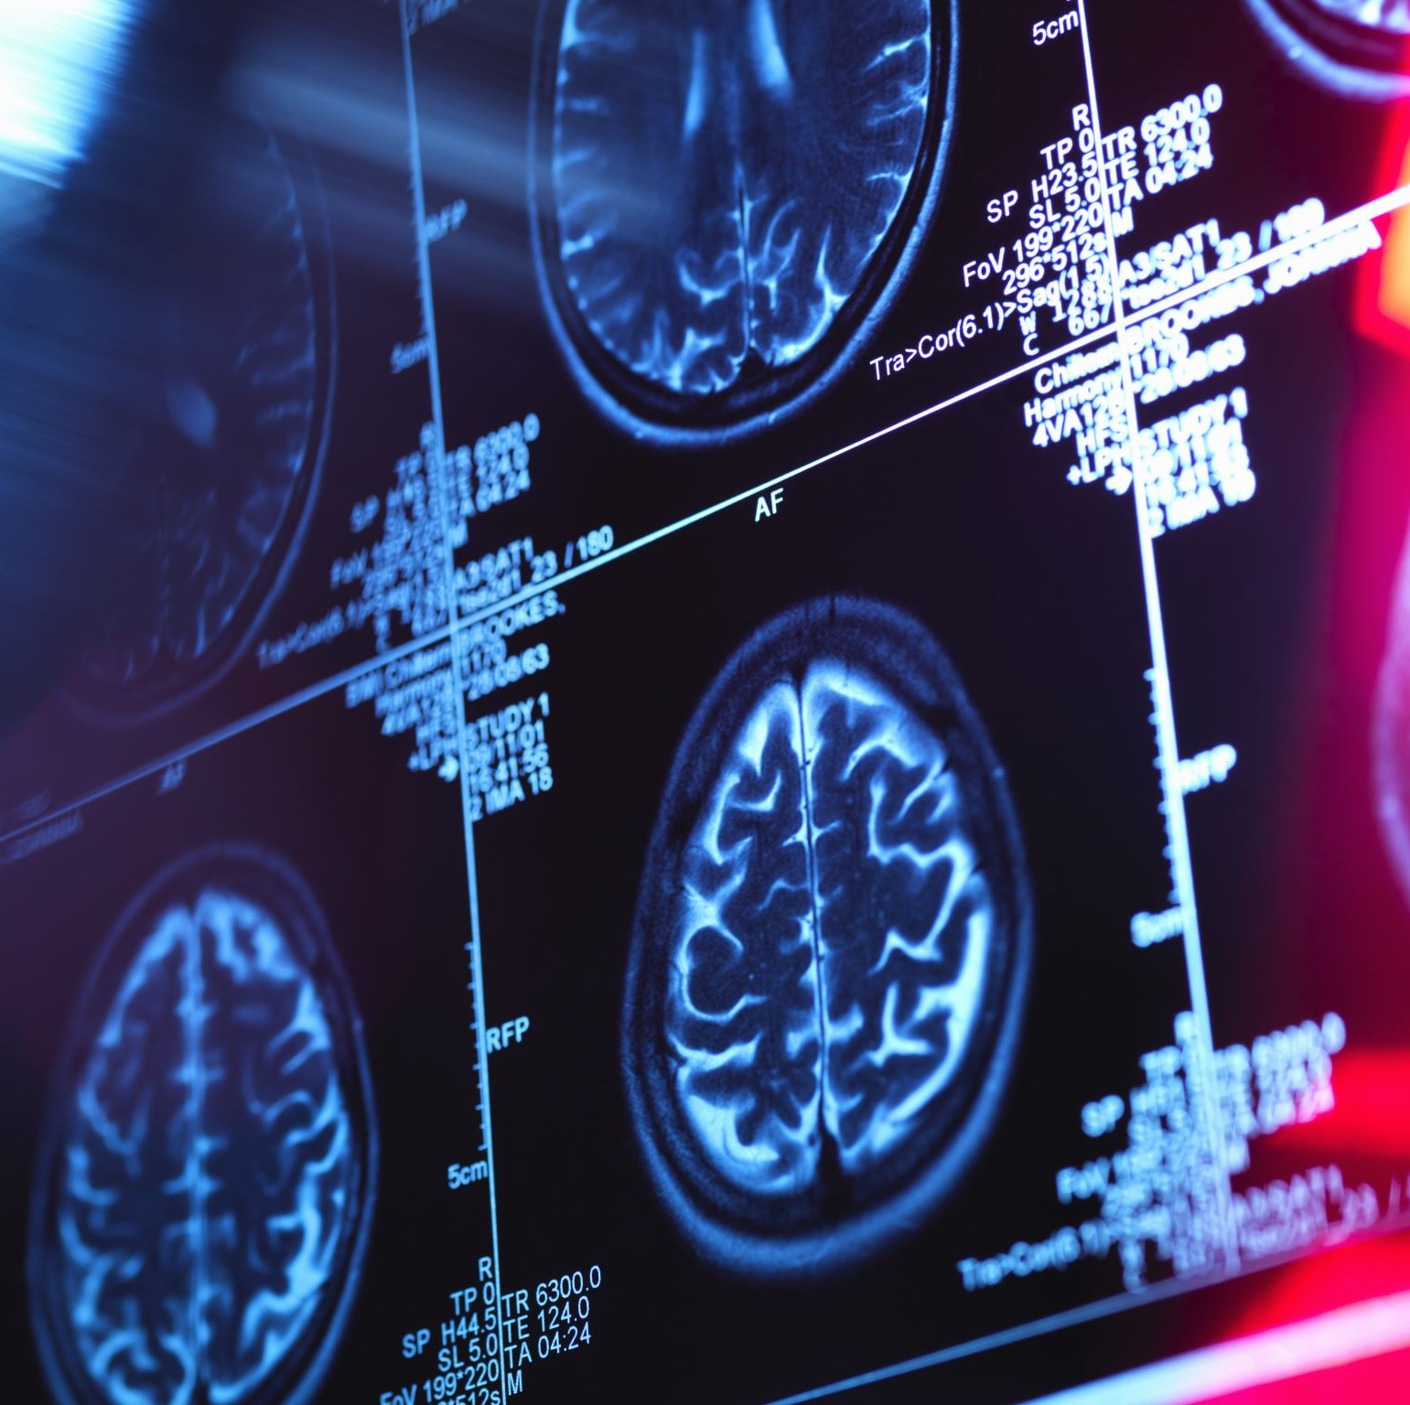
Health Status in Adults with IDD
Nearly all medical conditions were significantly more common in adults with autism, including :
Immune system mediated conditions
Gastrointestinal disorders
Sleep disorders
Seizure disorders
Obesity
Dyslipidemia
Hypertension
Diabetes
Notes:
As this study was a retrospective comparison with a non-affected population the conditions presenting with greater frequency and intensity are additional challenges. There is an entire lecture series which might begin to explain the possible etiologies of higher chronic disease presence.
But multiple chronic conditions outside the CNS are common and require ongoing monitoring, treatment and care

Slide 13
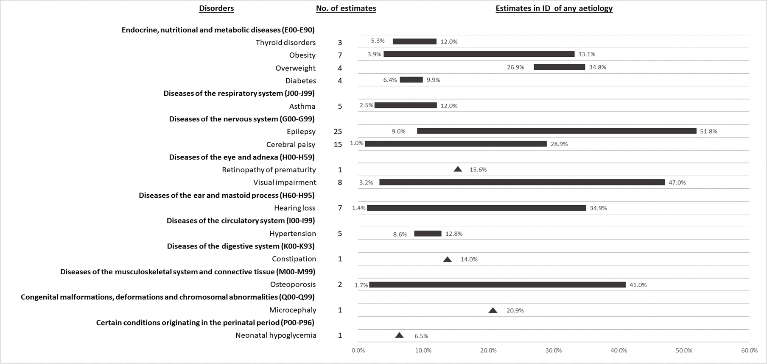
Prevalence and incidence of physical health conditions in people with intellectual disability – a systematic review Liao, P., Vajdic, C. M., Trollor, J. N., & Reppermund, S. (2021). Prevalence and incidence of physical health conditions in people with intellectual disability – a systematic review. PLOS ONE, 16(8), e0256294. https://doi.org/10.1371/journal.pone.0256294
Notes:
This is a study reviewing a number of mostly small studies on the IDD population It demonstrates the need for more study mostly

Slide 14
Chronic Condition Prevalence in IDD Community Ervin, D. E., Hennen, B., Merrick, J., & Morad, M. (2014). Healthcare for Persons with Intellectual and Developmental Disability in the Community. Frontiers in Public Health, 2. https://doi.org/10.3389/fpubh.2014.00083
Notes:
This study demonstrates a plurality of chronic disease in the IDD population
So the need for a medical home and knowledgeable , familiar , longitudinal care is quite plain for a very vulnerable and growing ,aging population

Slide 15
HEALTH WATCH TABLES FOR SELECTED DEVELOPMENTAL AND RELATED DISABILITIES
Autism (vkcsites.org)
Down syndrome (vkcsites.org)
Prader-Willi Syndrome (vkcsites.org)
Muccilli, K. (n.d.). Checklists. Copyright (C) September 2016. https://iddtoolkit.vkcsites.org/physical-health/health-watch-tables-2/
Notes:
These are diagnoses that require some very specific screenings and monitoring over the life cycle. Awareness of clinical presentation and nuances of symptoms can really be important and the difference between early detection and increased morbidity and mortality
These guides for different IDD syndromes and genetic conditions can be very helpful in guiding longitudinal examinations and preventing issues from emerging
Having resources like this is invaluable especially for adult patients

Slide 16
Centers in NJ where you will find a specialist in Neurodevelopmental Brain Disorders …Pediatric
Children's Specialized Hospital150 New Providence Road Mountainside, NJ 07092 United States of America
K. Hovnanian Children's Hospital at Jersey Shore University Medical Center1945 Corlies Avenue Neptune, NJ 07754 United States of America
Newark Beth Israel Children’s Hospital of New Jersey201 Lyons Avenue at Osborne Terrace Newark, NJ 07112 United States of America
Saint Barnabas Children's Center Saint Barnabas Medical Center94 Old Short Hills Road Livingston, NJ 07039 United States of America
St. Joseph's Children's Hospital703 Main Street Paterson, NJ 07503 United States of America
The Bristol-Myers Squibb Children's Hospital at Robert Wood Johnson University HospitalOne Robert Wood Johnson Place New Brunswick, NJ 08903-2601 United States of America
The Children's Hospital at Monmouth Medical Center300 Second Avenue Long Branch, NJ 07740 United States of America
The Children's Hospital at Saint Peter's University Hospital254 Easton Avenue New Brunswick, NJ 08903 United States of America
The Children's Regional Hospital at CooperOne Cooper Plaza Camden, NJ 08103 United States of America
The Goryeb Children's Hospital100 Madison Avenue Morristown, NJ 07962 United States of America
The Joseph M. Sanzari Children's Hospital Hackensack University Medical Center30 Prospect Avenue Hackensack, NJ 07601 United States of America
Voorhees Pediatric Facility1304 Laurel Oak Road Voorhees, NJ 08043-4392 United States of America

Slide 17
Centers in NJ where you will find a specialist in Neuro-developmental Brain Disorders…Adult
Notes:
Let’s now find a medical home.
What do we look for

Slide 18
Characteristics of an ideal Clinician to care for challenging patients with IDD
Appreciation of life cycle and family life cycle
Awareness of psychosocial complexities
Skills and training developed with exposure across the lifecycle which gives insight and heightened ability in the diagnosis and ongoing care of patients who may be nonverbal
Notes:
My subtle description of a Family Physician

Slide 19
Characteristics of an ideal physician to care for patients with IDD
Facility with medical complexity
Facility with fluid concepts of family
Intuition(clinical skill that is needed in pediatrics and geriatrics)
Appreciation of Behavioral Health role and integration into the care
Comfort and competency with psychopharmacology
Culturally aware
Notes:
Seems straightforward but you don’t see these capabilities listed on Yelp or Healthgrades or ZocDoc
Most often it is word of mouth… the IDD community-mostly moms-recommend a medical home
It often defaults to the ER –not having a PCP
Pitch the residency programs – Family Medicine residency programs- as a longitudinal care site

Slide 20
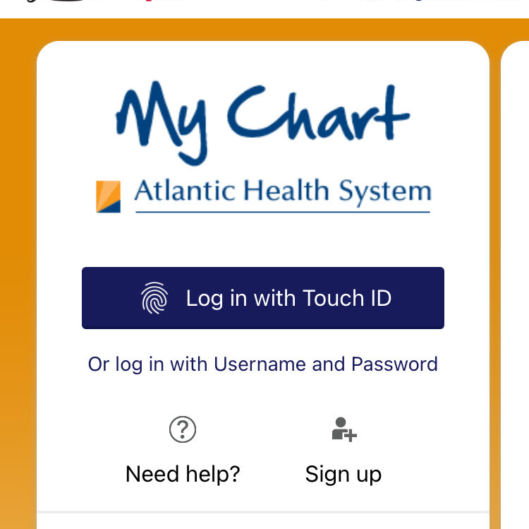
Preparing for a successful visit in Primary Care
Utilize patient portals to detail concerns and purpose of visit
This is a great tool for family members and Direct Support Professionals who have witnessed a change in behavior or other status change- to detail what they witnessed. Too often the support person taking the patient to the office has no familiarity with the patient and no detailed information about the changes in health or behavior that prompted the visit.
Notes:
Congratulations!
You have vetted a medical home and found it good!
Take advantage of the communication technology for non-emergent issues and med renewals and scheduling an appointment

Slide 21
Preparing for a successful visit in Primary Care
If the visit is for the NJ DDD physical - have the updated Medication List
Blood work is often required, especially with certain long-term medications and a pre-visit lab draw should be arranged for fasting labs or a “trough” blood draw
Have a "huddle" in the GH prior to the visit to review and include observations and concerns and convey them prior to the visit
Be sure ALL necessary renewals, requests for letters of medical necessity , durable medical goods, referrals...etc,etc,etc ...are communicated prior to or at the visit
Notes:
Other issues like guardianship will often come up to complicate things. Logistics, state laws (i.e., Danielle’s Law) may interrupt continuity .
These are part of the culture of care for IDD folks and each state has it’s own particular flavor of these challenges which are worthy of separate long form discussions.

Slide 22
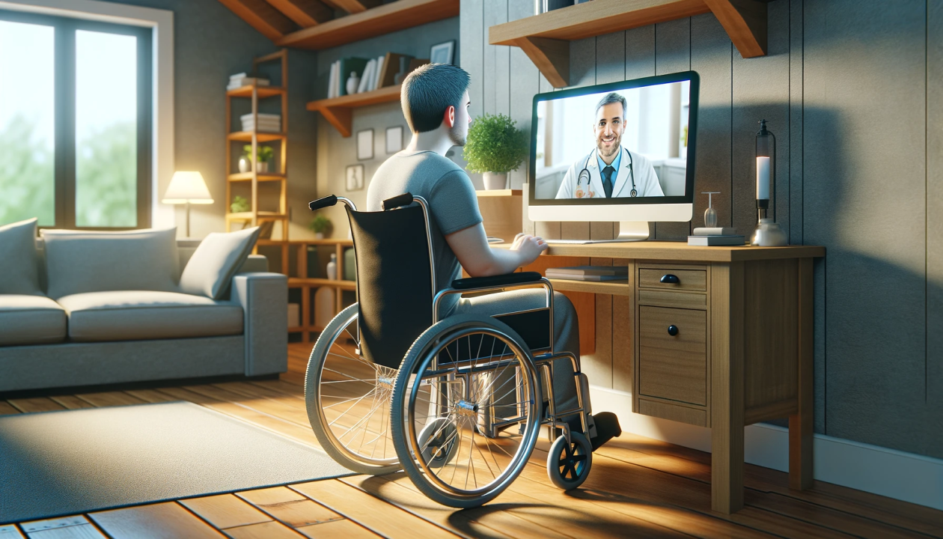
Preparing for your telemedicine appointment:
Get ready. Prepare as you would for an in-person visit. Make sure you have your medication list handy and write your list of questions you would like to ask.
Medication check. Check to see if you have enough pills at home or if you need refills. Remember, try to have a 90-day supply on-hand during quarantine.
Communication program check. Download the technology/application your physician is using for the call ahead of time. You will most likely use a program such as, Epic, Zoom, FaceTime, Skype or others. Your provider will let you know which program to download.
Device preparation. Make sure you set up in a location with a good internet connection. Charge your device before the appointment starts or try to keep it plugged in.
Be ready to move. Try to position yourself near a space where you can perform typical tasks your doctor or specialist may ask you to complete. For instance, a movement disorders specialist or physical therapist may ask you to walk. It may be helpful to have a family member ready to help during the appointment.
Final touches. Have a paper and pen nearby, along with any items your healthcare specialist may have asked you to bring to your appointment (for instance, a thermometer).
Video Tips:
Limit any clutter between you and the camera
Avoid backlighting (like windows behind you)
Limit background noise that may come from a TV, radio, pets or affect your device’s microphone (a fan overhead, loud AC unit, open window)
Speak in your normal voice
Do not place papers or objects near the microphone. If you are not using your cell phone, place it away from your device.
Ask your questions. Take notes and add them to your medical file: be sure renewals are all thought out prior.
Provide updates. Your pharmacy, insurance or contact information may have changed. Let the doctor’s office know before your appointment ends.

Slide 23
Comprehensive Disability Clinical-Care Curricula and Disability Competency Training National Council on Disability. (2022, August). Health Equity Framework for People with Disabilities. National Council on Disability /Policy Framework. Retrieved February 17, 2023, from https://ncd.gov/sites/default/files/NCD_Health_Equity_Framework.pdf
An abundance of research indicates the lack of disability competency and interdisciplinary training among medical professionals contributes to the lack of health equity for people with disabilities across the nation.

Slide 24
Challenges to Care of IDD population
Health care professionals are not adequately exposed to this population during training
Medical professionals lack knowledge of logistics (motivation, competence, liability avoidance, and confidence) involved in providing care to persons with IDD
Treatment of patients with IDD is poorly reimbursed, which discourages some from treating the complex needs of persons with IDDT
Informed consent for patients with IDD may be complicated by guardianship (i.e., the legal designation of another person as the patient’s decision maker), which requires extra effort and increases clinician concern about effectively communicating with patients, managing complex conditions, and the risk of litigation and malpractice
IDD is poorly reimbursed, which discourages some from treating the complex needs of providing care to persons with IDD
AMA J Ethics. 2016;18(4):422-429. doi10.1001/journalofethics.2016.18.4.pfor1-1604.onfidence)

Slide 25
No One Will See You Now
Primary Care Scorecard 2024

Slide 26
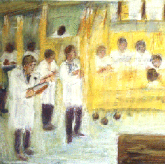
Medical Schools stepping up…a little
Medical School Partners — AADMD
25 down –167 to go!
May H. Lesser

Slide 27
Characteristics of underserved population as it relates to health care delivery
Absence/Loss of medical home
Absence/Loss of longitudinal care
Episodic care predominates
Gaps in care become pronounced over time
Loss of coordinated care and preventive intervention leads to entry at the most dangerous and expensive parts of the health care system
Notes:
So, the foregoing projections are indicating challenges in primary care access and though emerging movement to incorporate IDD awareness and clinical skills , The IDD population remains at particular risk for the points listed but it describes(these gaps describe something else-

Slide 28
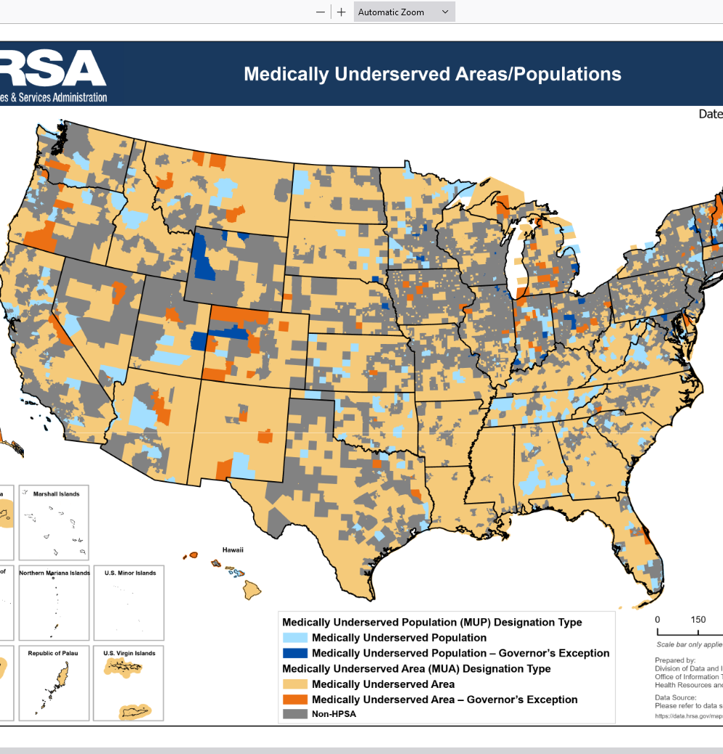
MUP-Medically Underserved Population
The IDD population meets many of the criteria found in other populations deemed “medically underserved
THERE IS NO SUCH DESIGNATION for this population
Such designation would allow the IDD population access to 34 federal programs which could address disparities in health care and access
Implications of Health Care Reform for Individuals With Disabilities ;Joe Caldwell DOI: 10.1352/1934-9556-48.3.216
Notes:
Those criteria define a medically underserved population and this is not just a descriptive-it is a legal designation that opens the door to a number of changes for a MUP

Slide 29
“…………the test of a civilization is the way that it cares for its helpless members.”
Pearl Buck

Slide 30
Contact
John J. Nevins , DO FAAFP
Medical Director Chatham Family Medicine
Faculty at AHS/Overlook Family Medicine
John.Nevins@atlantichealth.org

