Slide 1
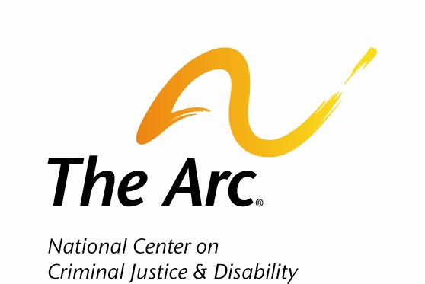
Bridging Bridges between the Disability & Criminal Justice Communities

Slide 2
The Arc of the United States
The Arc’s Mission:
  To promote and protect the human rights of people with intellectual and developmental disabilities and actively support their full inclusion and participation in the community throughout their lifetimes.
Largest organization in the U.S. that serves people with intellectual and developmental disabilities (IDD) and their families
Policy, program, and legal advocacy
550+ chapters across the country

Slide 3
National Center on Criminal Justice and Disability
Created in 2013 with support from the Bureau of Justice Assistance
Mission: Advocate at the intersection of criminal justice reform and the advancement of disability rights
  Work on both victim/witness issues and on issues facing those who are charged with crimes
Broad portfolio of projects and contracts from the federal government and foundations, some fee-for-service
Target audiences: Disability advocates, criminal justice professionals, people with IDD and The Arc’s chapter network

Slide 4




National Center on
Criminal Justice and Disability
Training and technical assistance
  Pathways to Justice®
  www.nccjdpathwaystojustice.org
  Community-based program that creates Disability Response Teams (or DRTs)
Information and referral
  For people with disabilities and their families as well as criminal justice and allied professionals
  https://thearc.org/our-initiatives/criminal-justice/
Resource collection and creation
  Policy briefs, fact sheets, other publications
Education
  Social media, webinars, and conferences

Slide 5













Project Partners

Slide 6
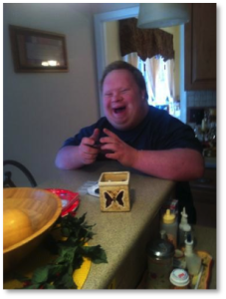
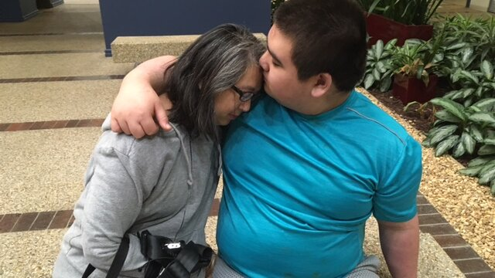
WHY WE CAN’T STOP ADVOCATING
Ethan Saylor (2013)
Eric Parsa (2020)

Slide 7
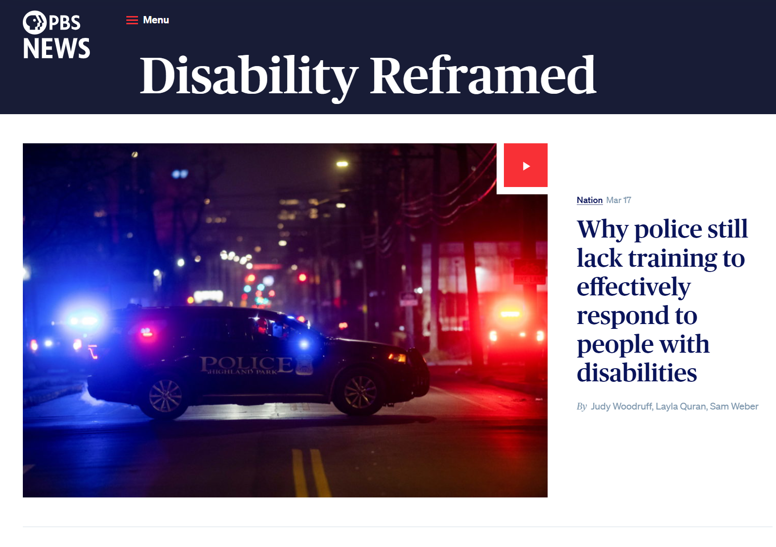

Slide 8
What the
Data Tells Us

Slide 9
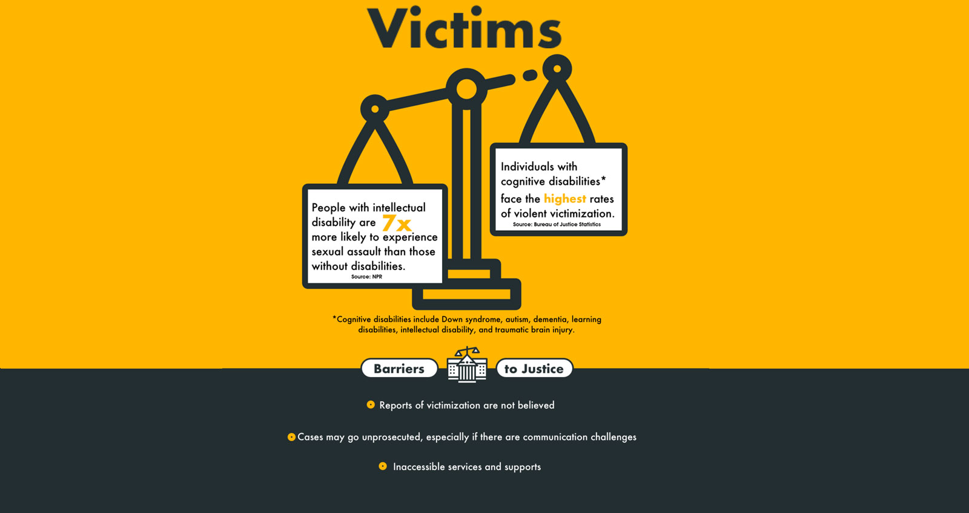

Slide 10
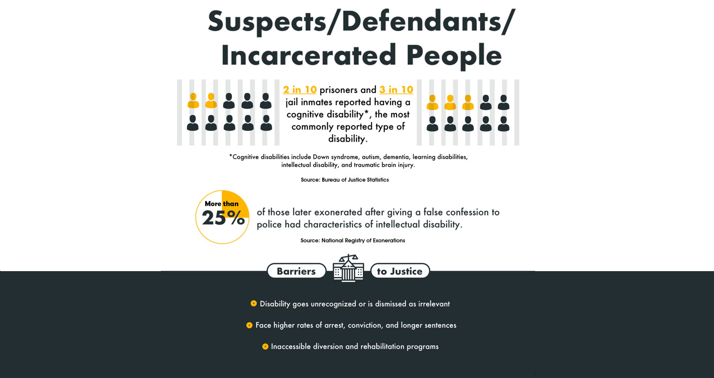

Slide 11
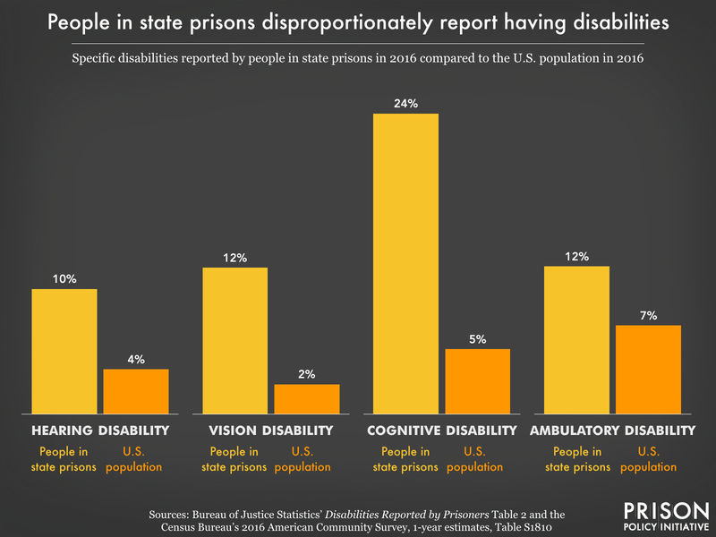

Slide 12
Race & Disability
American Journal of Public Health article (McCauley, 2017) found that young people with disabilities are 13% more likely to be arrested than their peers without disability
  That figure jumps to 17% for Black youth with disabilities
People with disabilities have an overall 43% chance of arrest, with a disproportionate risk falling on young Black men

Slide 13
NCCJD Projects & Initiatives
Interviewing and Interrogating People with IDD – IACP & COPS Office
Just Policing: In-Person and Online Training for Police on IDD – COPS Office
Language Access Barriers to Justice Among Victims with IDD - OVW
Crisis Response Intervention Training (CRIT) – IACP & BJA
Home Safe: People with autism/IDD and wandering – Autism Society & BJA
International work: Access to Justice Knowledge Hub - OSF
Transforming Healthcare: Educating health care with a disability-led lens - WITH
NCCJD’s Community of Practice for The Arc’s chapter network

Slide 14
Pathways to Justice Training Program

Slide 15
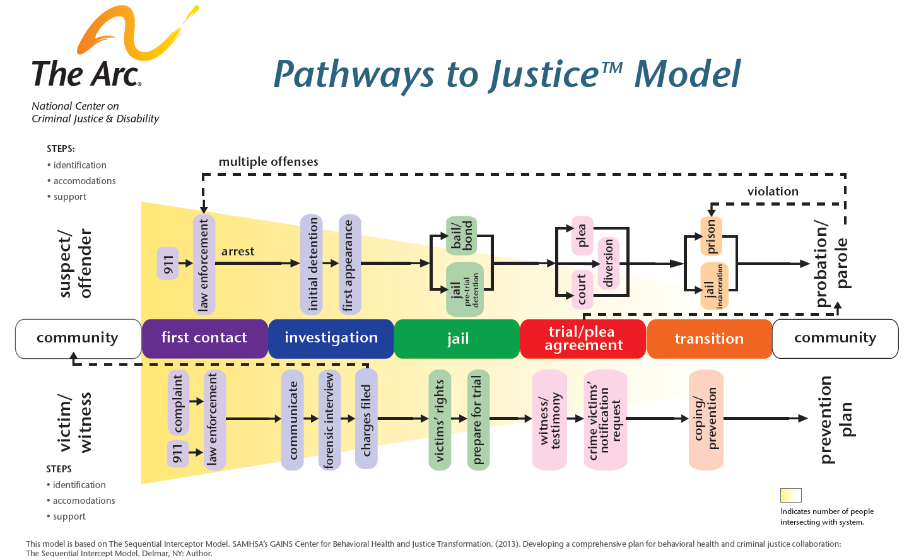
Pathways to Justice™ Model

Slide 16
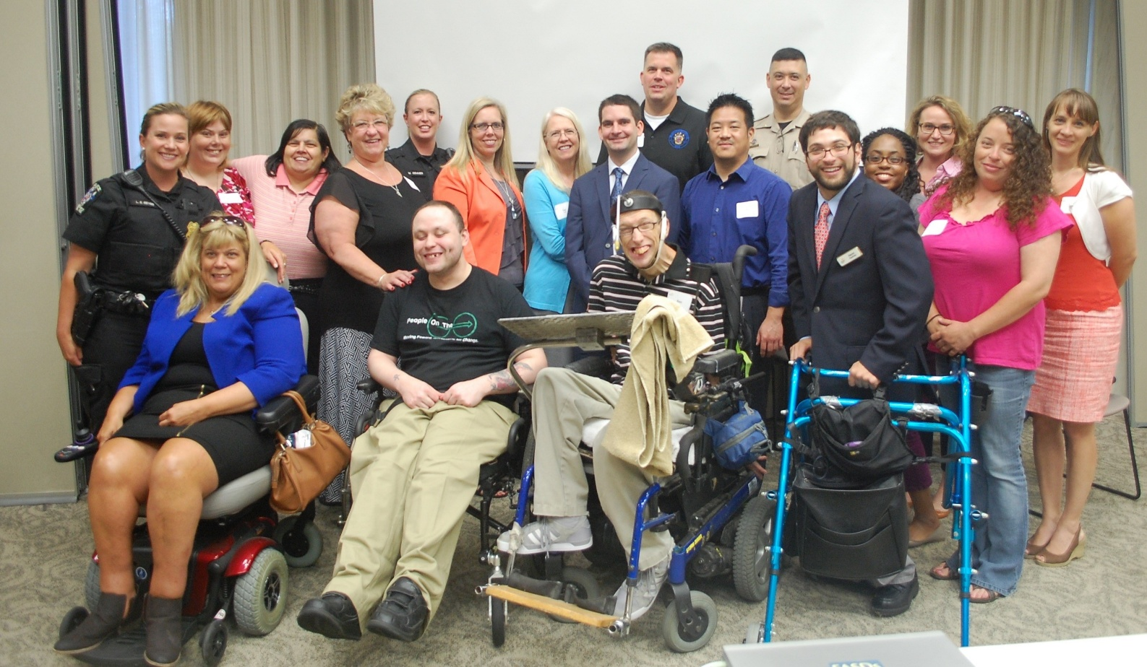
Pathways to Justice®
STEP 1:
Disability Response Team (DRT)
STEP 2:
Training
for Justice Professionals
STEP 3:
Ongoing Technical Assistance
Pathways Principles:
Nothing about us, without us
Community-based
Multidisciplinary
Relationship-oriented

Slide 17


Pathways to Justice®:
A Comprehensive Approach
  Module 1: Introduction to DRTs and the Pathways to Justice Training Program
  Module 2: Disability Basics
  Module 3: Law Enforcement
  Module 4: Victim Service Providers
  Module 5: Attorneys
  Module 6: Developing a PTJ Plan
  Evaluation Process

Slide 18
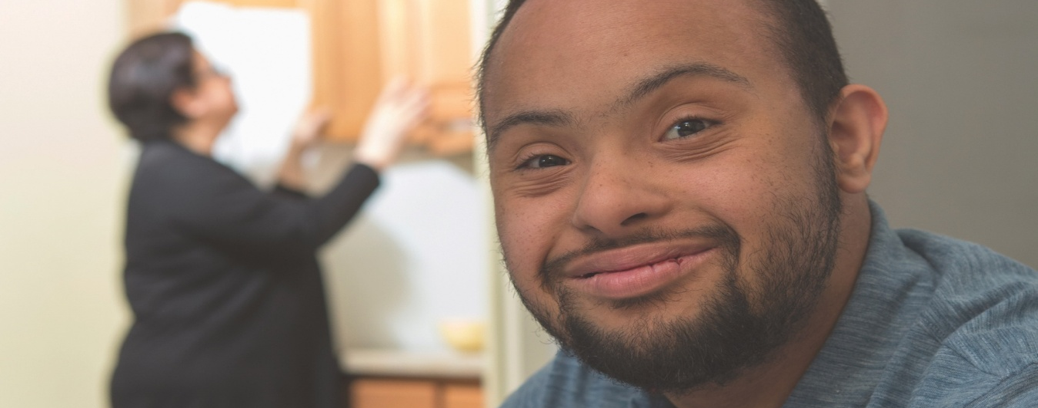
The Impact of Pathways to Justice
15 Disability Response Teams in 12 different states
Over 1,700 justice professionals trained since 2015

Slide 19
Contact Information
NCCJD Team
  Leigh Anne McKingsley, Senior Director
  Mckingsley@thearc.org
  Victoria “Tori” Glaude, Program Manager
  Jessica Oppenheim, Expert Consultant
  Oppenheim@thearc.org
  Erica Harris, CRIT Project Consultant
Visit NCCJD® online
www.thearc.org/NCCJD
Pathways to Justice®
https://thearc.org/our-initiatives/criminal-justice/pathway-justice/

Slide 20
Questions?

