Slide 1
Oral health and dental care for individuals with I/DD The Arc of New Jersey Health Care Advocacy Webinar series
Evan Spivack, DDS
April 16, 2024

Slide 2
Evan Spivack, DDS
Director, Special Care Treatment Center
Professor, pediatric dentistry
Rutgers School of Dental Medicine
Attending dentist
Department of Dental Medicine
University Hospital
spivacev@sdm.rutgers.edu

Slide 3
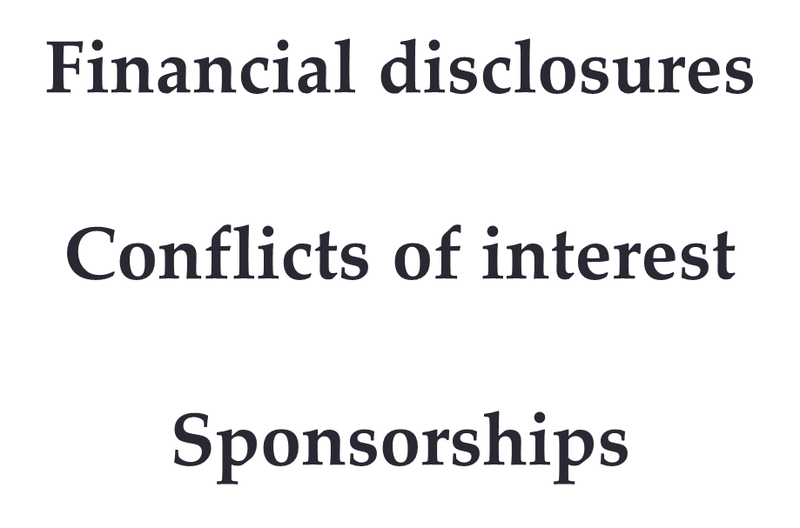

Slide 4
Why do we care?

Slide 5
Unmet oral health needs
With
DD
Without
DD

Slide 6
Overall oral health
Without
DD
With
DD

Slide 7
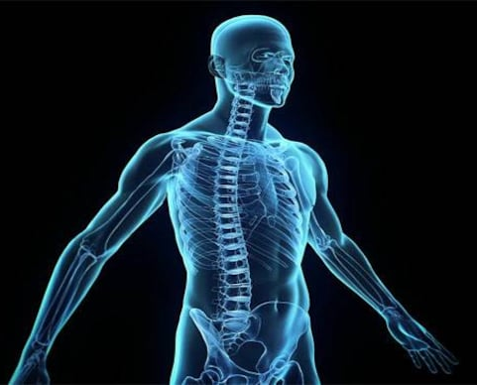
The link to overall health
Pulmonary problems
Cardiac concerns
Cognitive decline

Slide 8
CAREGIVER
HOUSING
BEHAVIOR
MEDICAL
CONCERNS
CULTURAL
ISSUES
SIDE
WALKS
DOORS
SUPPORT
NETWORK
DENTAL
COMPLEXITY
TRANSPORT
ORAL
HYGIENE
FINANCES
DIET
STAIRS
PHYSICAL
CONCERNS
COMMUNI
CATION

Slide 9
Oral conCerns

Slide 10
Significant oral concerns
Dental caries
Periodontal disease
Oral cancer

Slide 11
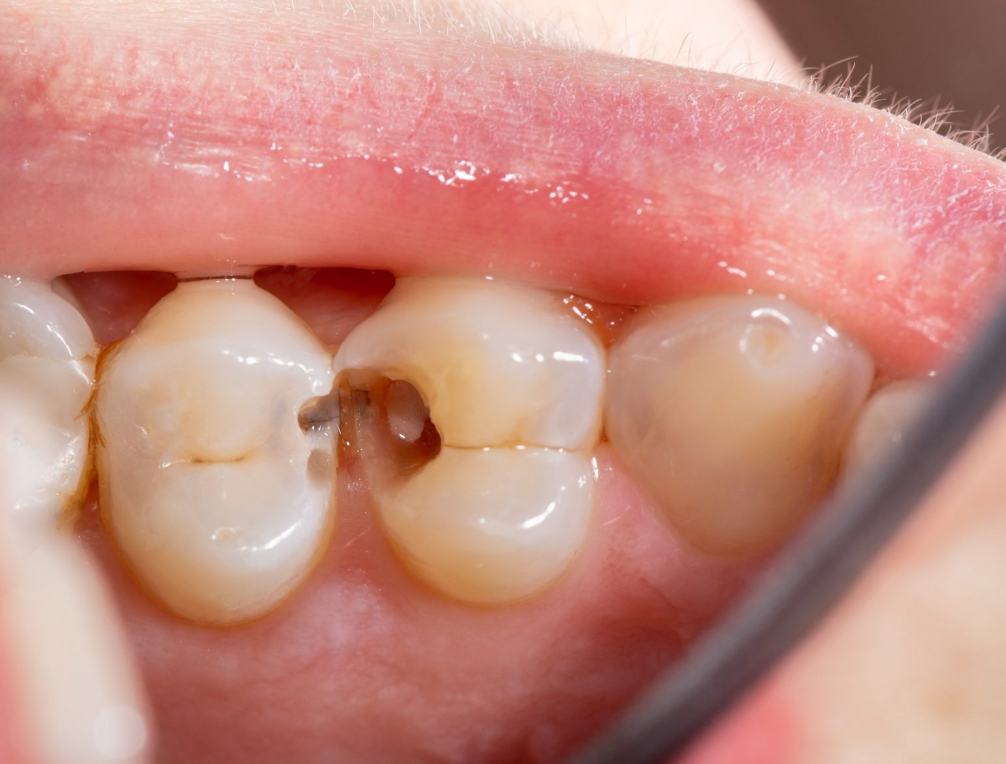
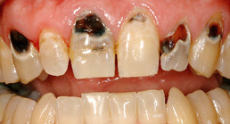
Significant oral concerns
Dental caries
Periodontal disease
Oral cancer

Slide 12
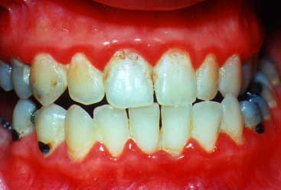
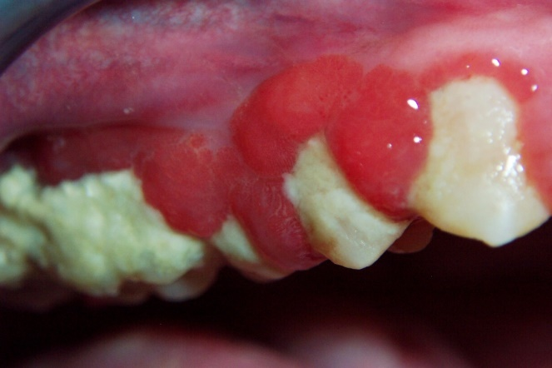
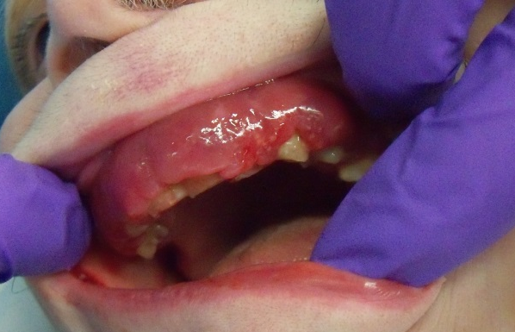
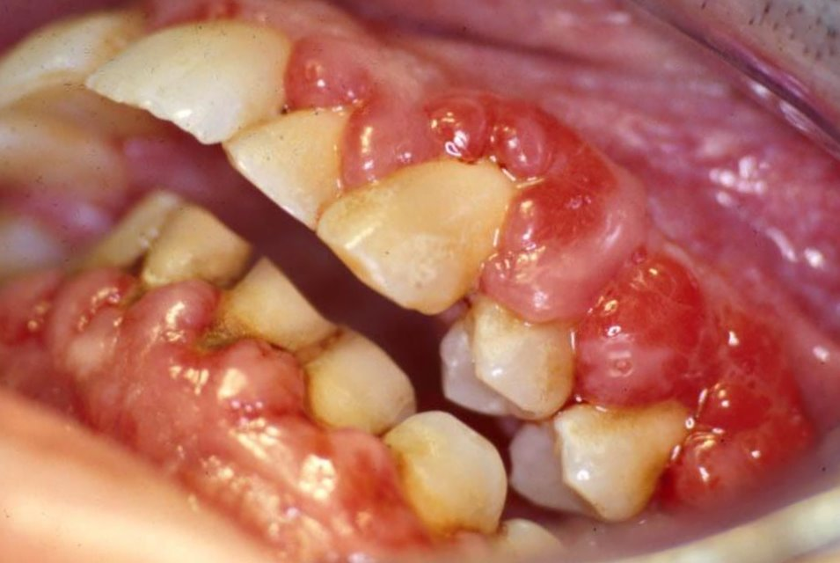
Significant oral concerns
Dental caries
Periodontal disease
Oral cancer

Slide 13
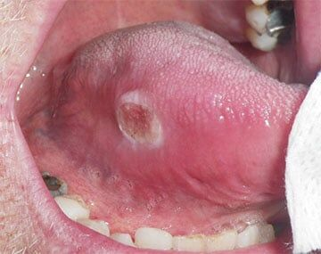
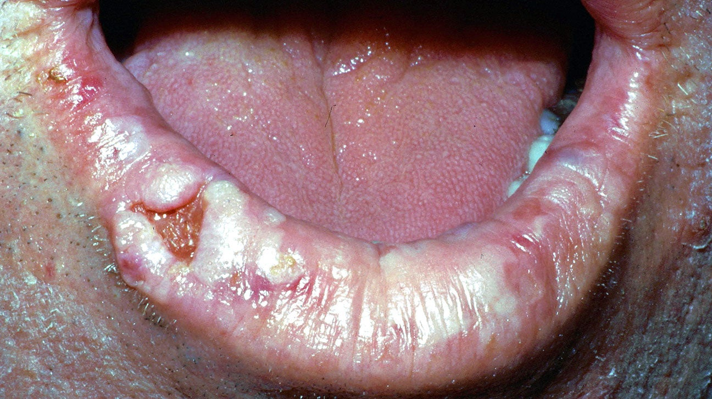
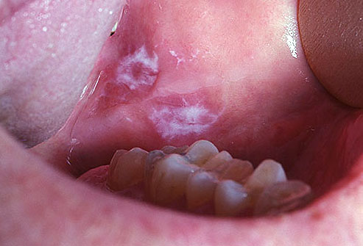
Significant oral concerns
Dental caries
Periodontal disease
Oral cancer

Slide 14
Other oral challenges
Poor oral hygiene
Xerostomia
GERD
Bruxism
Self-injurious behaviors

Slide 15
Other oral challenges
Poor oral hygiene
Xerostomia
GERD
Bruxism
Self-injurious behaviors

Slide 16
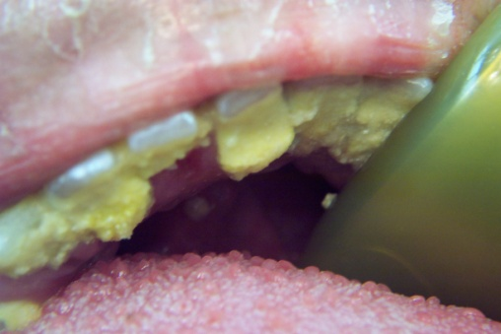
Other oral challenges
Poor oral hygiene
Xerostomia
GERD
Bruxism
Self-injurious behaviors

Slide 17
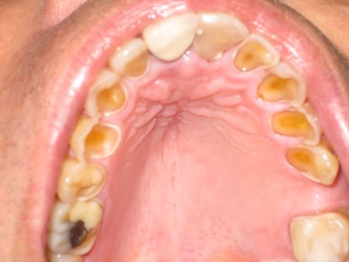
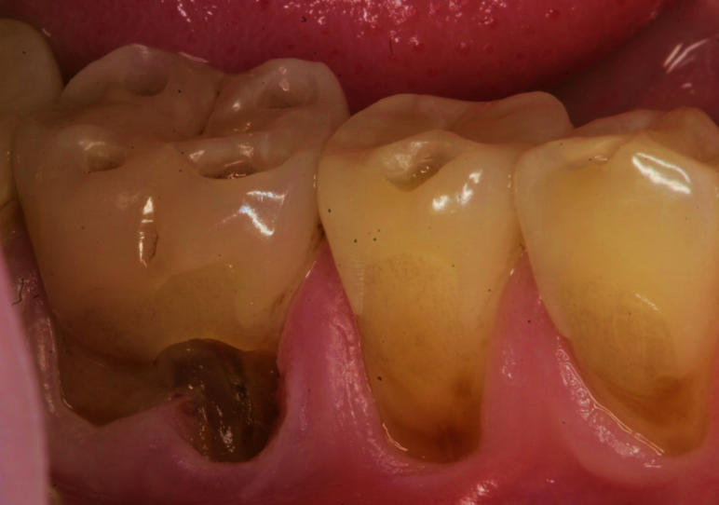
Other oral challenges
Poor oral hygiene
Xerostomia
GERD
Bruxism
Self-injurious behaviors

Slide 18
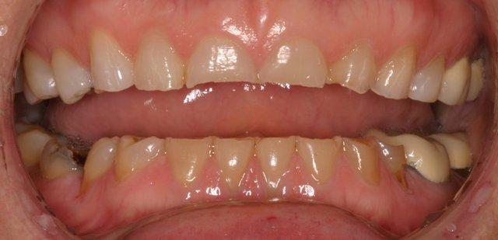
Other oral challenges
Poor oral hygiene
Xerostomia
GERD
Bruxism
Self-injurious behaviors

Slide 19
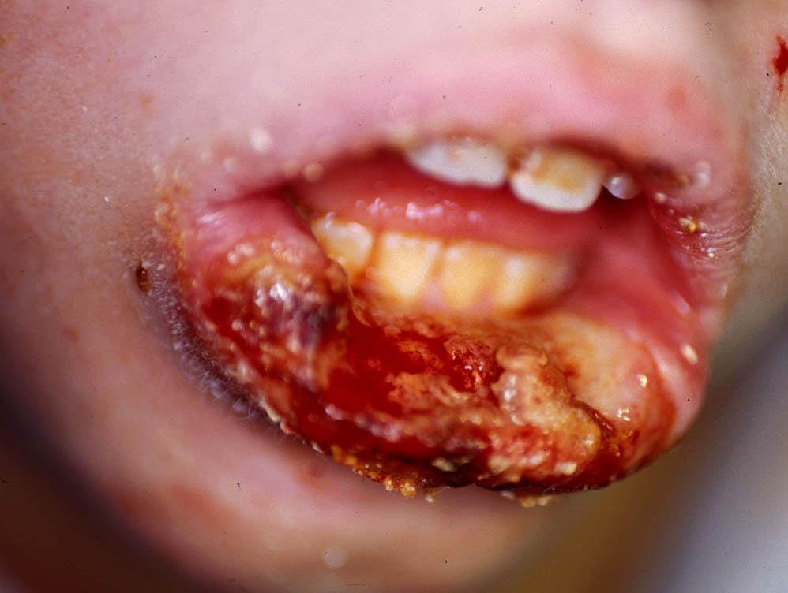
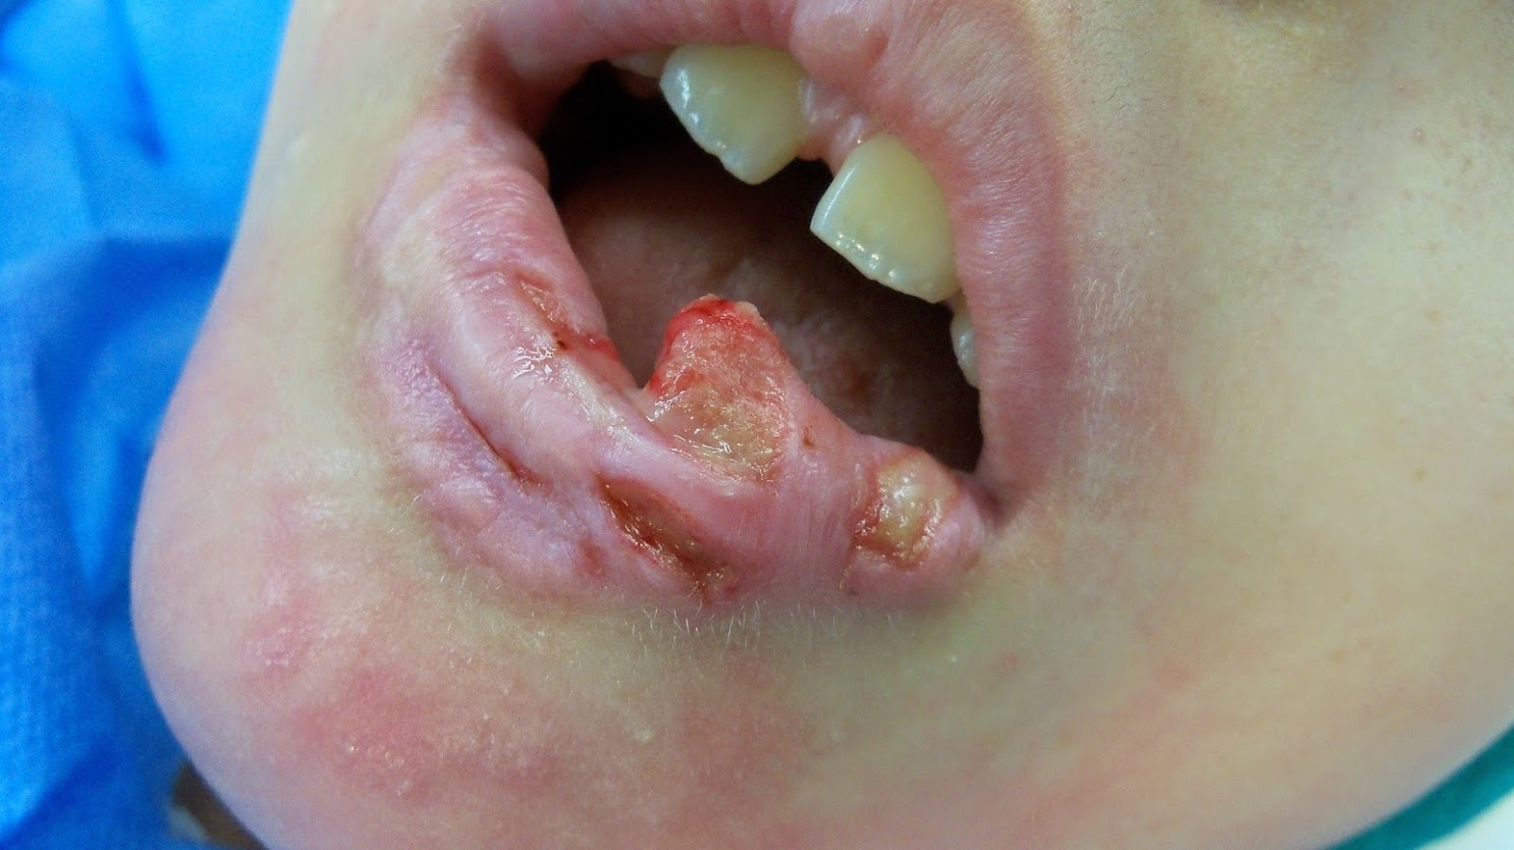
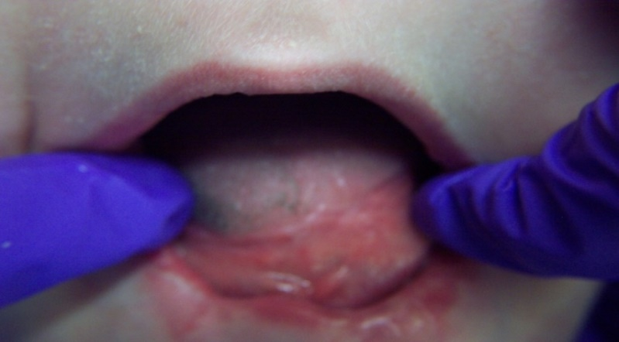
Other oral challenges
Poor oral hygiene
Xerostomia
GERD
Bruxism
Self-injurious behaviors

Slide 20
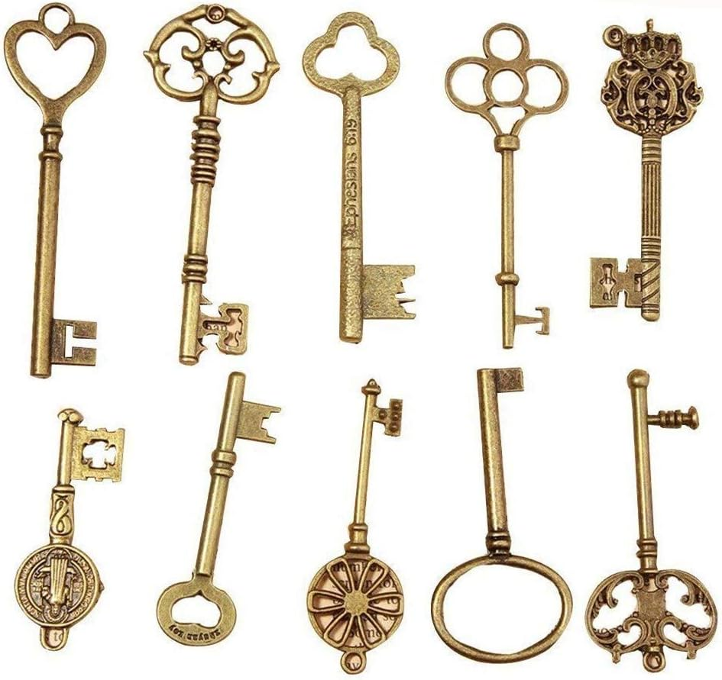
The keys to oral Care

Slide 21
How can we maintain oral health?
Professional follow-up
Diet and nutrition
Oral home care

Slide 22
How can we maintain oral health?
Medical diagnoses
List of medical providers
List of medications
List of allergies
List of surgeries
Special information
Professional follow-up
your job
the dentist’s job
Diet and nutrition
Oral home care

Slide 23
How can we maintain oral health?
Professional follow-up
your job
the dentist’s job
Diet and nutrition
Oral home care
Gather information
Oral examination
X-rays/imaging
Diagnostic tests
Treatment planning

Slide 24
Planning patient care
ORAL HEALTH
OVERALL HEALTH

Slide 25
Throwing away the book

Slide 26
Just because you CAN do something… doesn’t mean you SHOULD do something

Slide 27
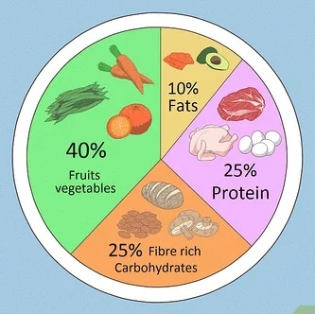
How can we maintain oral health?
Professional follow-up
Diet and nutrition
Oral home care

Slide 28
How can we maintain oral health?
Professional follow-up
Diet and nutrition
Oral home care
Toothbrushing
Mouth rinsing
Flossing
Tongue brushing

Slide 29
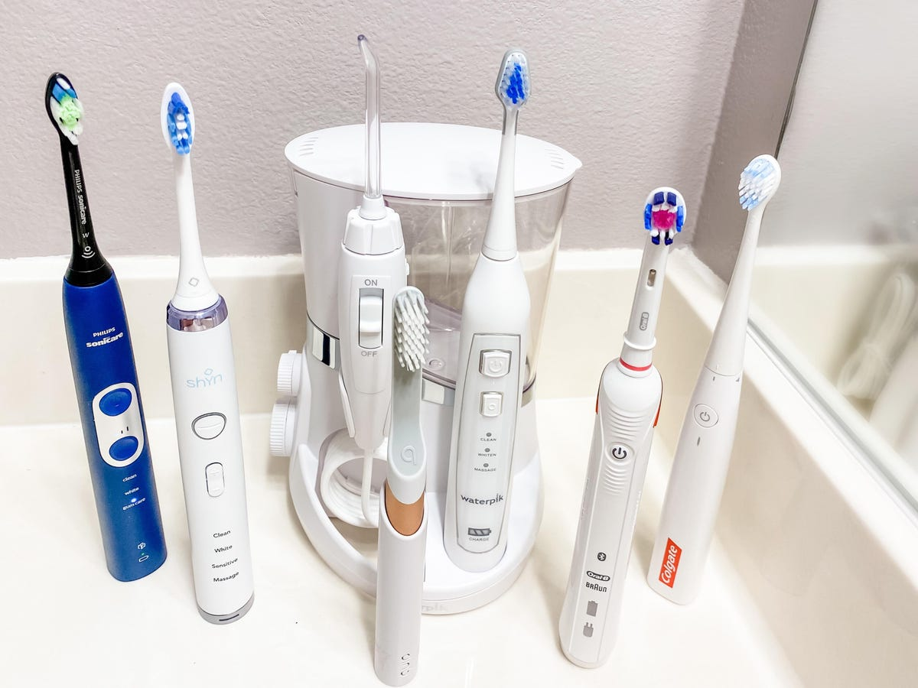
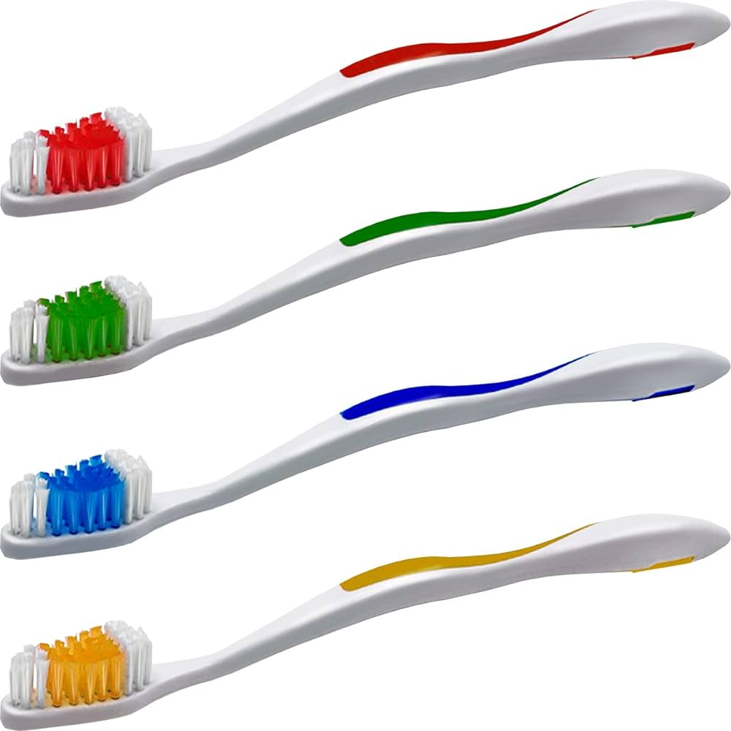
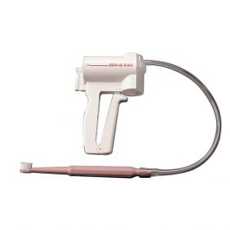
Toothbrushes
Manual or powered?
Soft, medium or hard?
When to replace the brush?
How long to brush for?
When to brush?
What if there is bleeding?

Slide 30
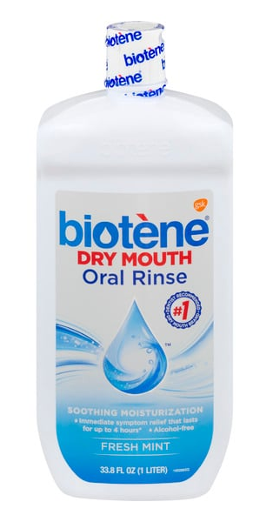
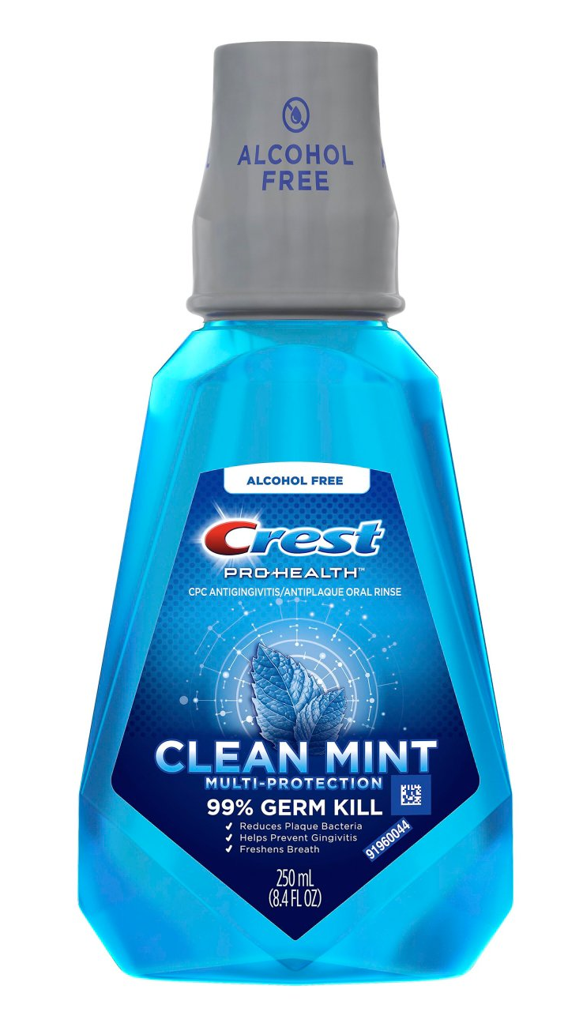
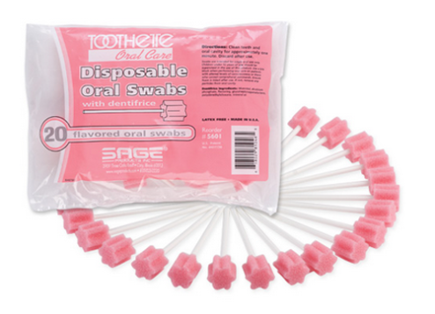
Mouth rinses
What rinse to use?
Alcoholic
Alcohol-free
Specialty
Prescription
How to use them?
Rinse
Swab
Are they harmful?

Slide 31
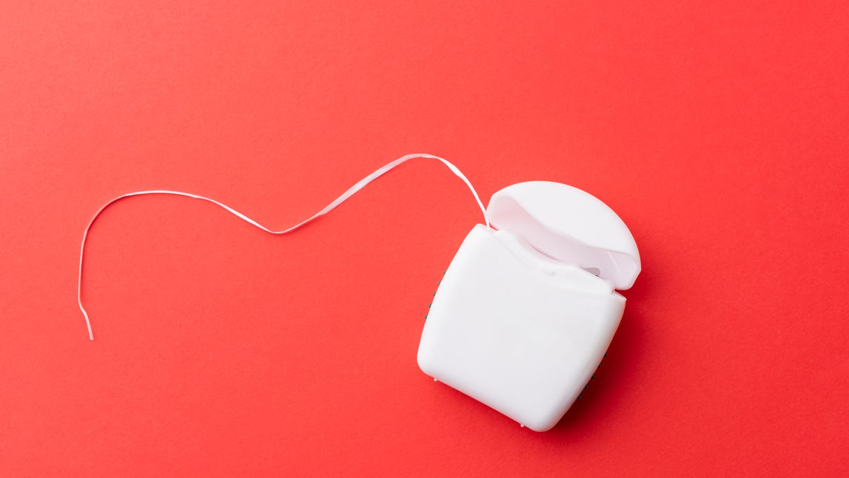
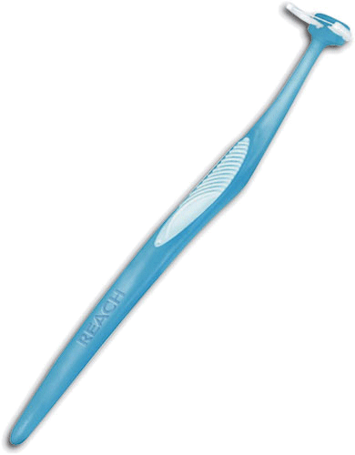
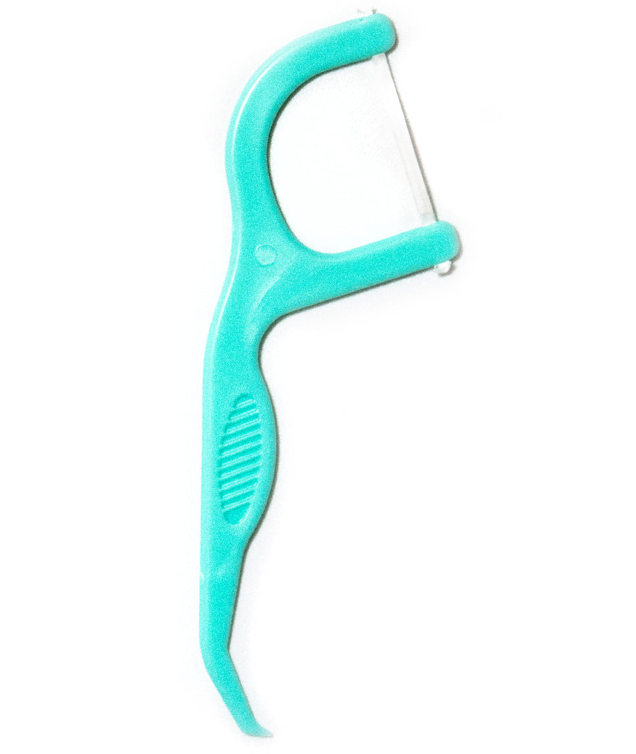
Flossing aids
Different floss aids
How often to floss?
What if there is bleeding?

Slide 32
spivacev@sdm.rutgers.edu

