Slide 1
Enabling Technology
(Assistive Technology)
September 2, 2025

Slide 2
Objectives
Provide a high level overview of Enabling Technology and Remote Supports
Review current technology initiatives including our work with Electronic Visit Verificaiton
Review data and identify next steps in development of Enabling Technology

Slide 4
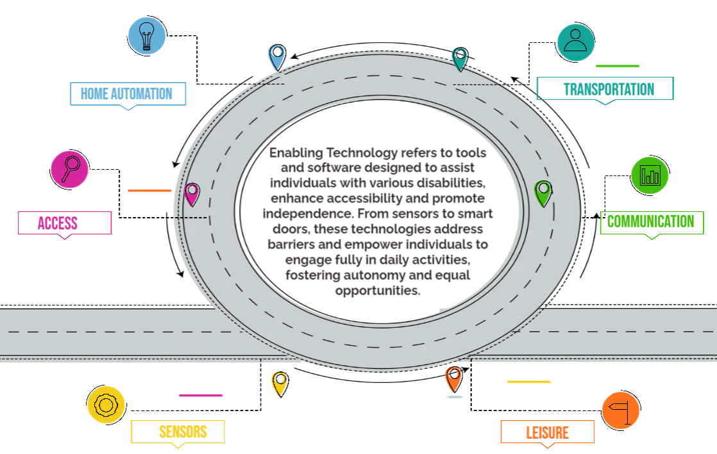

Slide 5
Enabling Technology Characteristics
Technology that promotes independence
Service(s) that encourage skill development
Technology is chosen based on personal outcomes and preferences
Technology/Supports that do not require a medical professional’s recommendation
Solutions that are based off of Person-Centered Planning

Slide 6
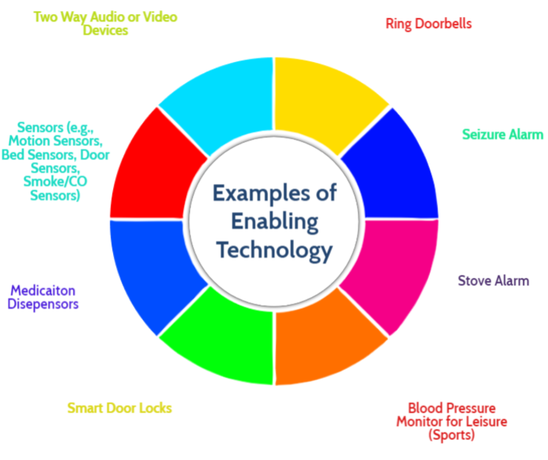

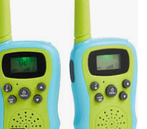
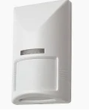

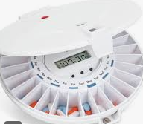




Slide 7

Enabling Technology can include Remote Supports
Remote Supports utilize technology like video calls and messaging to provide personalized assistance and guidance from a distance. Remote Supports promotes independence and inclusion by helping individuals with daily tasks and skill development regardless of location.

Slide 8
Remote Support Characteristics
Includes the ability to send and receive real time data
Uses wireless technology
Includes two way communication with support staff (paid or unpaid) in real time
Has emergency backup options in place
Promotes independence and is person centered

Slide 9
Benefits of Technology with Remote Supports
Provide assistance with tasks and activities from a distance, empowering individuals to manage their lives more autonomously.
Allow for individualized approaches that address specific needs and preferences; flexible and customizable.
Assist providers with navigating staffing shortages for Direct Support Professionals.
Cost effective; allow individuals to expand their budget by identifying the most cost effective services.
Keep individuals in the least restrictive environments.

Slide 10
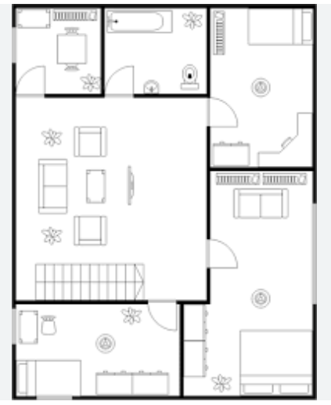
Sample Tour
Stove Alarm
Medication Dispenser
Window Sensor
Video Call Station
Ring Doorbell
Event Support
Vs.
Scheduled Support
Door Sensor
Emergency Response Button
Bed Pad – Fall Notifications

Slide 11




Remote Supports Sample Flow
Remote Staff Contacts Individual and Provides Guidance
Wireless Notification Sent To Remote Support Vendor
Identified Remote Staff Receive Notification
Remote Staff Contacts Provider Agency or Identified Support
Sensor Alarm Sounds
Remote Staff Contacts Emergency Services

Slide 12


Slide 13
Individual
Directs the development of the person-centered plan and is the central and primary “voice” and perspective for the planning process.
Identifies the need and outcome that may be met through the utilization of technology and remote supports.
Makes a decision on the type of support received based on variables identified through Interdisciplinary Team (IDT) planning.
Remains the primary voice through the implementation, and ongoing use, of Enabling Technology/Remote Supports.

Slide 14
Family, Guardians, Friends
Support the individual’s decision to utilize enabling technology and remote supports to meet an identified need.
Works with the IDT to ensure the service is appropriate through sharing observations and perspectives.
Monitors the use of remote supports as the technology is phased in and on an on-going basis.
Reports any concerns to the IDT for immediate review.

Slide 15
Provider Agency (Daily Rate Example)
Provides all services as identified by the IDT through the person-centered planning process.
Helps to identify opportunities where Remote Supports could be utilized.
Provides on-going monitoring for any health and safety concerns.
Immediately notifies the IDT with any concerns or challenges.

Slide 16
Support Coordination
Facilitates the person-centered planning process with the individual and the IDT.
Assures the individual understands and agrees with the Enabling Technology/Remote Support service being provided.
Documents the entire planning process within the Individual Service Plan (ISP) and supporting documentation.
Completes the Enabling Technology/Remote Supports Assessment Request and submits a request through iRecord.

Slide 17
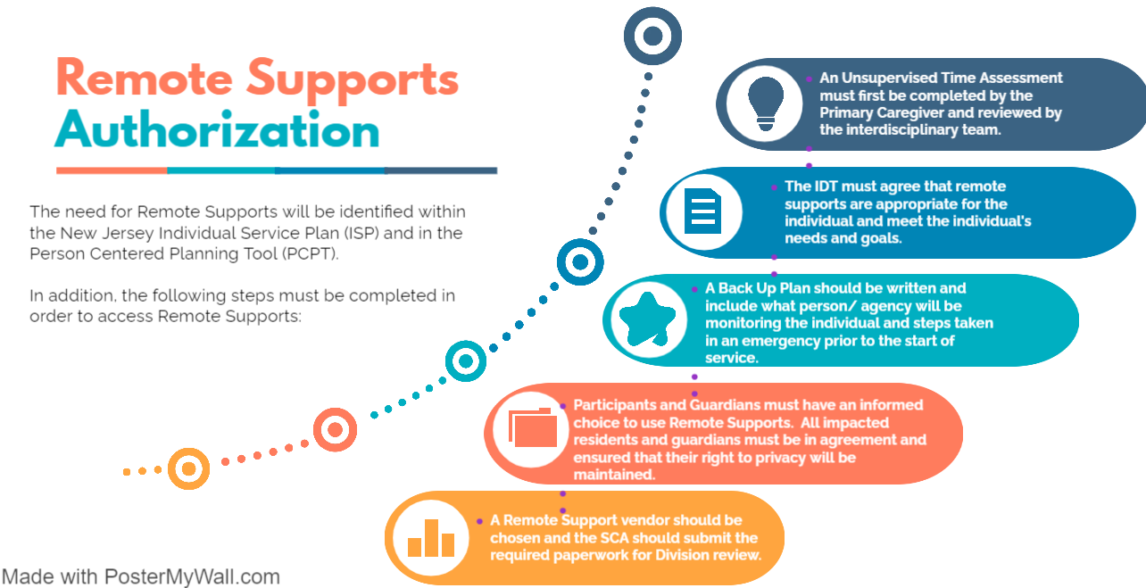

Slide 18
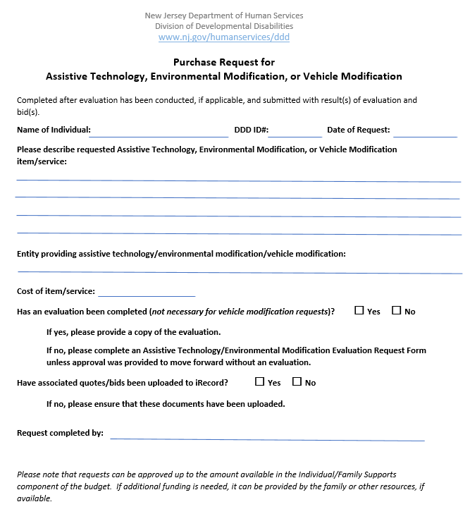
Requesting Technology/Remote Supports
Complete a screening tool/request form to determine if the individual and/or the provider (daily rate) are in agreement to move forward.
SCA submits request for Division review and approval.
Conduct IDT meeting with vendor and review approved services.
Vendor to setup/Install identified supports.
Conduct IDT meeting to complete trainings and begin implementation.
Conduct IDT meetings each month for the first three months (can be part of monthly monitoring).
Conduct annual review.

Slide 19
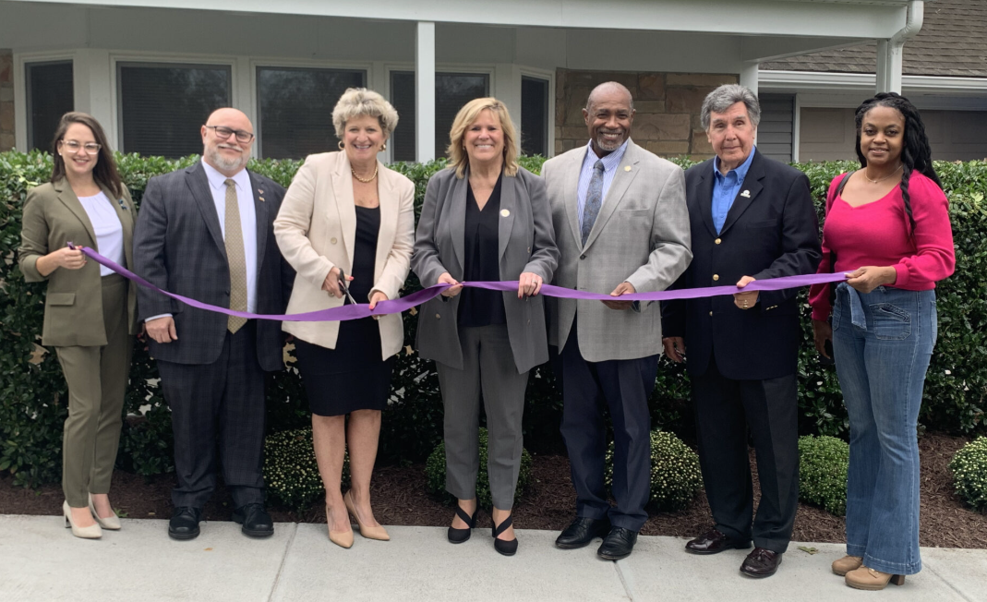
How has this already been implemented??
Bancroft launched a pioneering Smart Home project in New Jersey, aiming to enhance safety, independence, and quality of life for adults with disabilities.
Key Features:
Smart Sensors & Devices: Customized to individual needs, including biometric locks, safety sensors, and smart appliances.
Assistive Technology: Voice assistants, smart lighting, and medication dispensers promote autonomy.
Staff Support Tools: Remote monitoring and alerts to assist staff in providing timely care.
Impact:
Increased Independence: Residents can perform daily tasks with minimal assistance.
Enhanced Safety: Proactive alerts reduce risks and improve response times.
Workforce Efficiency: Technology streamlines tasks, allowing staff to focus on personalized care.
Support & Funding:
State Investment: $500,000 from the New Jersey Department of Human Services.
Community Collaboration: Partnerships with local officials and community members.

Slide 20
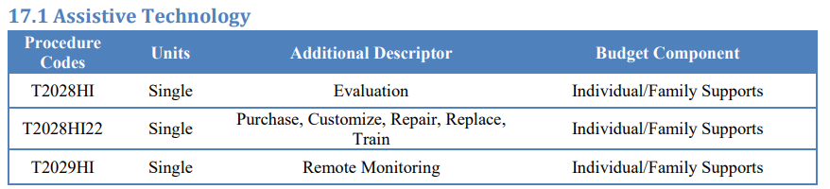
Waiver & Costs
Do not anticipate requesting an amendment to the 1115
Enabling Technology to be built into T2028HI22
Remote Supports to be built into T2029HI
** Ongoing discussions **

Slide 21
Common Denials for Technology
NJCAT indicates that speech is readily understood by others.
NJCAT indicates that the individual does not utilize a wheelchair and demonstrates no mobility issues.
The AT-EM Evaluation Request form is missing in the iRecord.
AT-EM Evaluation Request form is submitted incorrectly.
Individual resides in an apartment/rents a home – A written letter of permission from the landlord is required.
Incorrect assessment fees.
DME & full-house generators.
Vehicle Modifications.

Slide 22
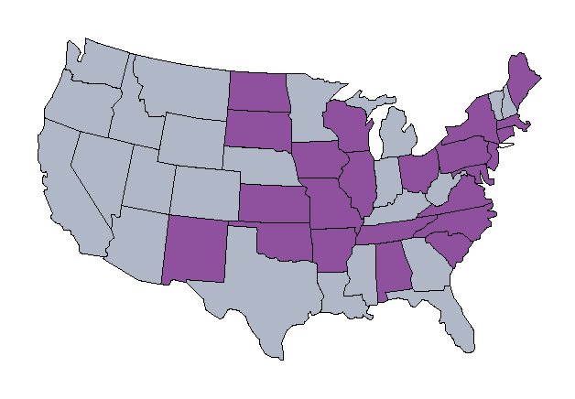
Consortium of Technology
Member States
Alabama
Arkansas
Connecticut
District of Columbia
Illinois
Indiana
Kansas
Maine
Maryland
Massachusetts
Missouri
New Jersey
New Mexico
New York
North Carolina
North Dakota
Ohio
Oklahoma
South Carolina
South Dakota
Tennessee
Virginia
Wisconsin

Slide 23
Example Costs
Sample Rates from Oklahoma:
  Remote Support Service:
    Remote Supports with Paid Back Up Support - $3.28 per quarter hour
    Remote Supports with Unpaid Back Up Support - $1.81 per quarter hour
Grey Matters annual renewal costs (provides only tech)
  GMA System and Software License & Renewal - $3500
  Initial costs will include charges for the selected technologies (i.e. Angel Sense, sensors, video doorbells)
  Recurring Monthly Service Rate - $350

Slide 24
Example Costs Continued
SafeinHome costs (provides tech and remote support services)
  Initial costs include charges for the selected technologies. Prefer to lease their technologies rather than allow the state to buy them outright.
  Monthly service charges range from $35 to $110 per month. The service charge depends on what type of technologies are chosen.
THS costs (provides tech and remote support services)
  Initial costs include charges for the selected technologies and varies.
  Monthly service cost is $76 per month. This may range depending on types of tech chosen.
Dose Health
  Med dispenser is $60 per month.

Slide 25
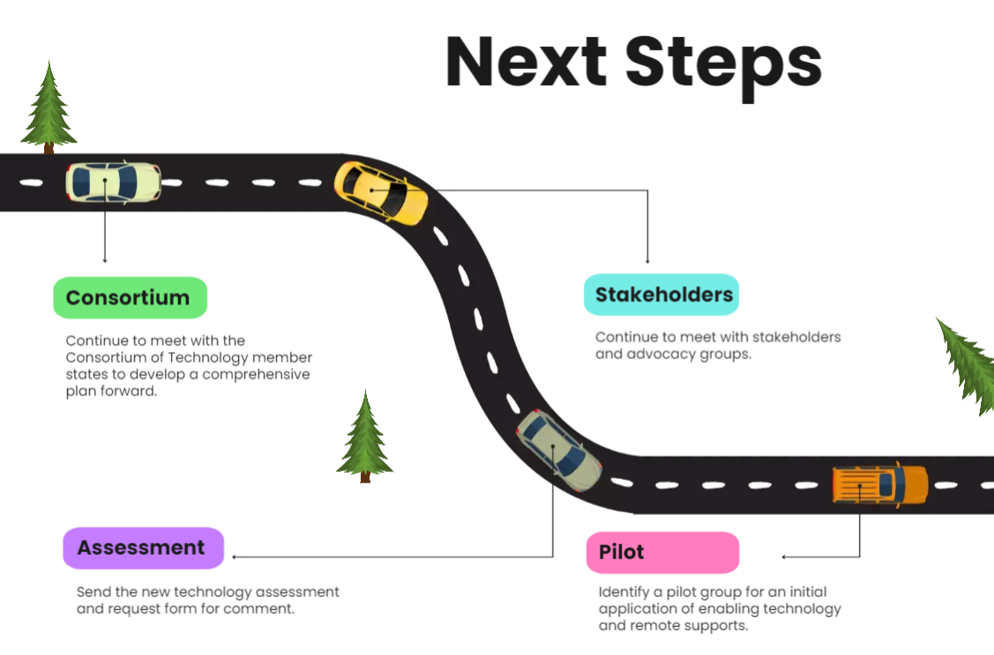



Slide 26
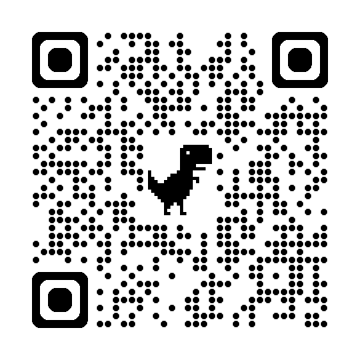
Contact Information:
Gregory Leonardi
Unit Director, Waiver and Quality Unit
973-977-4004
Gregory.Leonardi@DHS.NJ.GOV

